Slide 1
Waste as a Resource in Circular Economy
Module 9
Circular Economy in the Construction Industry

Slide 2
Summery
Within this module the trainee will gain an understanding of what the opportunities associated with material reuse are and how this can be applied to their industry. they will also recognise some of the barriers that exist within a national context. They will also become familiar with some material digital marketspaces as well as becoming familiar with the concept of buildings as material banks. This will all then be related to Multi-functional Green Roofs Facades and Interior Elements.

Slide 3
Objectives/Learning Outcomes
5 – Design with products and materials that can be easily reused or recycled after use
16 – Enable second hand sale of multifunctional roof/façade products through marketplaces or services
19 – Transform waste products and materials from multifunctional roofs, façades or interior elements for reuse, or as a last resort into lower value products in the same industry
20 – Use waste products and materials from construction demolition projects that have been processed and recycled
21 – Collect products and materials for reuse or recycling in roofs, façades or interior elements from outside construction

Slide 4
Objectives/Learning Outcomes
22 – Transform waste products and materials from multifunctional roofs, façades or interior elements for reuse outside construction, or as a last resort into lower value products outside construction
23 – Use waste products and materials from outside construction that have been processed and recycled
48 – Employ a regional construction digital marketplace for construction resources
58 - Reduce waste as much as possible during production
73 – Organise logistics and storage of secondary materials, whilst aiming to reduce waste

Slide 5
Objectives/Learning Outcomes
78 – Assess quality of materials to be reused from multifunctional green roofs, façades, and interior elements (audit of waste)
79 – Trade secondary materials and products on digital marketplaces

Slide 6
Content
Waste as a Resource
Implementing material reuse
Digital marketspace
Material Banks
Application for Multi-functional Green Roofs Facades and Interior Elements

Slide 7
Waste as a Resource

Slide 8
Waste as a Resource
The EU Data Centre on Waste compiles waste data at European level.
According to data for 2010 for 29 European countries (i.e. EU‑28 and Norway), around 60 % of the waste generated consisted of mineral waste and soil, largely from construction and demolition activities and mining.
For metal, paper and cardboard, wood, chemical and medical waste and animal and vegetal wastes, each waste type ranged from 2 % to 4 % of the total.
Source:https://www.eea.europa.eu/publications/signals-2014/articles/waste-a-problem-or-a-resource

Slide 9
Waste as a Resource
Around 10 % of the total waste generated in Europe consists of what is known as ‘municipal waste’
Waste generated mainly by households, and to a lesser extent by small businesses, and by public buildings such as schools and hospitals.
In 2012, 481 kg of municipal solid waste was generated per person in the 33 member countries of the European Environment Agency (EEA). There is a slight downward trend from 2007 onwards, which can be explained partly by the economic crisis affecting Europe since 2008.
Source:https://www.eea.europa.eu/publications/signals-2014/articles/waste-a-problem-or-a-resource

Slide 10
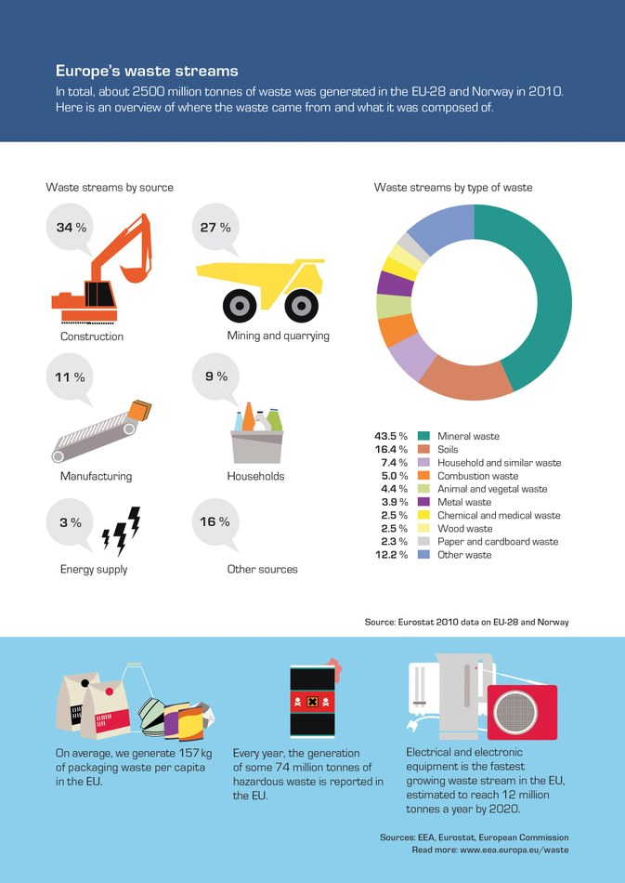
Source:https://www.eea.europa.eu/publications/signals-2014/articles/waste-a-problem-or-a-resource

Slide 11
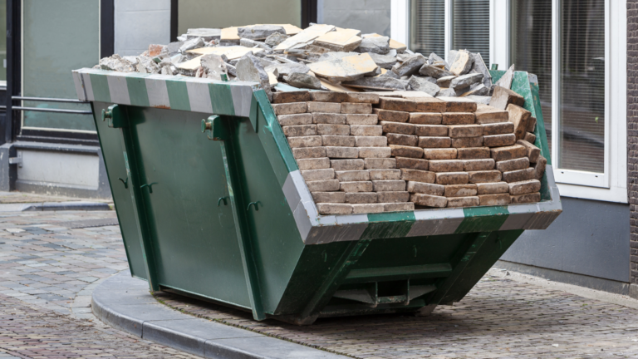
Irish Context
The construction industry accounts for approximately
50% of materials used on the planet,
48% of all waste generated in Ireland
Very little of this waste is currently reused, or even recycled. Where recycling does take place, it is often in the form of downcycling, creating aggregates and backfill at best.
Source:https://www.igbc.ie/the-irish-green-building-council-launches-a-pilot-scheme-to-increase-reuse-of-construction-materials/

Slide 12
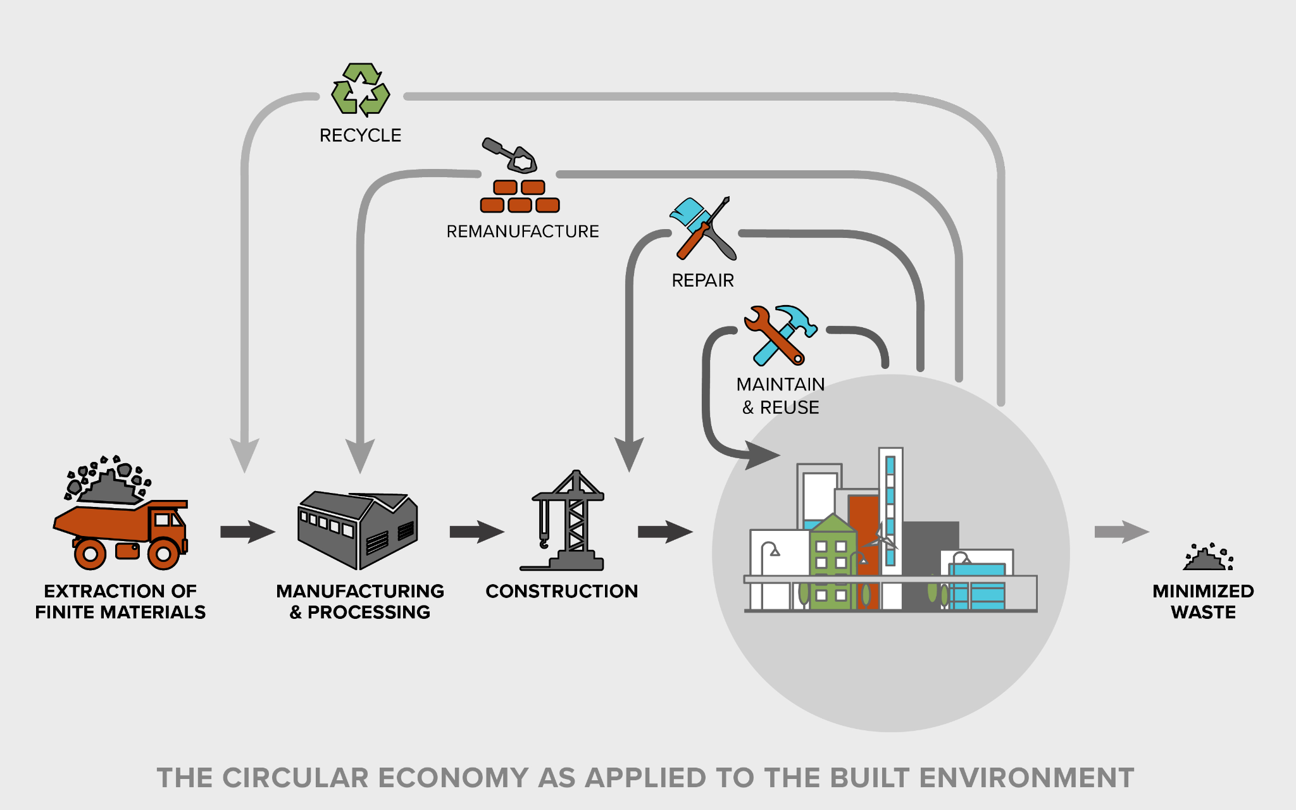
Irish Context
The objective of the pilot (Construction Materials Exchange (CMEx) project) is to demonstrate a
feasible
transparent
fair
user-friendly
system for the reuse of construction materials that would otherwise enter the waste stream.
Source:https://hickokcole.com/ilab-microgrants/waste-less/
Source:https://www.igbc.ie/the-irish-green-building-council-launches-a-pilot-scheme-to-increase-reuse-of-construction-materials/

Slide 13
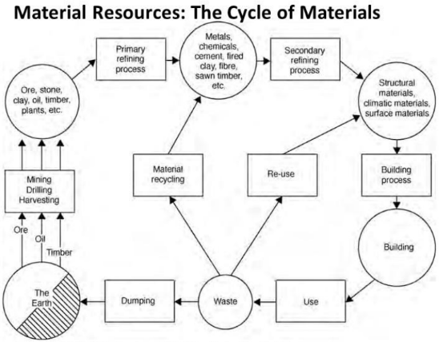
Source:BERGE, B., (2009) the ecology of building materials 2nd ed

Slide 14
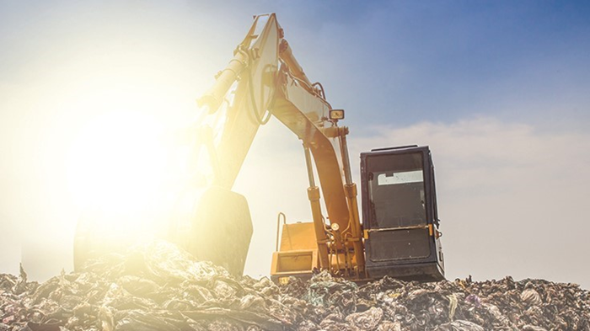
Circular Economy & Waste
The construction sector consumes 42 billion tonnes of resources annually, making it the most material-intensive sector.
The construction sector also produces about one-third of all global waste, most of which is not recycled or reused, but ends up in landfills.
Source-Google Search
Source:https://www.circle-economy.com/resources/building-a-circular-construction-sector-is-hard-but-it-is-happening

Slide 15
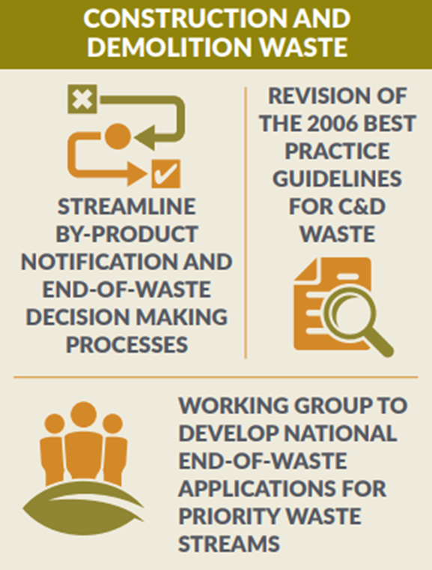
Circular Economy & Waste
Construction and Demolition (C&D) waste is waste from any building works, demolition and development (including transport infrastructure).
The remainder includes concrete, brick, tiles, metal, glass, wood, plastic and metal.
Excavated soil and stone is the largest element of construction and demolition waste at approximately 85%
The quantity of C&D waste generated and collected in Ireland increased to 8.8 million tonnes in 2019
Source:https://www.gov.ie/en/publication/c305a-construction-and-demolition-cd-waste/

Slide 16
Circular Economy & Waste
Most of the C&D waste collected in Ireland in 2019 was backfilled (82 %), while 10 per cent went for disposal and only 7% per cent was recycled. This reflects the large proportion of soil and stones in C&D waste.
Recycling was the main treatment operation for metals (100%) and waste bituminous mixtures (64%).
It is notable that only 39% of segregated wood, glass and plastic waste was recycled in 2019 while 54% went for energy recovery (incineration)
Source:https://www.gov.ie/en/publication/c305a-construction-and-demolition-cd-waste/

Slide 17
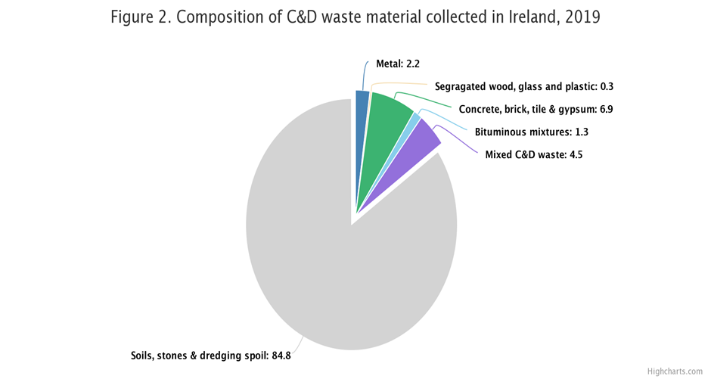
Circular Economy & Waste
Source:https://www.gov.ie/en/publication/c305a-construction-and-demolition-cd-waste/

Slide 18
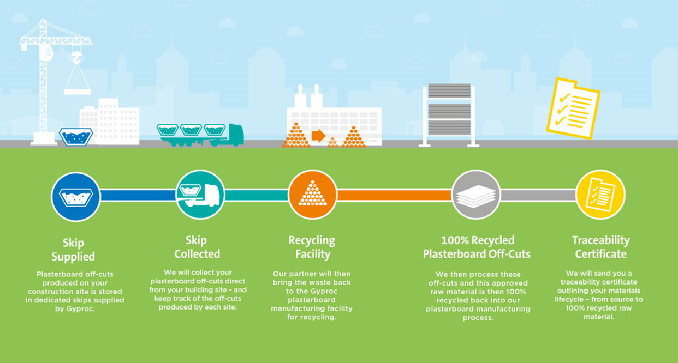
Circular Economy & Waste - Example
Plasterboard Recycling Service (PRS)
https://www.gyproc.ie/services/plasterboard-recycling-service

Slide 19
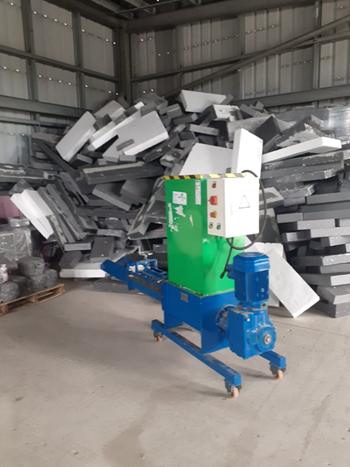
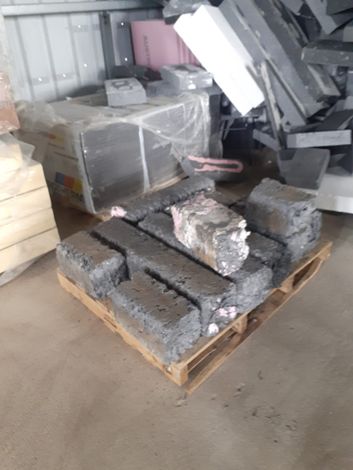
Circular Economy & Waste - Example Expanded polystyrene (EPS)
EPS is used for packaging and insulation
Offcuts and waste are shredded, then heated and compressed into a solid mass, reduced to 10% of its’ original size, for resale and re-use.
It is exported to manufacture insulation to Spain, Portugal and Germany.
12% of EPS currently recycled globally
Waste Matters (Ireland) Ltd
https://www.youtube.com/watch?v=zDfdya7iUVY&ab_channel=WasteMatters
Recycling system at (LOETB) National Construction Training Centre at Mount Lucas, Ireland

Slide 20
Enablers for Reuse
Increased community awareness and education on recycled products.
Develop supportive regulations, policies and specifications.
Facilitate sustainable programs.
Promote product certification.
Advocate targeted technologies and innovative practice.
Source:https://www.researchgate.net/figure/Emergent-model-on-barriers-and-enablers-for-using-recycled-C-D-waste-products_fig4_346258505

Slide 21
Barriers for Reuse
Increased costs of energy and transport.
Lack of knowledge on recycled products.
Limited technologies for waste recovery.
Low quality and possible contamination.
Lack of market availability of the products.
Limitations caused by specifications, standards and permits.
Limited acceptability and negative perception.
Source:https://www.researchgate.net/figure/Emergent-model-on-barriers-and-enablers-for-using-recycled-C-D-waste-products_fig4_346258505

Slide 22
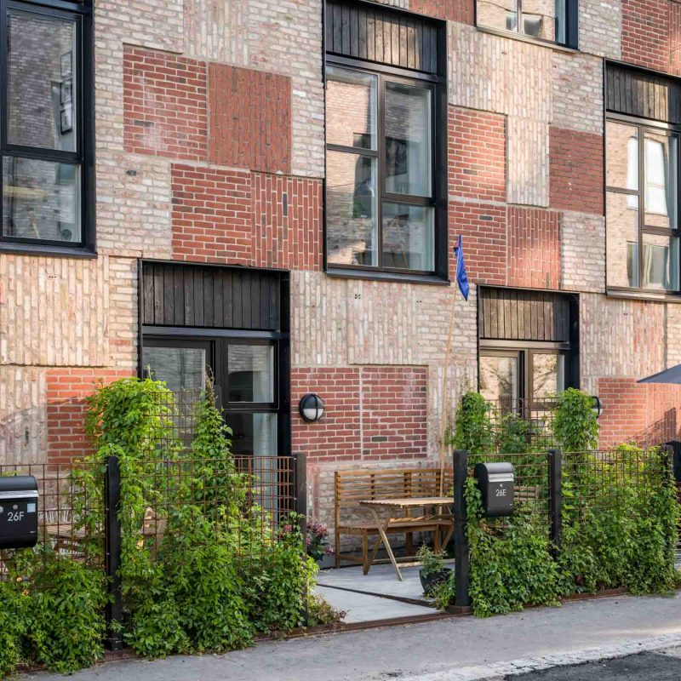
Lendager Group - Resource Rows Project
Oerestad, Copenhagen
The Resource Rows is using upcycled bricks and waste wood, a recycled concrete beam used as a bridge and old windows and waste wood as rooftop community gardens huts with an atmosphere of allotment gardens.
A significant and innovative concept is to reuse brick facades from abandoned structures in the new building, saving as much as 29% CO2 by upcycling only 10% of all building materials.
Source:https://lendager.com/project/resource-rows/

Slide 23
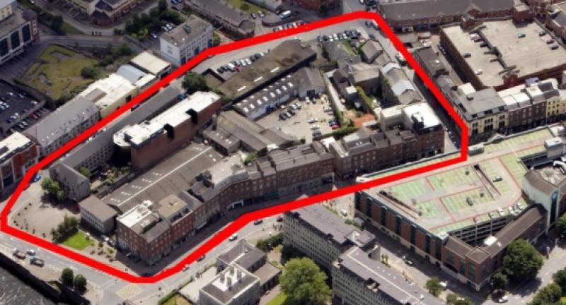
Limerick 2020 - OPERA SQUARE
Limerick, Ireland
It's one of the country’s biggest projects involving the recycling and reuse of construction rubble in which over 1,000 tonnes of
stone
brick
cobblestone
old doorways
gates
have been salvaged.
Source:https://www.limerickleader.ie/news/planning/690157/update-issued-on-progress-to-develop-iconic-limerick-site.html
Source:https://www.rte.ie/news/regional/2022/0414/1292354-limerick-opera-recycling/

Slide 24
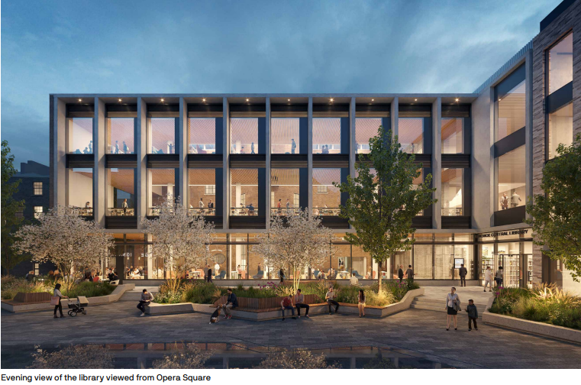
Limerick 2020 - OPERA SQUARE
Limerick, Ireland
Sixteen old buildings, many of them Georgian, and of important historical significance, are being retained for use as living accommodation, but huge volumes of material which would otherwise go to landfill, are also being harvested for reuse in other building projects throughout the Opera Sita and greater Limerick.
Further information and image source - https://limerick2030.ie/opera-site/
Source:https://www.rte.ie/news/regional/2022/0414/1292354-limerick-opera-recycling/

Slide 25
Digital Marketspace

Slide 26
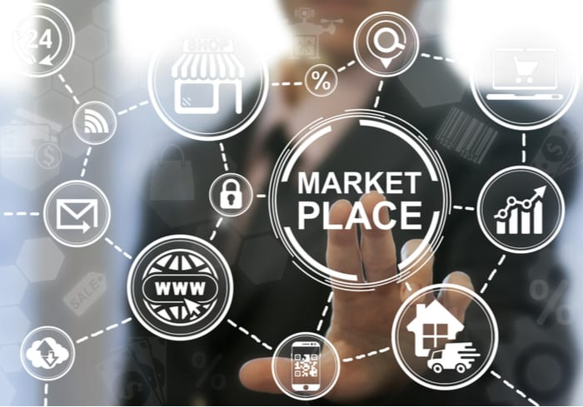
What is a Digital Marketspace
In simple terms, digital marketplaces connect multiple sellers with multiple buyers via an online platform. They exist across a wide range of operating models, including price comparison sites, affiliates, online auction platforms, lead generators, cashback sites, sales platforms and classifieds. Some marketplaces adopt multiple models to serve multiple needs.
Source-https://www.pymnts.com/news/retail/2019/digital-marketplaces-consumer-needs-gig-economy/
Source:https://www.pwc.co.uk/industries/technology-media-and-telecommunications/insights/digital-marketplaces.html

Slide 27
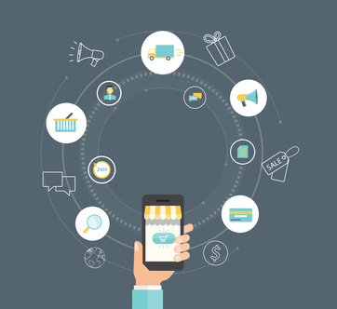
Types of a Digital Marketspace
Business-to-consumer (B2C) marketplaces
Business-to-business (B2B) marketplaces
Peer-to-peer (P2P) or consumer-to-consumer (C2C) marketplaces
Consumer-to-manufacturer (C2M) or consumer-to-business (C2B) marketplaces
Service-to-consumer (S2C) marketplaces
Source-https://www.telcoprofessionals.com/blogs/9924/1228/the-new-digital-marketplace?mobile=1
Source:https://www.the-future-of-commerce.com/2021/05/12/digital-marketplaces/
Notes:
Business-to-consumer (B2C) marketplaces – One of the most saturated categories with tons of players, including global giants such as Amazon and local leaders like TMALL and jd.com in China and Mercado Livre in Brazil and Latin America. Add niche B2C marketplaces (focused on specific categories like electronics, apparel, and home improvement) to this mix and voila! You’ve got competition galore.
Business-to-business (B2B) marketplaces – Growth in sheer monetary potential can be found among B2B marketplaces. Notable examples include Alibaba and Amazon Business. B2B marketplaces are more niche and vertical industry focused.
Peer-to-peer (P2P) or consumer-to-consumer (C2C) marketplaces – Notable examples include eBay, TaoBao, Mercari, Etsy, and even Airbnb. This is a marketplace where consumers are both sellers and buyers. P2P and C2C marketplaces are not an insignificant contributor to the marketplace juggernaut.
Consumer-to-manufacturer (C2M) or consumer-to-business (C2B) marketplaces – The biggest and most noteworthy example of this type of marketplace is PinDuoDuo. In a few short years, this model has gained a 4% share of the global e-commerce business and is ripe to expand beyond China to be other parts of the world.
Service-to-consumer (S2C) marketplaces – This is a made-up label, but it’s a growth category with numerous local examples. Think HomeAdvisor and TaskRabbit in the United States, or UrbanClap in India, hipages in Australia, and so on. Power to the gig economy!

Slide 28
Benefits of a Digital Marketspace
Easy to use. Online platforms are usually user friendly and human focused.
Access to a ready customer base. Supports connections with target audience and can remove barriers that may exist outside of these platforms.
Fulfillment, payment, and logistics. Payment and supply is easy and straightforward. It can also support buying local removing waiting times.
Innovation. Allows for new products, concepts or material used to be shared easily in one place with other professionals.
Marketing, analytics, and personalization. Easy to tailor your search or direct you towards a target audience from one place.
Global reach. Can allow for connections and sales to happen internationally where necessary, however, it is often better and more sustainable to purchase locally.
Source:https://www.the-future-of-commerce.com/2021/05/12/digital-marketplaces/

Slide 29
Examples of Digital Marketspaces in Construction
Digital marketplaces have a place in the construction industry going forward. They not only allow for easy access to expert reusable and more sustainable materials they also help to guide consumers to local business and suppliers.
The benefits of employing digital market spaces are similar to the benefits that can be seen in the second hand clothing market already, such as reduced material loss and longer lifetimes of products. This can lead us to a more sustainable future and circular future for the construction industry.
Source-https://cobuilder.com/en/digitising-construction-data-classification-systems-and-data-templates/

Slide 30
Ireland CMEx Project
The CMEx project is a pilot scheme to demonstrate a
feasible
transparent
fair
user-friendly system
for the reuse of construction materials that would otherwise enter the waste stream.
Source:https://www.igbc.ie/wp-content/uploads/2021/12/CMEx-One-page-Flyer.pdf

Slide 31
Ireland CMEx Project
The project will identify and track resources through the supply chain;
identify the potential value of matching materials
apply these insights to steer organisational processes towards supporting a circular economy.
It will identify materials from the waste stream with the potential for diversion to reuse and develop mechanisms to enable reuse through an online platform that generates materials passports, facilitates material matches, and utilises blockchain technology to document transactions.
Source:https://www.igbc.ie/wp-content/uploads/2021/12/CMEx-One-page-Flyer.pdf

Slide 32
Excess Materials Exchange Platform
Excess Materials Exchange (EME) is a young and innovative technology company. They find new high-value reuse options for materials or (waste) products for companies. Far too many valuable resources and materials are wasted or ill-designed in the current paradigm, for which the planet must pay a heavy price. Isn’t that a waste?
EME aims to accelerate the global transition to a circular economy – and play a part in creating a more viable planet. By showing the financial and ecological value of materials. By challenging companies to design and produce their goods in a more efficient and circular manner.
Source:https://excessmaterialsexchange.com/en_us/

Slide 33
Excess Materials Exchange Platform
The digital platform unlocks the maximum potential of your company’s materials, products and waste streams by matching them to their highest value uses. The best part about that? It’s better for your profits as well as the planet. In our experience, material flows increase by 110% on average in financial value, and the ecological footprint reduces by 60% on average. Four tools are instrumental to our method of working:
Resources Passport
Tracking and Tracing
Valuation
Matchmaking
Source:https://excessmaterialsexchange.com/en_us/

Slide 34
Material Banks

Slide 35
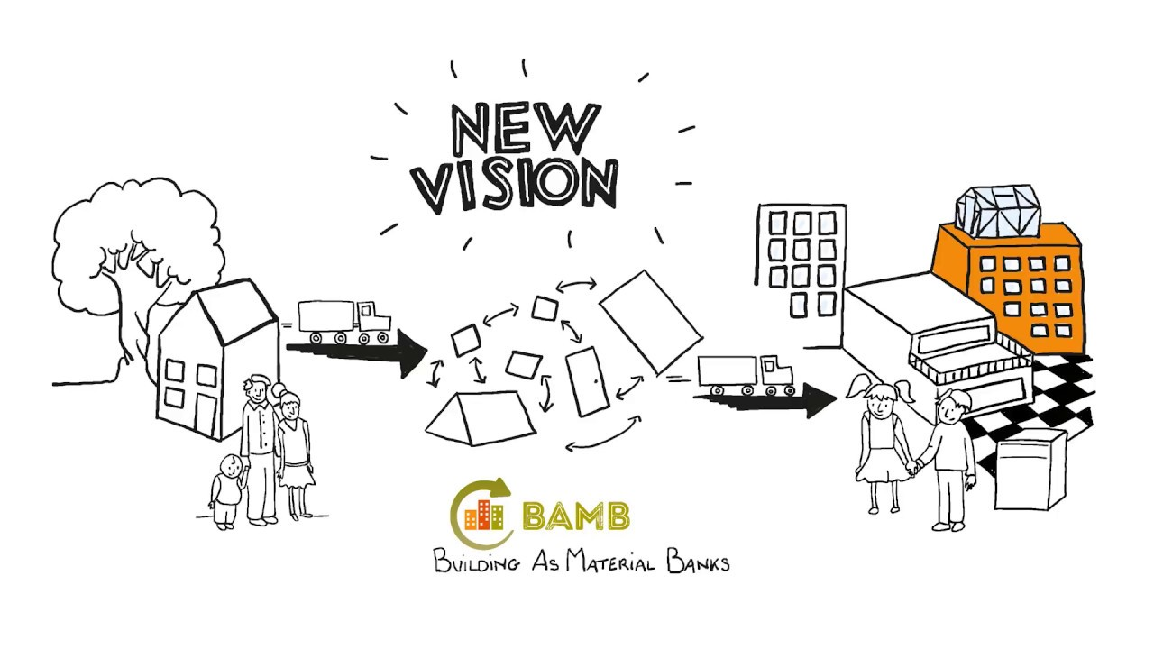
Material Banks
A material bank is essentially a stockpile or store of materials for future use.
In construction this can take the form of a building, this change in the way we think about a building can help us to view a building as something that can continue its life after the initial use is complete.
This can pair with Material Passports or Design for Disassembly for added value.
Source-https://www.youtube.com/watch?v=3EKddd_dAt0
Follow link to watch video

Slide 36
BAMB
In the Project BAMB – Buildings As Material Banks 15 partners from 7 European countries were working together with one mission –
Enabling a systemic shift in the building sector by creating circular solutions.
Today, building materials end up as waste when no longer needed, with effects like
destroying ecosystems
increasing environmental costs
creating risks of resource scarcity
Source:https://excessmaterialsexchange.com/en_us/

Slide 37
BAMB
To create a sustainable future, the building sector needs to move towards a circular economy.
Whether an industry goes circular or not depends on the value of the materials within it – worthless materials are waste, while valuable materials are recycled. Increased value equals less waste, and that is what BAMB is creating – ways to increase the values of building materials.
Source:https://excessmaterialsexchange.com/en_us/

Slide 38
BAMB
BAMB will enable a systemic shift where dynamically and flexibly designed buildings can be incorporated into a circular economy. Through design and circular value chains, materials in buildings sustain their value – in a sector producing less waste and using less virgin resources. Instead of being to-be waste, buildings will function as banks of valuable materials – slowing down the usage of resources to a rate that meets the capacity of the planet.
Source:https://excessmaterialsexchange.com/en_us/

Slide 39
Application for Multi-functional Green Roofs Facades and Interior Elements

Slide 40
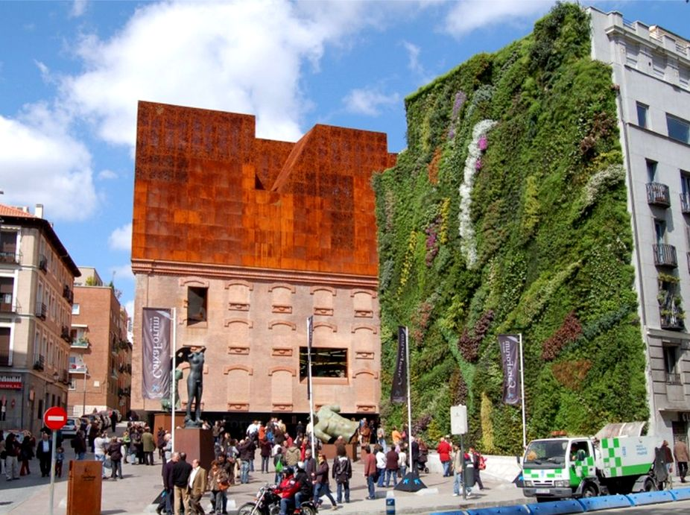
Caixa Foundation - Madrid, Spain - Herzog & De Meuron
Situated in the heart of Madrid’s cultural district, the Caixa Forum Museum vertical garden was designed and created by Patrick Blanc using his Le Mur Végétal system. The adjacent square is accessible to the public who can walk up, touch, and explore over 15,000 plantings on the hydroponic living wall.
Nearly 300 different species were chosen by Patrick Blanc who had to keep in mind Madrid’s very demanding seasons – very hot in the summer and cold in the winter.
Source:https://www.greenroofs.com/projects/caixa-forum-museum-vertical-garden/

Slide 41
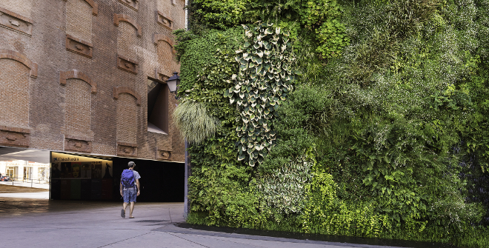
Caixa Foundation - Madrid, Spain - Herzog & De Meuron
Question One
Taking into account all parts of the building here, what are some examples of reuse of waste that could have been utilised in the construction of this building?
Consider how the plants are attached, the materials used and the demolition of the building that may have stood here previously.
Source:https://www.esmadrid.com/en/tourist-information/caixaforum-vertical-garden

Slide 42
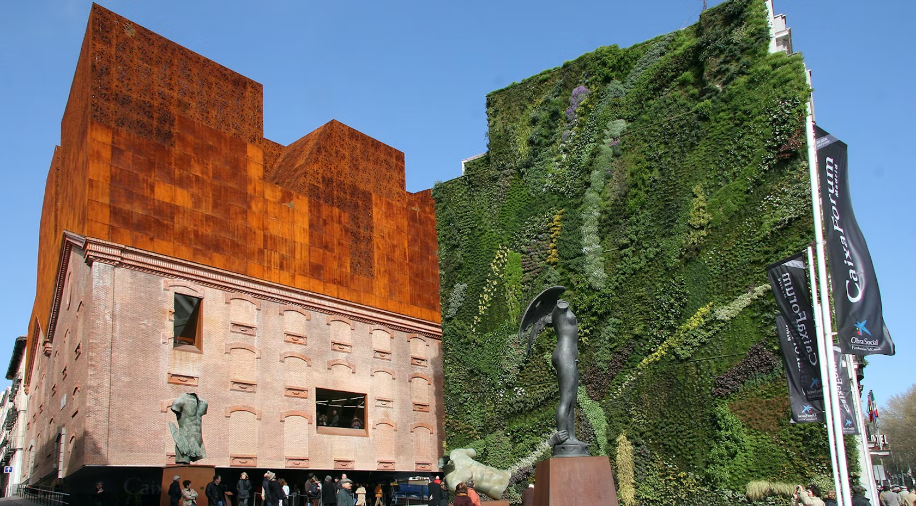
Caixa Foundation - Madrid, Spain - Herzog & De Meuron
Question One
If this project was to be demolished, what opportunities would present themselves with the waste materials?
Source-https://architizer.com/projects/caixaforum/
Source:https://www.esmadrid.com/en/tourist-information/caixaforum-vertical-garden

Slide 43
QUIZ/ASSIGNMENT/ACTIVITY

Slide 44
EXTRA READING/STUDY

Slide 45
EXTRA READING/STUDY
For Further Case Studies and Training Material Please Follow the Link Below
https://docs.google.com/spreadsheets/d/1DTte4Ph8pQ4lKzYGFt2_S-d1Z_Rmd9-i/edit?usp=sharing&ouid=112148808974461842163&rtpof=true&sd=true

Slide 46
EXTRA READING/STUDY
BAMB - Building as Material Banks
https://www.bamb2020.eu/topics/reversible-building-design/
Urban Mining: The Future of Material Sourcing
https://www.malbaproject.com/post/urban-mining-the-future-of-material-sourcing

