Slide 1
Implementing Circular Practice in the Design, Build and Deconstruction Phase of Construction
Module 2
Circular Economy in the Construction Industry

Slide 2
Summary
The trainee must gain a good understanding of what opportunities for circular economy are available to them in all phases of the construction process such as reuse, adaptability, modular design and implementation. They must also be able to clearly see the benefits to their work and how this can improve the quality of buildings. They should also gain a good understanding of how this can then be implemented in Multi-functional Green Roofs Facades and Interiors Elements.

Slide 3
Objectives/Learning Outcomes
27 - Design products so they use as little material, water, energy, etc. as possible during use phase
28 - Design modular structures for multifunctional green roofs, façades, and interior elements, so that the components can be disassembled and reused after end of service life
29 - Design multifunctional green roofs, façades, and interior elements to enable reuse and recycling
54 - Integrate multi-functionality into buildings by making use of roofs and façades
60 - Assemble modular structures for multifunctional green roofs, façades, and interior elements

Slide 4
Objectives/Learning Outcomes
65 - Disassemble modular structures from multifunctional green roofs, façades, and interior elements for reuse
61 - Conduct a feasibility study to, if applicable, prioritise renovation, minimise used surface, and minimise the total mass of materials to be used
76 - Operate multifunctional roofs in a clever manner that suits the current situation best, looking further than solely the original design to optimise sustainability and circularity

Slide 5
Module Content
Modular and Adaptable Design and Construction
Design For Disassembly (DfD)
Product-as-a-service (Paas)
Design and build Multi-functional Green Roofs Facades and Exterior Elements

Slide 6
Modular and Adaptable Design and Construction

Slide 7
Adaptable Design
Adaptive as the name suggests means CHANGING.
Changing according to the needs of surrounding architecture and external factors is the essence of adaptive architecture. Adaptive architecture is a framework which allows a building to changes its structure, behaviour or resources according to request and need.
It can be a multi-disciplinary approach concerned with buildings that are totally driven by internal data and also building that are designed to adapt to their environments, their inhabitants and objects.
In simple terms adaptive design is the ability of design to change based on need.
Source- https://sovereignarchitects.com/2015/05/16/adaptive-architecture/

Slide 8
Benefits of Adaptable Design
An adaptable home will allow people to remain in their homes throughout aging, injury, or illness, while also providing accessibility for unexpected disabilities that might occur later in life.
An adaptably designed home that allows you to stay in your home for a longer period of time will let homeowners enjoy the savings that often come with sustainable and energy-efficient upgrades and investments. For example, a solar PV system might take about a decade to pay off through your monthly energy bill savings. Since solar systems can easily last for over 25 years, staying in your home for a longer period can enable you to enjoy extended economic benefits.
Flexible home design can also allow homeowners to generate income later in life through rental or subletting.
Source- https://www.buildwithrise.com/stories/adaptable-design-how-to-build-a-home-for-a-lifetime

Slide 9
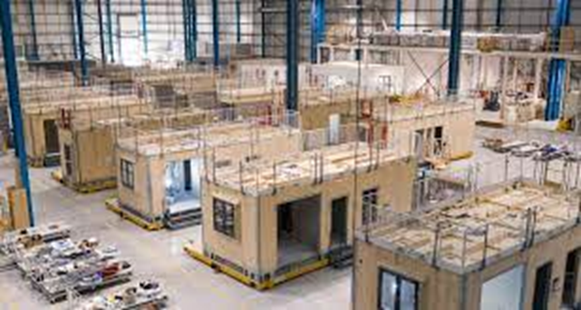
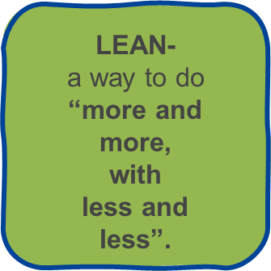
Modular Construction
Modular construction is a way of building through the use of modular parts that are constructed in a factory and assembled on-site.
Modular units can be used for any type of application, from entire houses to apartments to mobile site units, and more recently, home offices.
Source: https://gupp-class.eu/

Slide 10
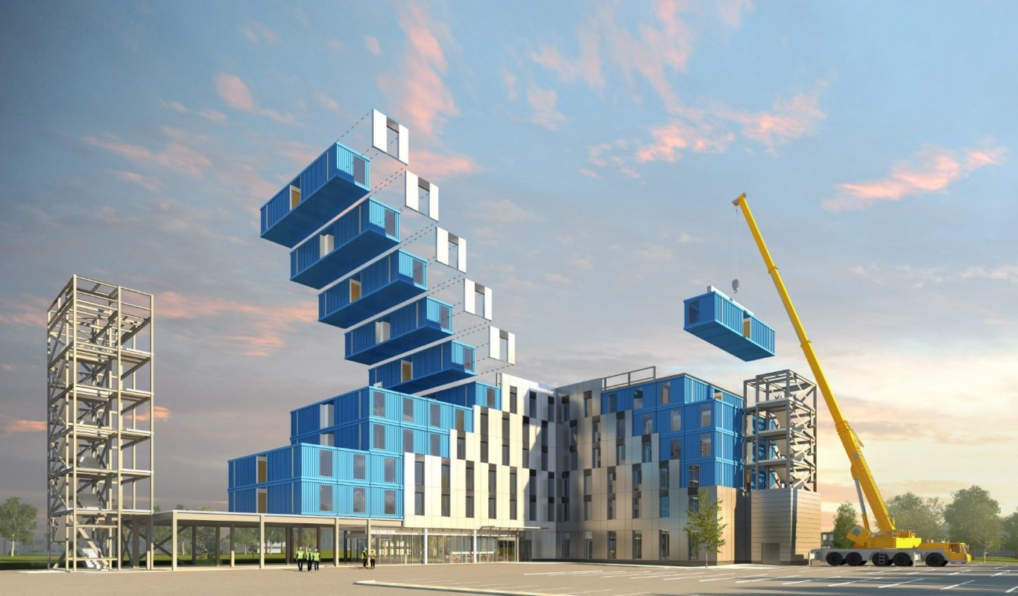
What is modular construction
Modular construction is a process in which a building is constructed off-site, under controlled plant conditions, using the same materials and designing to the same codes and standards as conventionally built facilities – but in about half the time. Buildings are produced in “modules” that when put together on site, reflect the identical design intent and specifications of the most sophisticated site-built facility – without compromise.
Source-https://www.chapmantaylor.com/insights/what-is-modular-construction-and-why-has-chapman-taylor-embraced-it
Source- https://www.modular.org/what-is-modular-construction/

Slide 11
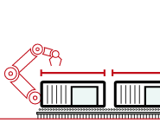
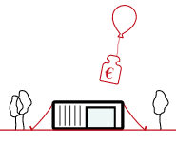
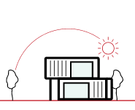
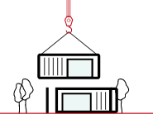
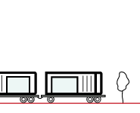
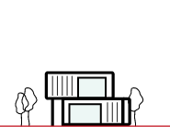
Advantages of modular constructions
Source- https://www.koma-modular.cz/en/modularity

Slide 12
Advantages of modular constructions
LINE QUALITY
Most production is carried out under constant climatic conditions in a production hall. Fully digitized production enables line quality to be achieved thanks to the control system.
Source- https://www.koma-modular.cz/en/modularity

Slide 13
Advantages of modular constructions
FIXED PRICE
The economic benefits are not only based on the speed of modular construction. Line production also means control over the price of a product. As a result, the price you agree to when awarding the contract is the price you actually pay for the construction.
Source- https://www.koma-modular.cz/en/modularity

Slide 14
Advantages of modular constructions
SPEED
Thanks to the preparation of modules, including the equipment in the production hall, the building will be erected on site in a matter of hours and is effectively ready for use.
Source- https://www.koma-modular.cz/en/modularity

Slide 15
Advantages of modular constructions
DISASSEMBILITY
A modular object can later be disassembled into individual modules and re-implemented to meet the needs of another object.
Source- https://www.koma-modular.cz/en/modularity

Slide 16
Advantages of modular constructions
FLEXIBILITY
Modular buildings can respond to the current needs of the owner and can be expanded. For example two additional floors could be added.
Source- https://www.koma-modular.cz/en/modularity

Slide 17
Advantages of modular constructions
ENVIRONMENTAL PROTECTION
One equally important feature follows from above; a modular structure is extremely environmentally friendly. Inhabitants of surrounding living spaces are not disturbed by an enduring construction process.
Source- https://www.koma-modular.cz/en/modularity

Slide 18
Greener
Greater Flexibility and Reuse: Modular buildings can be disassembled and the modules relocated or refurbished for new use, reducing the demand for raw materials and minimizing the amount of energy expended to create a building to meet the new need.
Less Material Waste: When building in a factory, waste is eliminated by recycling materials, controlling inventory and protecting building materials.
Improved Air Quality: Because the modular structure is substantially completed in a factory-controlled setting using dry materials, the potential for high levels of moisture being trapped in the new construction is eliminated.
Source- https://www.modular.org/what-is-modular-construction/

Slide 19
Faster
Reduced Construction Schedule: Because construction of modular buildings can occur simultaneously with the site and foundation work, projects can be completed 30% to 50% sooner than traditional construction.
Elimination of Weather Delays: 60 - 90% of the construction is completed inside a factory, which mitigates the risk of weather delays. Buildings are occupied sooner, creating a faster return on investment.
Built to Code with Quality Materials: Modular buildings are built to meet or exceed the same building codes and standards as site-built structures, and the same architect-specified materials used in conventionally constructed buildings are used in modular construction projects – wood, concrete and steel.
Source- https://www.modular.org/what-is-modular-construction/

Slide 20
Stronger
Safer Construction: The indoor construction environment reduces the risks of accidents and related liabilities for workers.
Better Engineered Building & BIM: PMC relies on advanced BIM for visualization to assess the energy performance and identify the most cost-effective efficiency measures. PMC is ideal for the use of this technology where the construction process is already a collaboration of systems, materials and people—much like the software itself.
Limitless Design Opportunities: Modular units may be designed to fit in with external aesthetics of any existing building and modular units, once assembled, are virtually indistinguishable from their site-built counterparts.
Source- https://www.modular.org/what-is-modular-construction/

Slide 21
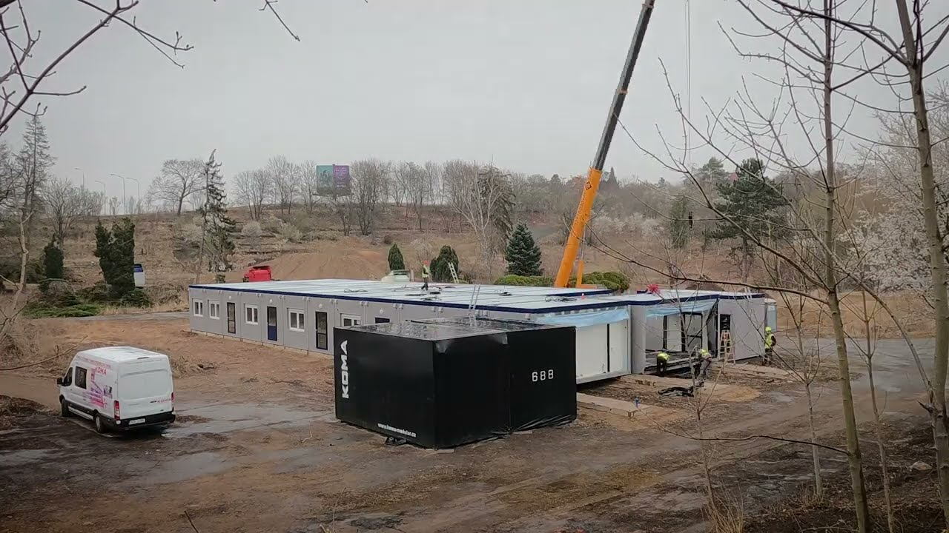
Temporary Community Centre for Refugees in Roztyly, Czech Republic
Modular community centre for refugees implemented in less than 1 month.
The assem­bly of the 26-modu­le buil­ding star­ted in March 2022 when the first half of the modu­les were deli­ve­red. The rest of the modu­les were deli­ve­red and assem­bled the next day. This was followed by finishing work, pre­pa­rati­on of the modu­les and equip­ping the buil­ding. The buil­ding is sche­du­led to be ope­rati­o­nal less than a mon­th after the start of assembly.
Source-https://i.ytimg.com/vi/WcyhM5QqJFQ/maxresdefault.jpg
Source-https://www.koma-modular.cz/en/references/docasne-komunitni-centrum-pro-uprchliky-v-roztylech

Slide 22
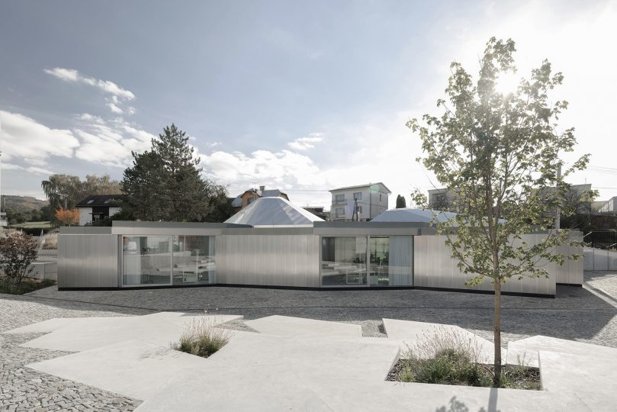
The Development and Innovation Centre of Modularity
The new building on the KOMA company premises breaks the stereotypes of modular construction. Thanks to cooperation with the architectural duo, Michal Krištof and Ondřej Chybík, it was possible to create a unique space with an area of 170 m2 using only 6 modules with a trapezoidal ground plan.
You can con­struct a buil­ding from a vari­e­ty of mate­ri­als – bricks, panels or who­le modu­les. This con­cept is taken a step further by using and fil­ling the spa­ce between the modu­les. This project also implements green roof structures.
Source-https://i.ytimg.com/vi/WcyhM5QqJFQ/maxresdefault.jpg
https://www.youtube.com/watch?time_continue=22&v=obP7sh3PNCM&feature=emb_logo
Video available (not English)
Source-https://www.koma-modular.cz/en/references

Slide 23
Design For Disassembly (DfD)

Slide 24
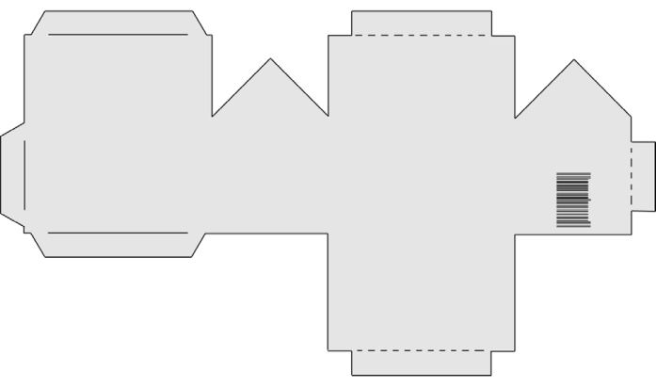
Design For Disassembly (DfD)
By definition, Design for Disassembly (DfD) is the design of buildings to facilitate future changes and dismantlement (in part or whole) for recovery of systems, components and materials, thus ensuring the building can be recycled as efficiently as possible at the end of its lifespan.
The strategy builds on an increasing acknowledgment of the fact that the majority of the built environment has a limited lifespan and that every building represents a depository of resources, which, rather than ending up in a landfill, should find their way back into the "reduce, reuse, recycle" loop.
Source-https://i.ytimg.com/vi/WcyhM5QqJFQ/maxresdefault.jpg
Source- https://www.archdaily.com/943366/a-guide-to-design-for-disassembly

Slide 25
Ten Key Principles for DfD
Document materials and methods for deconstruction. To efficient disassembly and deconstruction.
Select materials using the precautionary principle. Consideration for future impacts and high quality materials will retain value and/or be more feasible for reuse and recycling.
Design connections that are accessible. Accessible connections will increase efficiency.
Minimize or eliminate chemical connections. Reduce use of binders, sealers and glues on, or in materials, make them difficult to separate and recycle.
Use bolted, screwed and nailed connections.
Separate mechanical, electrical and plumbing systems. It is easier to separate components and materials for repair, replacement, reuse and recycling.
Source- https://www.lifecyclebuilding.org/docs/DfDseattle.pdf

Slide 26
Ten Key Principles for DfD
Design to the worker and labor of separation. Human-scale components or conversely attuning to ease of removal by standard mechanical equipment will decrease labor intensity and increase the ability to incorporate a variety of skill levels.
Simplicity of structure and form. Allow for ease of construction and deconstruction in increments.
Interchangeability. Modularity, independence and standardization will facilitate reuse.
Safe deconstruction. Allowing for movement and safety of workers, equipment and site access, and ease of materials flow will make renovation and disassembly more economical and reduce risk.
Source- https://www.lifecyclebuilding.org/docs/DfDseattle.pdf

Slide 27
Opportunities and Challenges
The construction industry is the world's largest consumer of raw materials, and most of them never return to the material loop. Incorporating the DfD strategy into the architectural process would reduce the embodied energy and carbon emissions of the construction sector, as it would significantly curtail the consumption of first-use materials.
Nonetheless, the DfD process is not without its challenges. The lack of regulation regarding recycled materials and the uncertainty around the quality and quantity of used materials are still disincentives to the DfD method. Another significant challenge, for the time being, is the cost and speed of the process, as demolition is considered cheaper and faster than taking a construction apart piece by piece.
However, research by EPA (Environmental Protection Agency) demonstrated that deconstruction could be cost-competitive with demolition if there are sufficient recoverable materials with a good market value to offset the higher labour costs.
Source- https://www.archdaily.com/943366/a-guide-to-design-for-disassembly

Slide 28
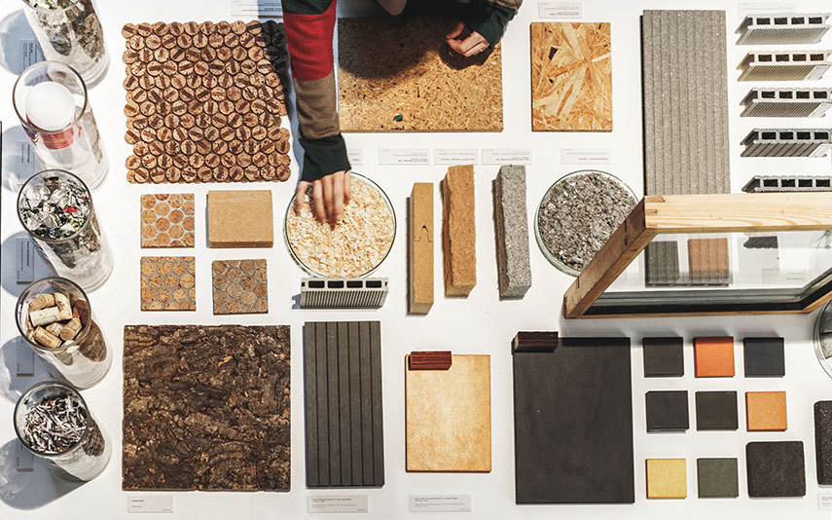
Material Requirements and Deconstruction
Design for Disassembly requires extensive research into construction materials for selecting the ones that are non-toxic, of high quality (to withstand assembly and disassembly) and have good recycling potential.
DfD requires generating a detailed deconstruction plan, including instructions for the disassembly of elements, as well as a review of the building components and materials and how they should be reused, recycled, or reclaimed.
Source-https://images.adsttc.com/media/images/5f06/3c89/b357/655d/4600/029d/slideshow/R_Hjortshoj-Wasteland_855.jpg?1594244228
Source- https://www.archdaily.com/943366/a-guide-to-design-for-disassembly

Slide 29
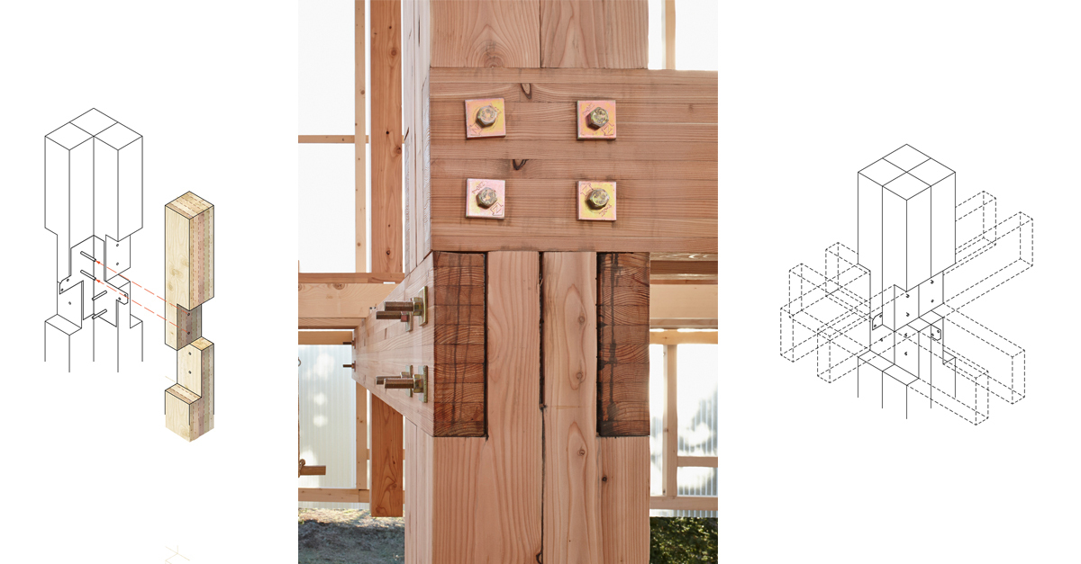
Connections
One fundamental principle of DfD is creating accessible connections and choosing the appropriate joinery in order to ease dismantlement and avoid the use of heavy equipment, or too many tools.
The focus should be on mechanical joinery, using bolted, screwed or nailed connections, as opposed to non-removable, chemical ones such as binders, sealers, glues or welding, which would make the material difficult to separate and recycle.
Source-https://images.adsttc.com/media/images/5f06/aa99/b357/655d/4600/032b/slideshow/kfi.jpg?1594272401

Slide 30
Design for DfD Further Information
https://www.lifecyclebuilding.org/docs/DfDseattle.pdf
Design for Disassembly in the built environment: DfD a guide to closed-loop design and building

Slide 31
Product-as-a-Service (Design and building life)

Slide 32
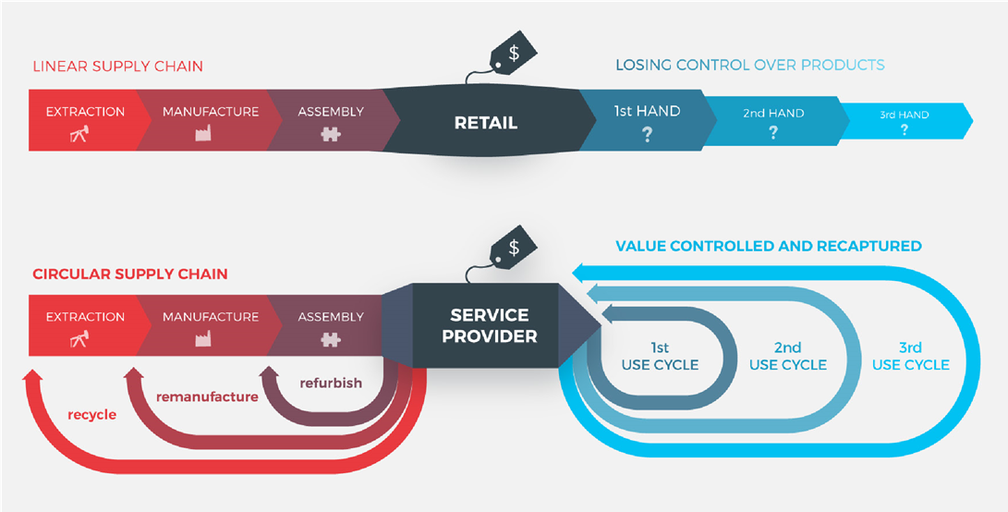
Product as a Service (PaaS)
In Product-as-a-Service (PaaS) business models, the provider retains ownership or control of the product throughout the use-phase.
As such, these businesses have a much stronger incentive to maximise product utilisation. It’s also in their interests to reduce the total number of products required and their lifecycle cost (LCC).
Source- https://assets.website-files.com/5d26d80e8836af2d12ed1269/5e4d0b66eb0887cb4ffa5e7c_PaaS-Question-Kit.pdf

Slide 33
Product as a service (PaaS) Strengths
Product Lifespan
As accountability for the product is shifted from the customer to the service provider, the incentive for the service provider is to increase resource and asset productivity and to prolong the lifetime of the product.
Customer Retention
Maintenance, repair, recycling and other services can lead to an increase in customer retention. Stable, long-term revenue, compared to traditional sales business model which it is more difficult to establish long term relationships with customers.
Sourcing
Less exposure to pricy or material scarcity.
Source- https://assets.website-files.com/5d26d80e8836af2d12ed1269/5e4d0b66eb0887cb4ffa5e7c_PaaS-Question-Kit.pdf

Slide 34
Product as a service (PaaS) Strengths
User Data
Predictive maintenance and other measures such as environmental impact.
Environmental Impact
Positive impact on the environment
The Cash Flow
In contrast to a linear business model, the incoming cash flow of the PaaS service provider is delayed as the customer pays a small service fee on a recurring basis instead of a one-off payment when buying the product.
The Customer
The financial or creditworthiness of the customer is crucial for the robustness of the cashflow.
Source- https://assets.website-files.com/5d26d80e8836af2d12ed1269/5e4d0b66eb0887cb4ffa5e7c_PaaS-Question-Kit.pdf

Slide 35
Product as a service (PaaS) Challenges
The Service Contract
The relationship between Client and service provider is captured in the service contract which becomes very important
The Assets
Assets becomes less adequate as collateral
The Circular Supply Chain
Risks to supply chain have more options to fail in comparison to one source
Source- https://assets.website-files.com/5d26d80e8836af2d12ed1269/5e4d0b66eb0887cb4ffa5e7c_PaaS-Question-Kit.pdf

Slide 36
PaaS Example Outside Construction
Headphones-as-a-service
The modular design allows 85% of components to be reused.
Products use durable, standardised designs, meaning fewer virgin materials are used to create new headphones.
The subscription model allows Gerrard Street to recover and recycle headphones at the end of their life.
Source- https://ellenmacarthurfoundation.org/circular-examples/gerrard-street

Slide 37
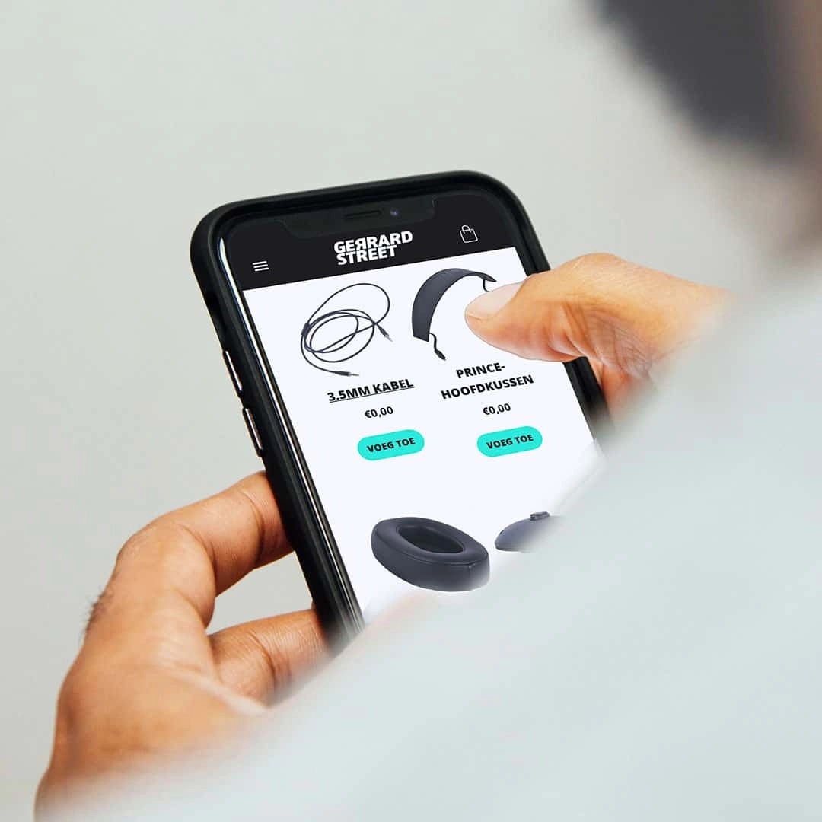
PaaS Example Outside Construction
Headphones-as-a-service
How it works
After subscribing and placing an order, Gerrard Street customers receive their headphones in a building kit box.
If headphones become damaged in any way, Gerrard Street will immediately send out a replacement part to the customer. Customers can also return the headphones for an upgrade or complete replacement.
New models are sent with return stickers to make the swapping process as easy as possible. This gives flexible access to people who want a high quality listening experience without a costly initial outlay.
Source-https://repeat.audio/
Source- https://ellenmacarthurfoundation.org/circular-examples/gerrard-street

Slide 38
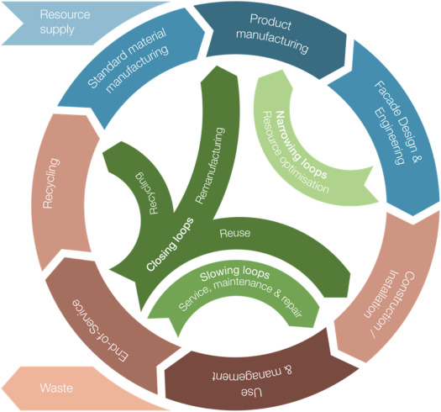
PaaS Example In Construction
Facades-as-a-service
Instead of transferring ownership of the facade in a traditional manner, the Facade Service Company remains the owner of- and responsible for the facade, its proper functioning and the agreed quality of services.
This service model stimulates the provider to develop a sustainable, future-proof facade and incentivises taking into account technological innovation and adaptability in the design phase.
Source-https://www.google.com/url?sa=i&url=https%3A%2F%2Fwww.sciencedirect.com%2Fscience%2Farticle%2Fpii%2FB978012822477900005X&psig=AOvVaw2xsNYttvxlCqbaxsTOTR4K&ust=1673009990874000&source=images&cd=vfe&ved=0CBAQjRxqFwoTCKit1Zu-sPwCFQAAAAAdAAAAABAJ
Source- https://www.circle-economy.com/resources/facade-as-a-service#:~:text=The%20Facades%2Das%2Da%2D,all%20adjustable%20by%20remote%20control.

Slide 39
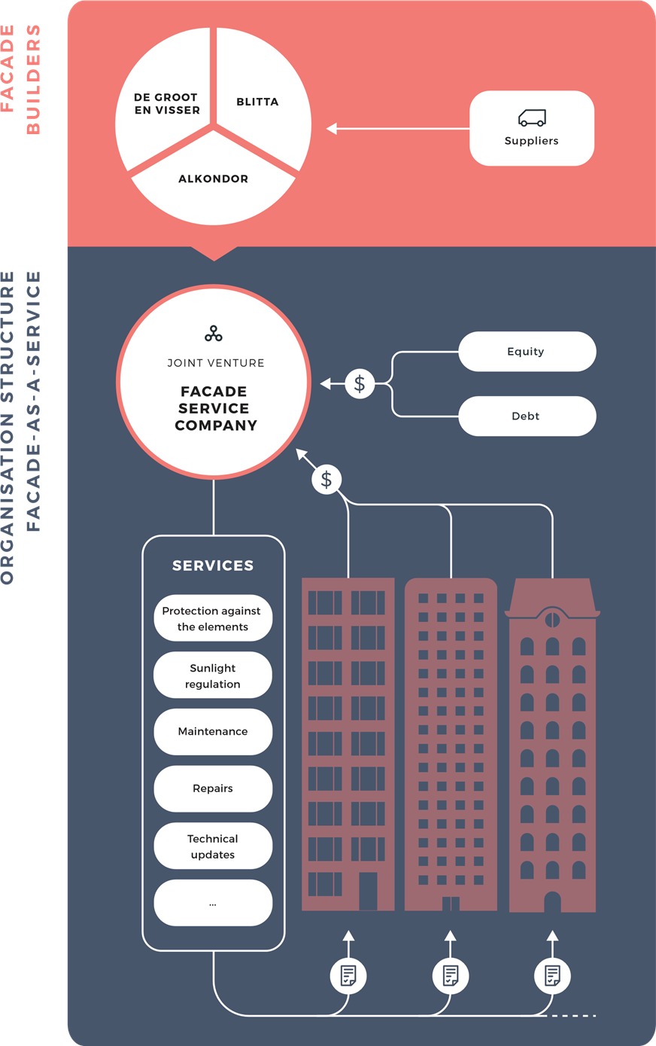
In return for paying a fixed periodic fee the customer receives the services and is unburdened: the Facade Service Company takes care of maintenance, repair and technical updates. This reinforces the 'trust' factor for the customer.
Incentivise sustainable energy consumption. There may be a possibility for a discount on the monthly service fee when maintenance costs are lower thanks to careful use of the facade.
Financially, this proposition is attractive if the total cost of usage of the facade does not exceed the total cost of ownership.
Source- https://www.circle-economy.com/resources/facade-as-a-service#:~:text=The%20Facades%2Das%2Da%2D,all%20adjustable%20by%20remote%20control.

Slide 40
Design and Build for Multi-functional Green Roofs Facades and Exterior Elements

Slide 41
Multi-functional Green Roofs Facades and Exterior Elements
Case Study
Modular and Adaptable Design
Green Roofs Facades and Interior Elements-as-a-Service (Green roofs-as-a-Service (GraaS))

Slide 42
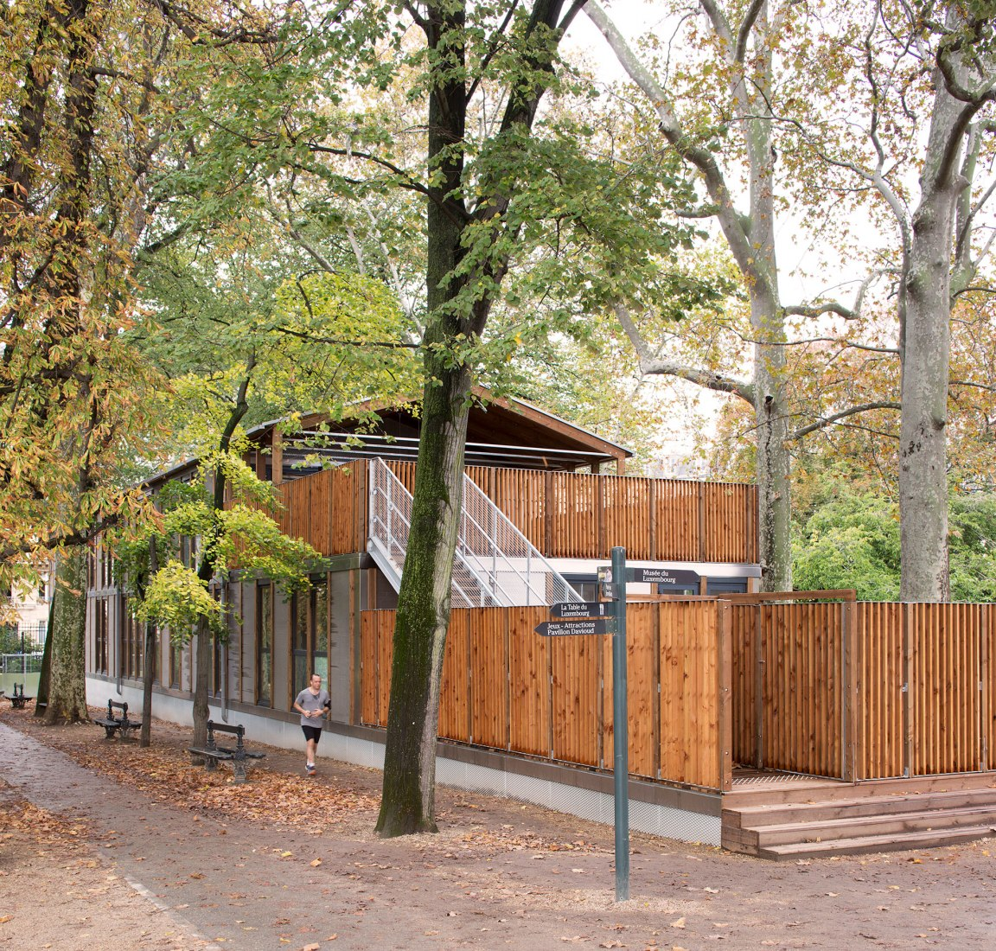
Elementary & Middle School - Paris, France - Djuric Tardio Architectes
Djuric Tardio Architectes has completed the project for the removable and rebuildable wooden nursery in the Luxembourg Gardens, one of the most popular places in Paris for both Parisians and tourists.
The construction of the nursery is temporary since the building will be dismantled and reassembled in another part of Paris, but in another configuration that remains free thanks to interchangeable and identical modules. The site where the modular building is currently located will be restored after two years.
Source:https://www.metalocus.es/en/news/modular-and-nomadic-building-paris-wooden-nursery-luxembourg-gardens-djuric-tardio-architectes

Slide 43
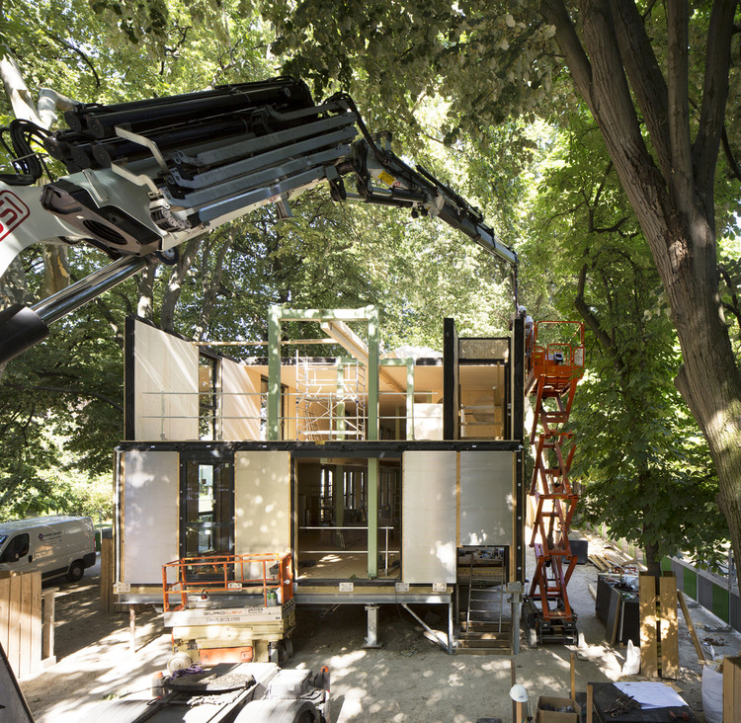
Elementary & Middle School - Paris, France - Djuric Tardio Architectes
Architectural approach. The Jardin du Luxembourg is an exceptional site. Therefore, the building had to take into account the constraint of a short-term existence and the requirement of a harmonious insertion. This high-performing and bio-sourced building was designed with the principle of reversibility. It can be entirely reconfigured to be utilized for this program or others (emergency housing, offices, etc.), in order to serve new needs and future uses. The Luxembourg site will be identically returned to its original state in two years and the building will be erected elsewhere.
Source:https://www.archdaily.com/943366/a-guide-to-design-for-disassembly
Source:https://www.archdaily.com/935476/wooden-nursery-djuric-tardio-architectes

Slide 44
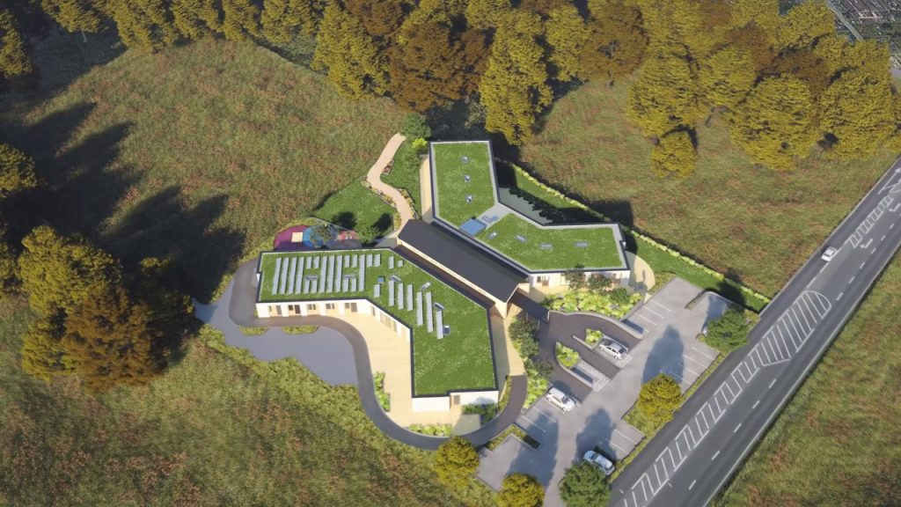
Case Study - Noah's Ark Children's Hospice
A green roof will soon be gracing the new building at Noah’s Ark Children’s Hospice in Barnet, London. And it will be a green roof with a difference. With solar panels and native wildflower vegetation, this biosolar roof will bring both energy and life to the project. Bridgman & Bridgman in partnership with Bauder Ltd started construction in October 2018. We were fortunate to being able to time-lapse the construction and shall continue to film the roof as it changes over time. By spring the roof will be a flourishing wildflower meadow in the sky, helping to support native wildlife. At the same time the solar panels will be producing renewable energy.
Source- https://livingroofs.org/noahs-ark-childrens-hospice-green-roof-start/

Slide 45
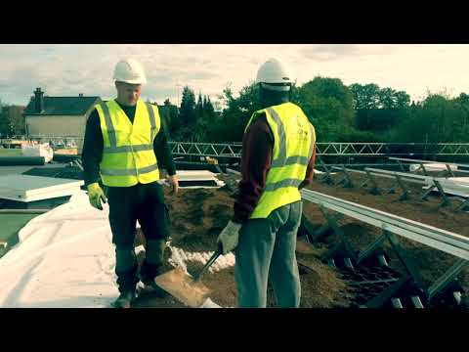
Press play on video or go to - https://youtu.be/B0W_PVmiWjA

Slide 46
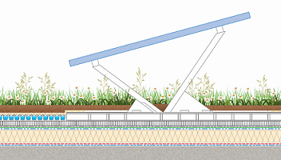
Modular and Adaptable Construction as Referenced to Case Study
Possibilities for implementing Modular Design
Repeatable modules for reuse and easy additions
Pre-planted modular trays
Possibilities for implementing Adaptable Design
Easy access to services and symptoms
Adaptable design symptoms allowing for addition of elements such as further solar panels
Source-https://www.bauder.co.uk/case-studies/noah%E2%80%99s-ark-children%E2%80%99s-hospice

Slide 47
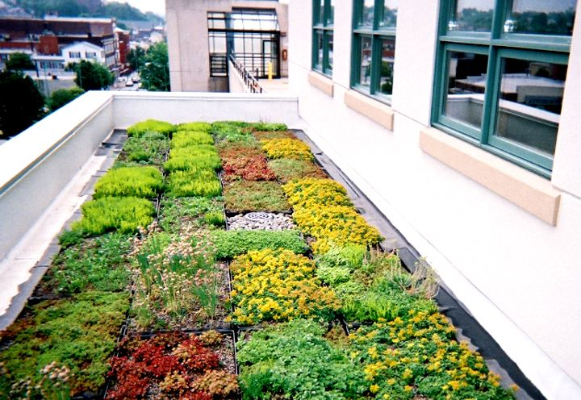
DfD and its Application to Case Study
Utilising Design for Disassembly and Modular design for green roofs, facades and interior elements means that elements of a building can easily be designed and built and reused following the end of life of the building. Allowing elements to be reused in the future.
Source-http://www.greenroofs.com/projects/pa-dept-of-environmental-protection-southeast-regional-headquarters/

Slide 48
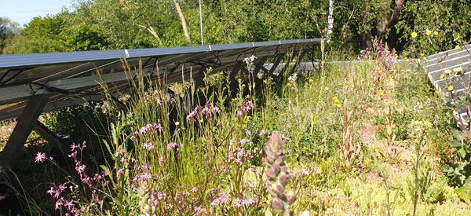
GRaaS - Opportunities
Similarly to Facades-as-a-Service, Green Roofs-as-a-Service (GRaaS) will -
Extend Product Lifespan
Insure Longer Customer Retention
Make Sourcing More Sustainable
Utilise User Data for Maintenance and Repairs
Environmental Impact Reduction
Source-https://www.bauder.co.uk/case-studies/noah%E2%80%99s-ark-children%E2%80%99s-hospice

Slide 49
QUIZ/ASSIGNMENT/ACTIVITY

Slide 50
EXTRA READING/STUDY

Slide 51
EXTRA READING/STUDY
For Further Case Studies and Training Material Please Follow the Link Below
https://docs.google.com/spreadsheets/d/1DTte4Ph8pQ4lKzYGFt2_S-d1Z_Rmd9-i/edit?usp=sharing&ouid=112148808974461842163&rtpof=true&sd=true

Slide 52
EXTRA READING/STUDY
Green Construction: A Growing Global Trend
https://a.storyblok.com/f/64835/x/7ddfdf5224/emea-green-construction-v1.pdf
BIMzeED
https://bimzeed.eu/
Product-as-a-Service in the circular economy
https://www.stenarecycling.com/what-we-offer/stena-circular-consulting/product-as-a-service/

