Slide 1
Circular Economy Across the Value Chain
Module 11
Circular Economy in the Construction Industry

Slide 2
Summery
The trainee should gain an understanding of what is available to them in order to implement circular practices into both their company and their community. This should include Communication, Knowledge sharing, Integration, implementation, national and European guidelines. This module should also highlight the importance of each of these topics in Multi-functional Green Roofs Facades and Interior Elements.
This project has received funding from the European Union’s Horizon 2020 research and innovation programme under grant agreement No 101033740

Slide 3
Objectives/Learning Outcomes
32 - Facilitate discussions and meetings between internal team members to identify circular opportunities multifunctional roofs and façades
33 - Integrate circular economy thinking into employee evaluations that are linked to professional compensation
34 - Collaborate to apply and improve circular procurement processes of multifunctional green roofs, façades, and interior elements
35 - Collaborate with industry stakeholders to share best practices in circular multifunctional roofs and façades, and act together
37 - Work together with residents and users to jointly create multifunctional green roofs, façades, and interior elements fit for them

Slide 4
Objectives/Learning Outcomes
38 - Engage in discussions with construction customers to raise awareness of the circular economy and explore circular opportunities for multifunctional green roofs, façades, and interior elements together
39 - Engage in discussions with government bodies and policy makers to push for regulations that support the application of circular multifunctional green roofs, façades, and interior elements
40 - Participate in government programs that support and advance circular multifunctional green roofs, façades, and interior elements
41 - Work together with the (local) community and engaging them in the company operations

Slide 5
Objectives/Learning Outcomes
49 - Incorporate circular strategies, archetypal circular interventions and case studies into educational programs (in the construction value chain)
50 - Provide internal training about navigating in the value chain for circular multifunctional green roofs, façades, and interior elements
51 - Solidify definitions of circular construction by being consistent and using circularity frameworks
52 - Conduct research about circular construction strategies applied to multifunctional green roofs, façades, and interior elements
53 - Follow developments in the field of environmental costing models and CO2 taxes

Slide 6
Objectives/Learning Outcomes
55 - Raise awareness about recycled construction materials and reconstructed buildings
71 - Explain the benefits of green and/or multifunctional green roofs, façades, and interior elements in different contexts and situations (e.g. public/private, to building users, industry, or local community)
80 - Redefine building regulations to incentivise circular approaches to multifunctional green roofs, façades, and interior elements
81 - Comply design of multifunctional green roofs, façades, and interior elements with applicable (national/local/EU) legal requirements
82 - Organise and provide insurance and guarantees for reused materials to buyers

Slide 7
Content
Collaboration and Knowledge sharing
Integration and implementation of Circular Economy in the workplace
Regulation and Definition
Multi-functional Green Roofs Facades and Exterior Elements

Slide 8
Collaboration and Knowledge sharing

Slide 9
Collaboration and Knowledge sharing
At its core, “collaboration in construction” simply means that teams are working together towards one project goal. Everyone can access the main plans and goals of a project at any time, without having to rely on gatekeepers or slog to faraway offices in order to get the information they need.
When collaboration is strong, team members pool their resources and knowledge and prioritize meeting shared goals dictated by the timeline and budget of the entire process rather than their own goals. This, of course, is the ideal way to conduct projects.
Source:https://constructionblog.autodesk.com/collaboration-construction/#:~:text=At%20its%20core%2C%20%E2%80%9Ccollaboration%20in,get%20the%20information%20they%20need.

Slide 10
Key Takeaways
Collaboration in construction requires teams to work together toward a common goal.
With collaborative construction, all stakeholders can access the main goals and plans at any time.
Around 43% of the highest trust construction firms place collaboration as a central goal when working on a project.
Collaboration can have challenges such as trouble with growing pains when getting used to a new system, changing job site and workplace culture, and the potential for higher upfront costs.
The benefits of collaboration may include fewer changes and rework, a higher likelihood of an on-time delivery, higher profits, fewer wasted materials, and other important positives.
Source:https://constructionblog.autodesk.com/collaboration-construction/#:~:text=At%20its%20core%2C%20%E2%80%9Ccollaboration%20in,get%20the%20information%20they%20need.

Slide 11
Key Takeaways
Successful collaboration in construction builds trust, is seamless, is inclusive, defines clear roles and responsibilities, and prioritizes high-quality communication.
Emphasizing collaborative communication between the key players in the design and preconstruction phases of a project has a positive impact on long-term results.
Developing a more collaborative culture is possible by changing project delivery methods, starting with collaboration with the original contract, embracing diversity, using collaboration tools, encouraging accountability, and focusing on human interaction.
Trust and collaboration go hand-in-hand. High-trust firms are half as likely to have problems linked to slow data exchanges and twice as confident about meeting their budgets and project schedules.
Source:https://constructionblog.autodesk.com/collaboration-construction/#:~:text=At%20its%20core%2C%20%E2%80%9Ccollaboration%20in,get%20the%20information%20they%20need.

Slide 12
Collaboration and Knowledge sharing
https://drive.google.com/file/d/1XKTqhfOypYgGWAl0tnMHiNGacsAYEKX1/view
Video - Importance of networking

Slide 13
Integration and Implementation of Circular Economy in the Workplace

Slide 14
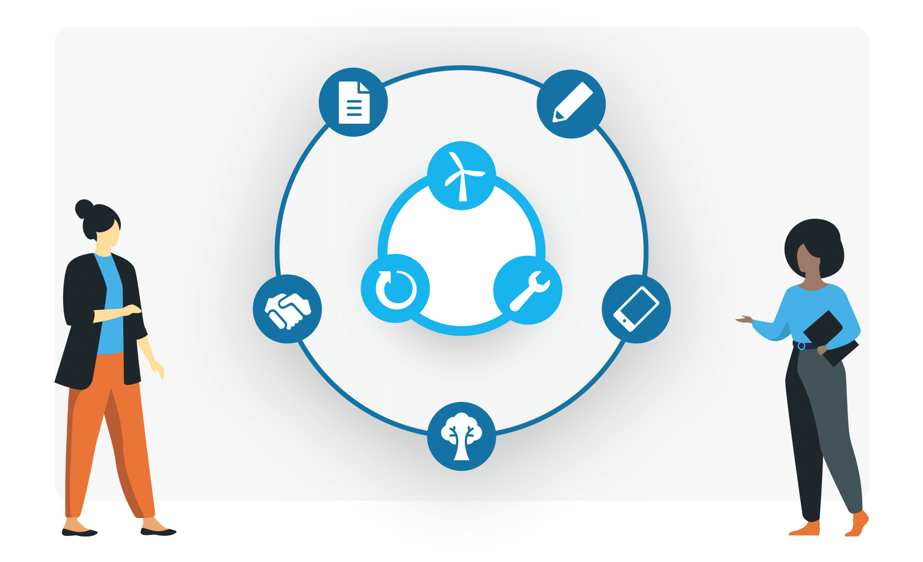
How to Implement Circular Economy
To implement circular economy in the construction industry the gaps existing within your company must be mapped and education and upskilling must then follow in order to implement this.
It is not necessary for the every person to be an expert in every element of the circular economy, however, it is vital that every team has an expert on each element of the circular economy.
Source: https://www.circle-economy.com/circular-economy/key-elements

Slide 15
Useful Tools
Circularity Academy
”CAMY”
Closing the green skills gap* is crucial to enable a circular economy. Our gamified e-learning platform boosts mass adoption of these skills.
*Linkedin's Green Skills Gap report
Ganbatte

Slide 16
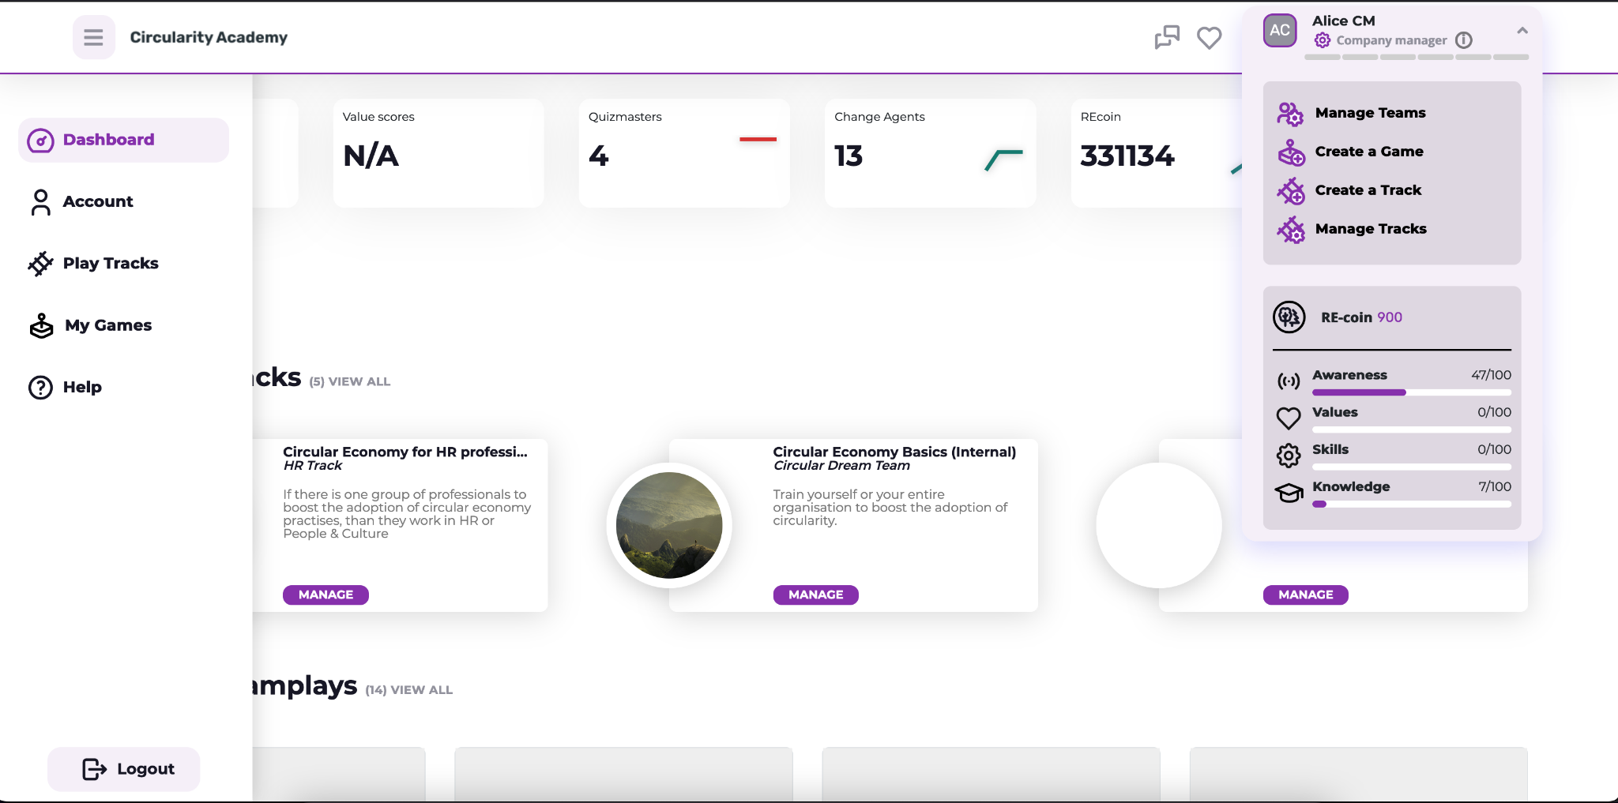
What is Circularity Academy? Left and right menu
For playing Tracks
From the menu on the left you can find all features for the players:
Account
change e-mail and other account settings
Tracks
Tracks are series of Games. Unless it is an open track, all tracks are invite only. As a player you’ll receive an invite from a Change Agent.
Games
Games are the central entity on the platform. They can be part of a track or can be played standalone. You can be invited for Teamplay sessions by Quizmasters.
There are 4 roles on the platform
Players (a.k.a. learners)
Play games and tracks, can be certified after finishing tracks Quizmasters (a.k.a. Game Guides)
Can guide the games in Teamplay modus. It works like Kahoot or Mentimeter. You generate a teamplay with a QR code which the players can scan. Now you can play the games as a group and discuss the outcomes Change Agents (a.k.a. Educators)
Can setup and guide tracks, which are more in depth learning experiences distributed over several learning session. With the data dashboards you can measure progress over time
Company Managers (a.k.a. Mission Manager)
The Company Manager has all roles + the overview of progress on the entire cohort or organisation. It can boost progress by notifying other roles to take action.

Slide 17
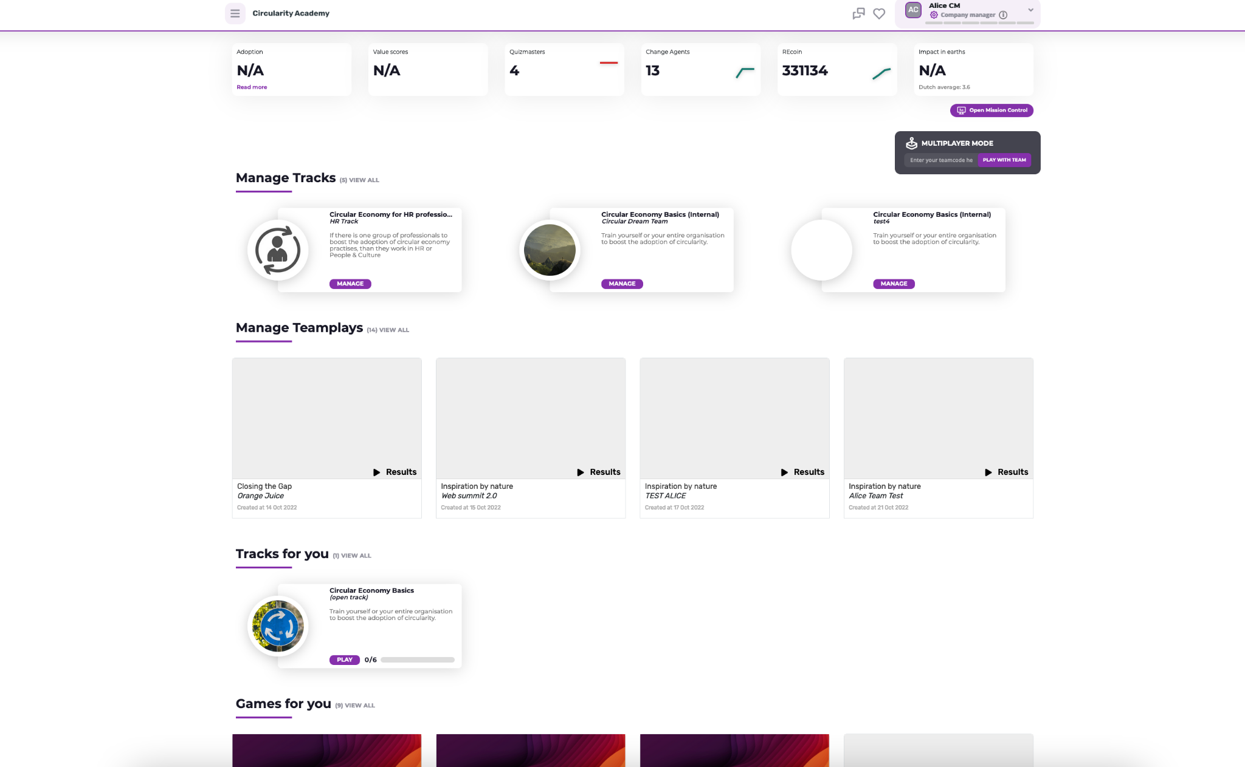
What is Circularity Academy? Dashboard based on role
Dashboard
The dashboard is the landingpage of the academy once you are logged in.
Depending on your role (player, quizmaster, change agent or company manager) you will have a different dashboard.
As any role can also just play games and tracks, you will always find games and track for you on the bottom or in the left menu.

Slide 18
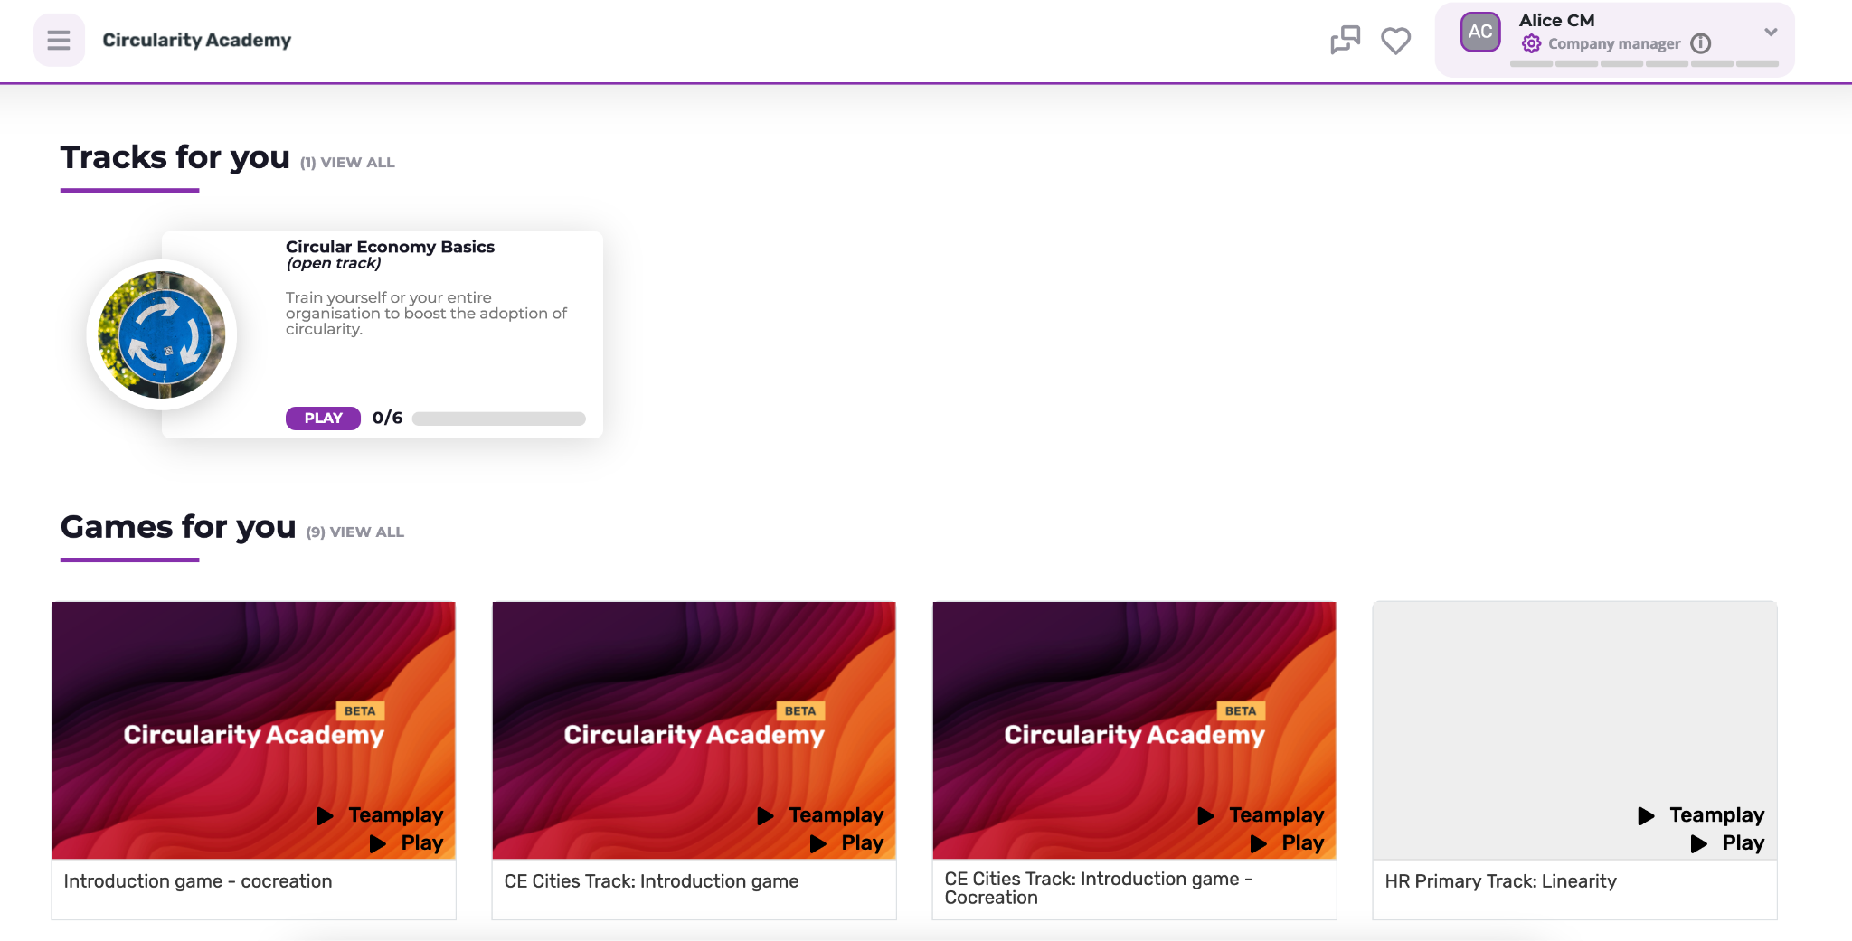
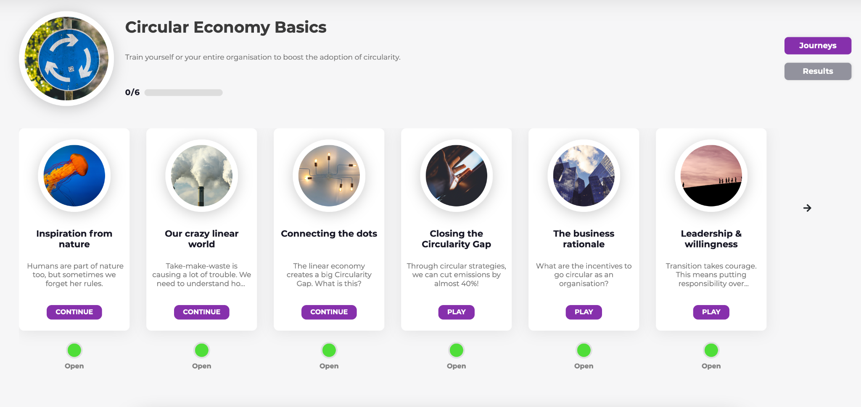
What is Circularity Academy? Playing games and tracks
Showcase a track (player perspective)
Scroll down to Tracks for you or click on play tracks in the left menu.
Now click play and the track will open and shows the games in the track.
NOTE: Don’t get confused: games in a track are called journeys.

Slide 19
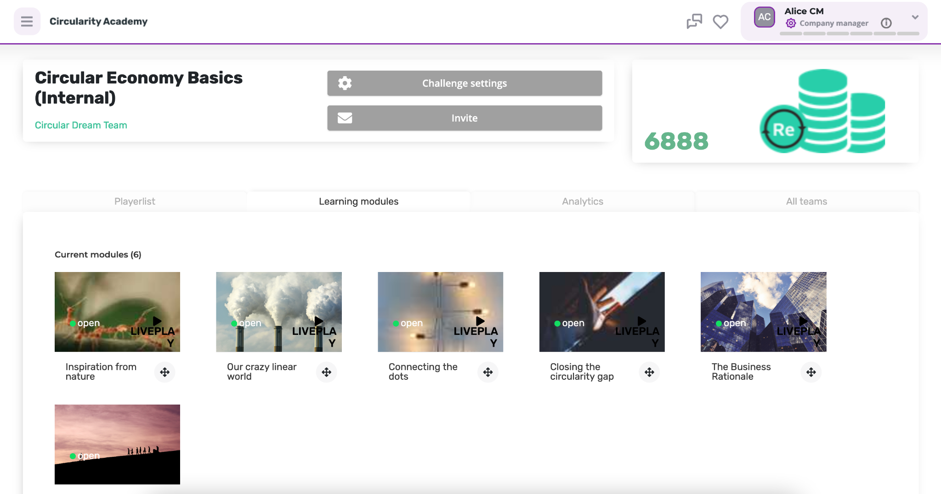
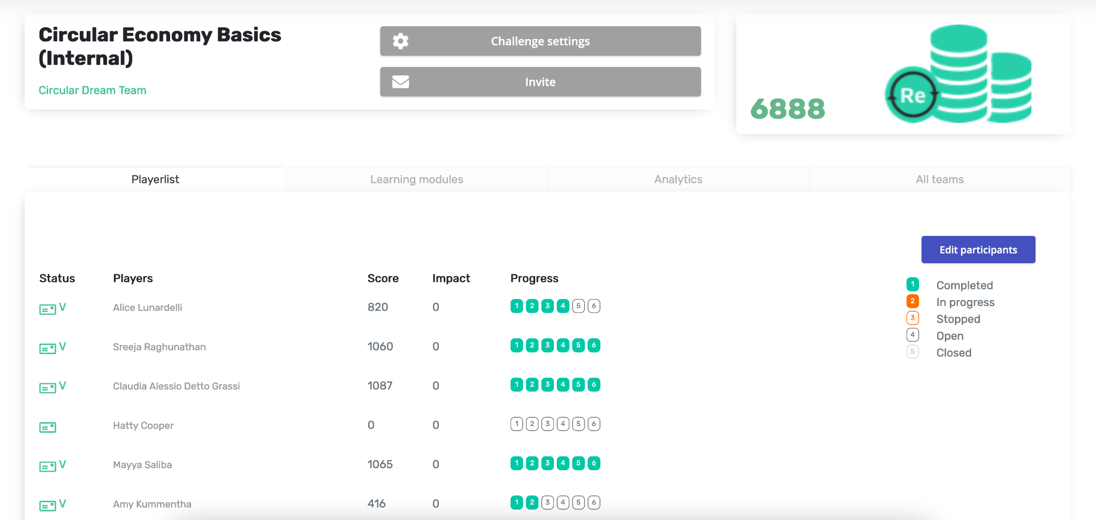
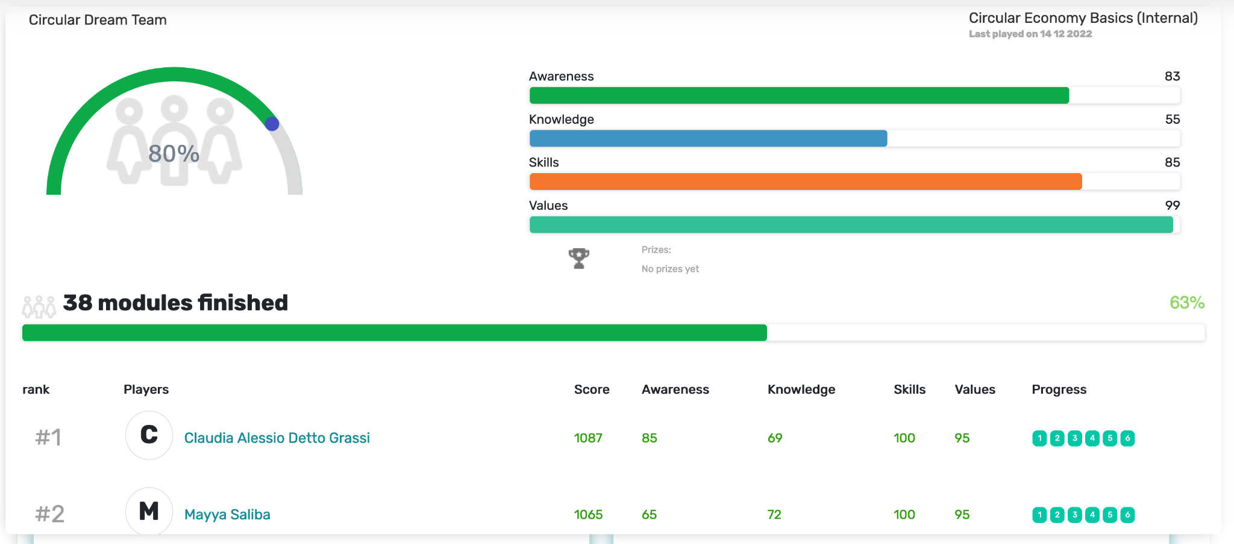
What is Circularity Academy? Guiding tracks
Showcase a track (Change Agent perspective)
If you are a Change Agent you can create, manage and guide tracks.
You invite a designated group of players (eg. your colleagues)
And you guide your team through a multi game track and tracks their progress and assess their awareness, knowledge, skills and values.
NOTE: Don’t get confused: games in a track are called journeys.

Slide 20
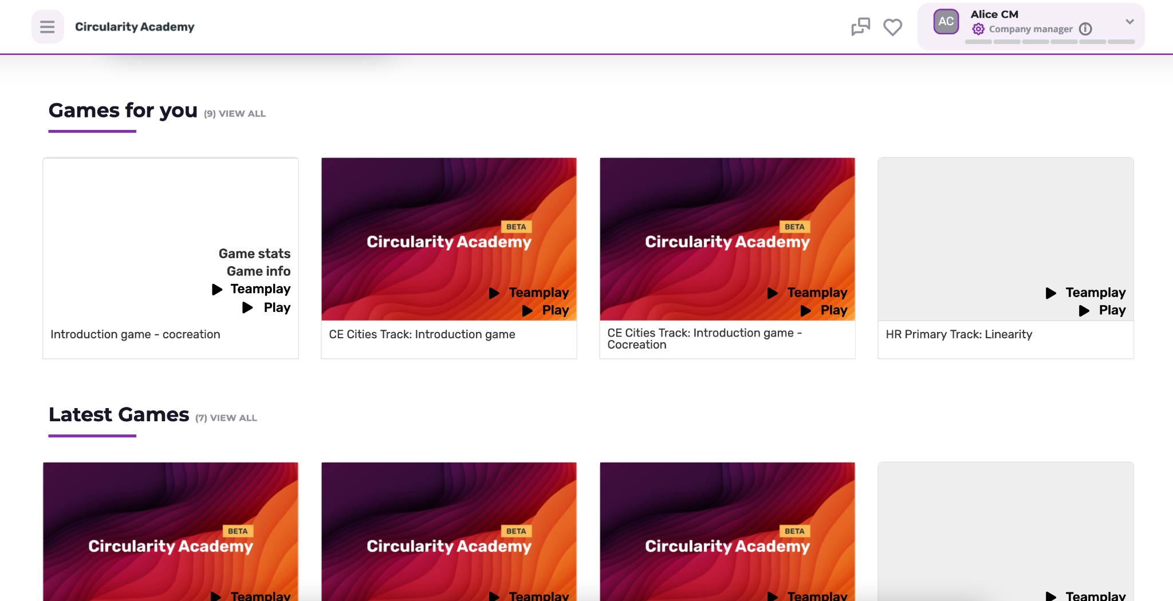
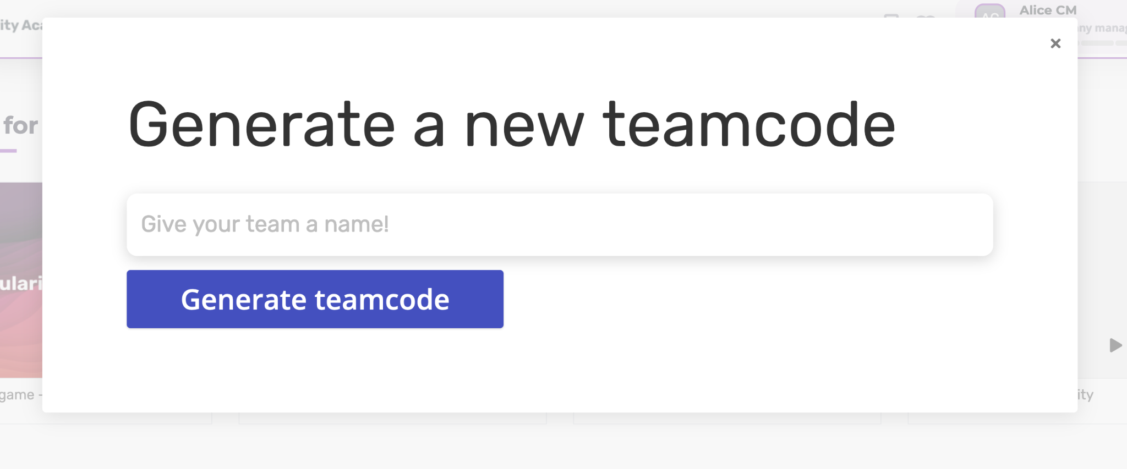
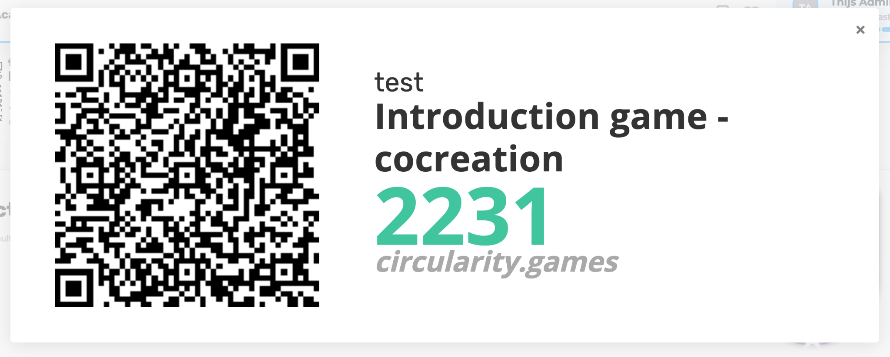
What is Circularity Academy? Guiding games
Showcase a track (Quizmaster perspective)
If you are a Quizmaster you can create and guide games.
You generate a QR code and anyone who scans it can join your game without the need for an account or login.
select game
start teamplay
share QR code
guide the game
discuss the results

Slide 21
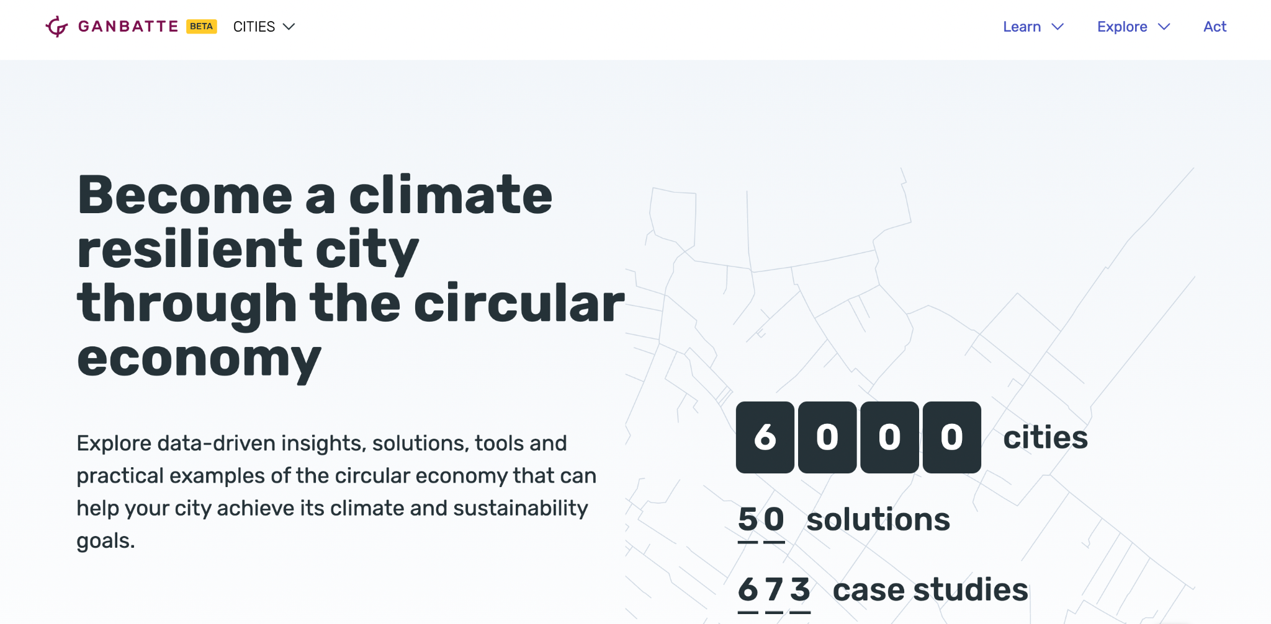

Slide 23
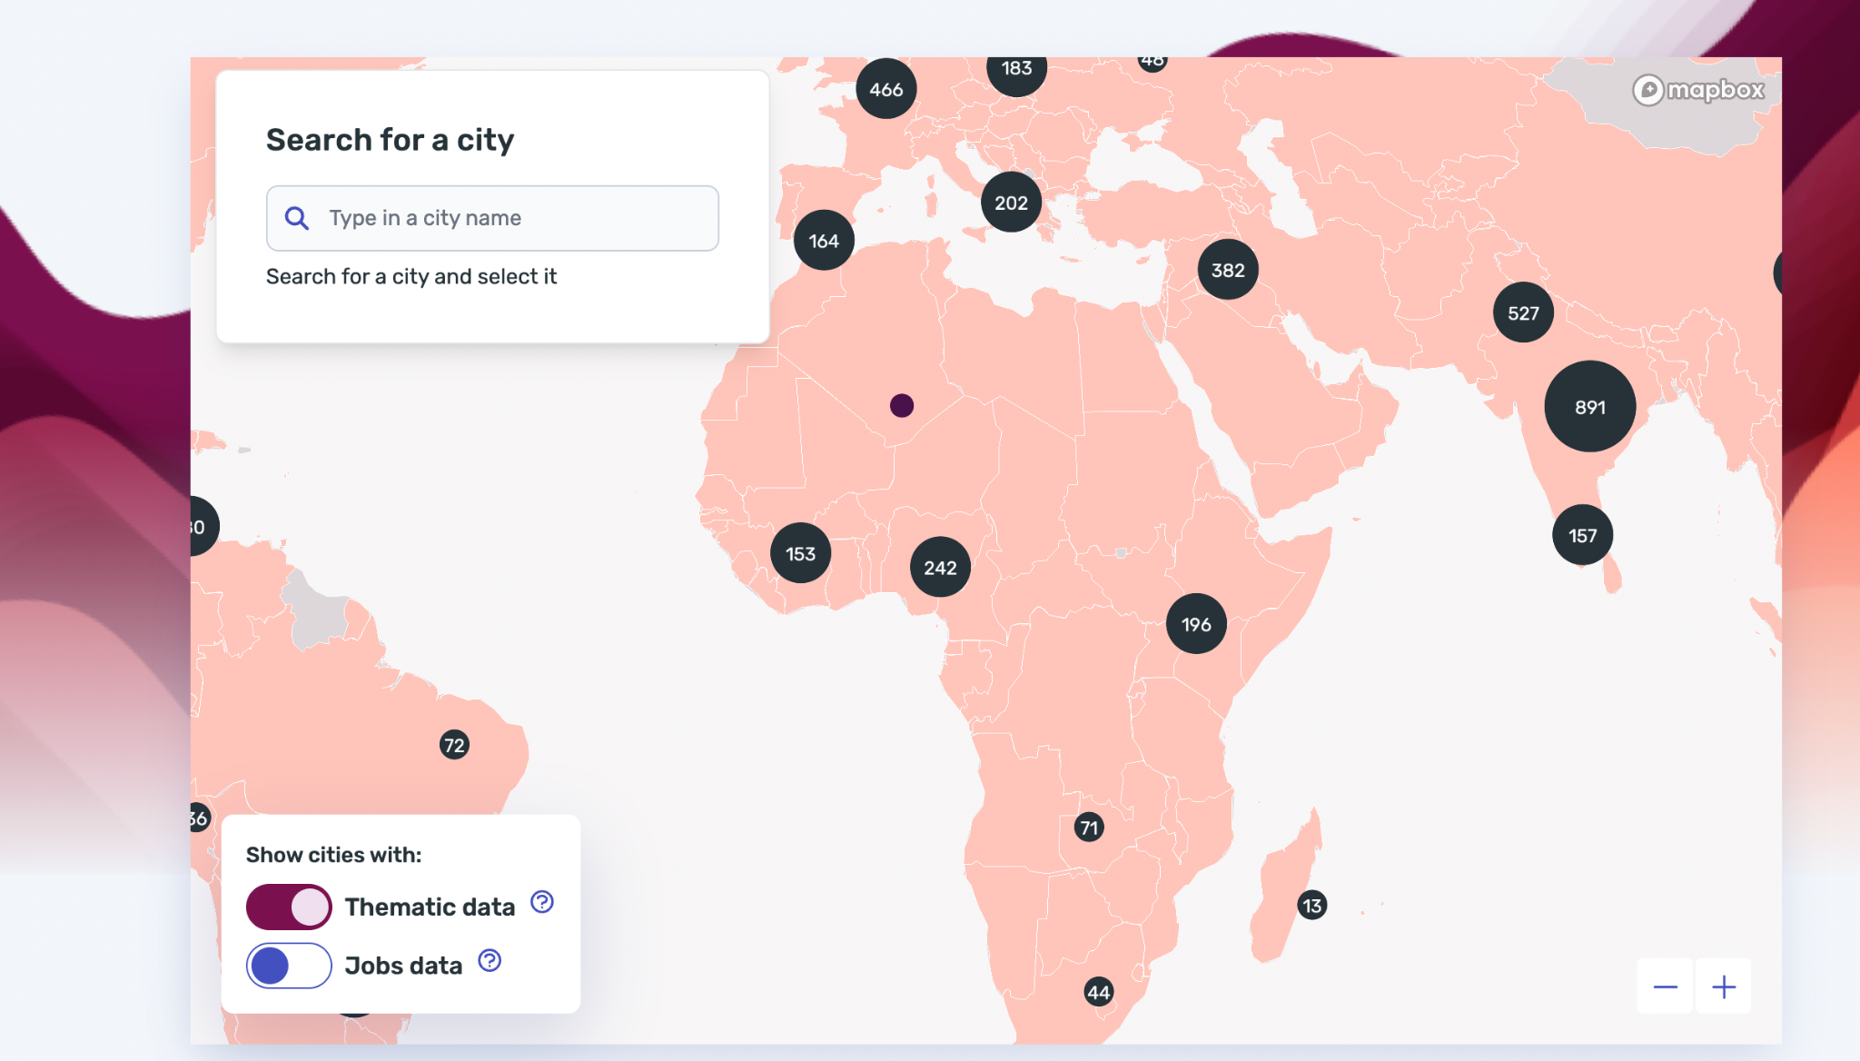

Slide 24
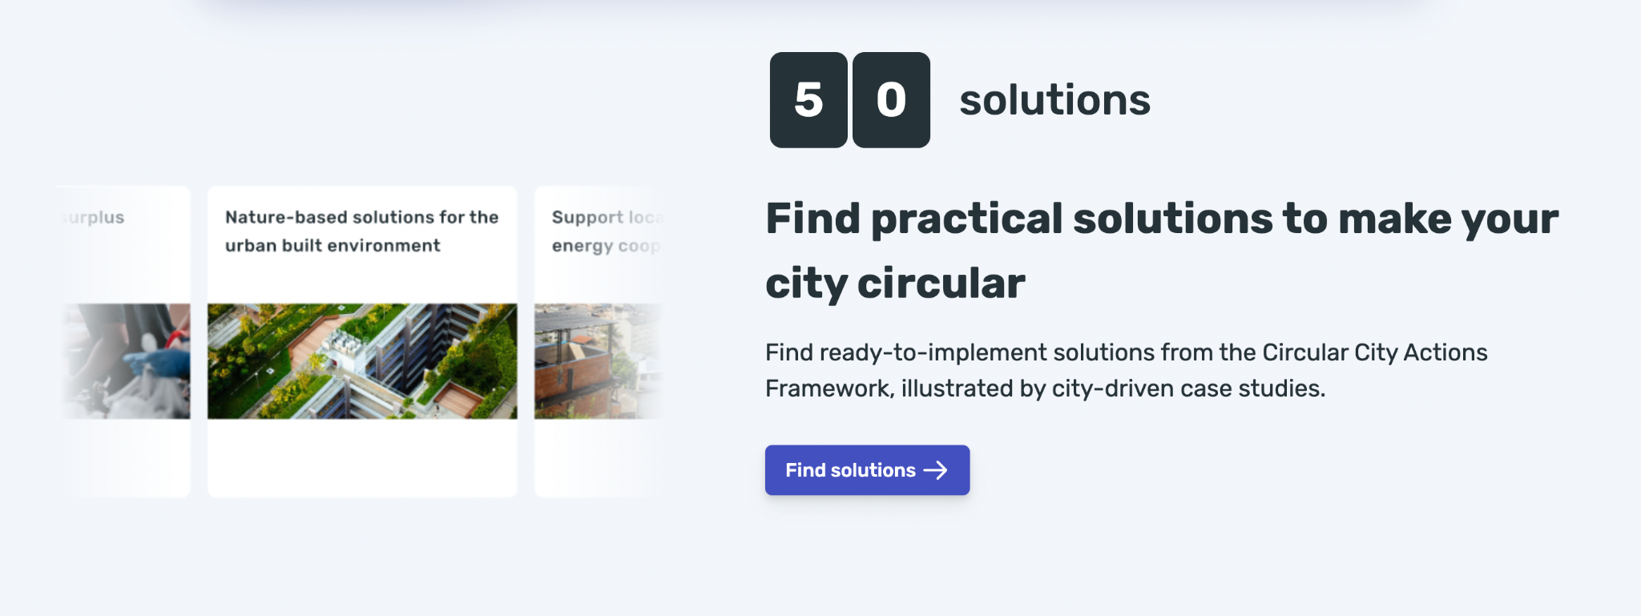

Slide 25
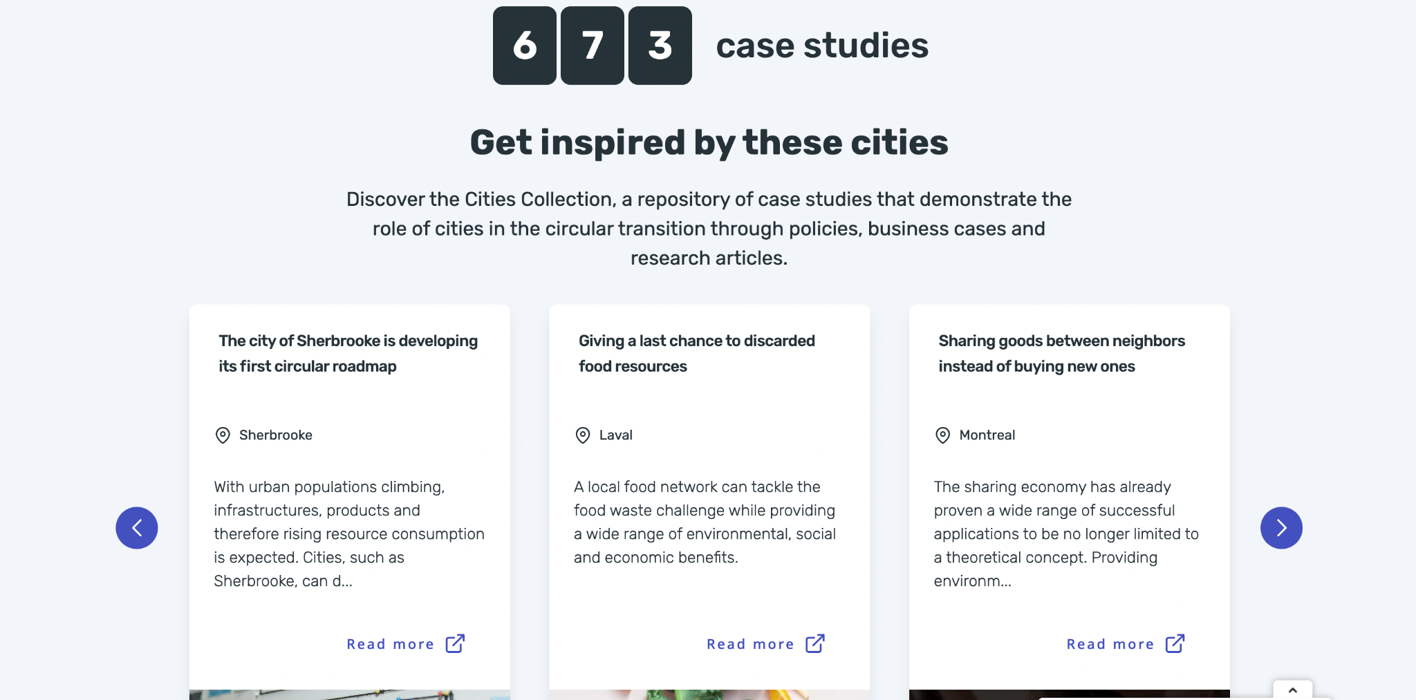

Slide 26
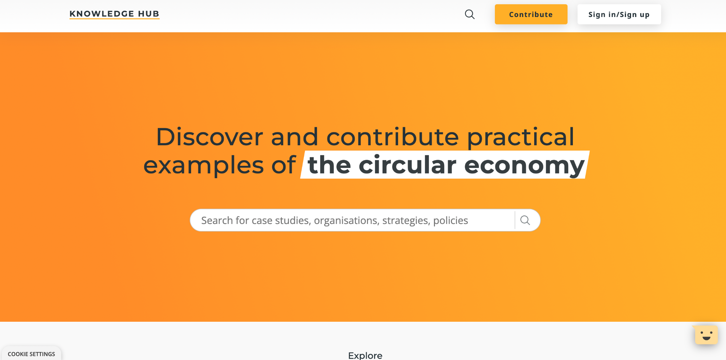

Slide 29
Regulation and definition

Slide 30
What is a Circular Economy
A circular economy is a system which maintains the value of products, materials and resources in the economy for as long as possible, and minimises the generation of waste. This means a system where products are reused, repaired, remanufactured or recycled.
Source: https://eur-lex.europa.eu/EN/legal-content/glossary/circular-economy.html

Slide 31
Value & Governance Video
https://drive.google.com/file/d/1keRvTmdEZRRvOA-m8hb2jlQaj7psD2P5/view
Video - Importance of Value & Governance

Slide 32
Current Guidance Document Examples
The EU Green Deal - Circular economy action plan
https://environment.ec.europa.eu/strategy/circular-economy-action-plan_en
Public Procurement for a Circular Economy
https://ec.europa.eu/environment/gpp/pdf/Public_procurement_circular_economy_brochure.pdf
Circular Economy for the built environment: a summary
https://drive.google.com/file/d/1miNS6IYTeFNteZoiI_vC0e8XtjGXwKDH/view
Roadmap Circular Land Tendering
https://www.metabolic.nl/wp-content/uploads/2019/02/roadmap_circular_land_tendering.pdf
Circular Economy Checklist Construction Designers
https://southernwasteregion.ie/sites/default/files/Circular%20Economy%20Checklist%20Construction%20Designers.pdf

Slide 33
Current Guidance Document Examples
LEVEL(S): A GUIDE TO EUROPE’S NEW REPORTING FRAMEWORK FOR SUSTAINABLE BUILDINGS
https://ec.europa.eu/environment/eussd/pdf/Level_publication_EN.pdf
EU Taxonomy
https://finance.ec.europa.eu/sustainable-finance/tools-and-standards/eu-taxonomy-sustainable-activities_en
A Holistic Sustainability Framework for Waste Management in European Cities: Concept Development
https://drive.google.com/file/d/1Q9eluKr4bI8YWLByPuAoq5Kh3nMRsfv_/view

Slide 34
Overview of Policies for Circular Economy Video
https://drive.google.com/file/d/15BeaLUm-U15OonovpzPlF17s7NhOHOyB/view
Video - Overview of Policies for Circular Economy

Slide 35
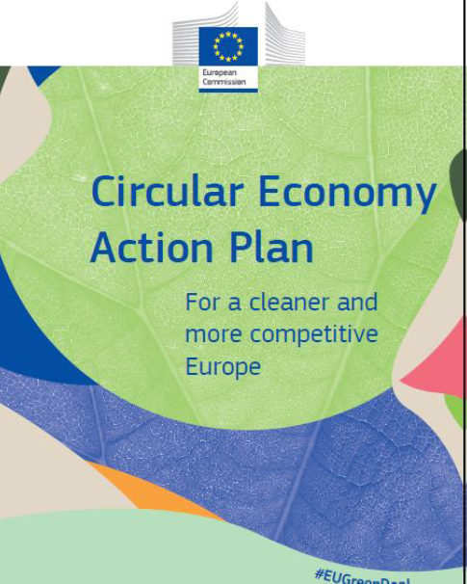
EU Green Deal
The Green Deal is a roadmap for achieving a sustainable, carbon-neutral, competitive and resource-efficient economy. Its objectives are:
reduce net greenhouse gas emissions to zero by 2050
Disconnecting idea of economic growth from resource consumption by promoting the circular economy
improve the quality of life of all
restore biodiversity and reduce pollution.

Slide 36
EU Green Deal- Action Plan for the Circular Economy
An initiative of the Green Deal Aims to modernise the European economy through a green and digital transformation
The Plan proposes measures to achieve:
That the products marketed in the European Union are sustainable
That consumers receive information on the durability and repairability of the products they purchase
Avoiding the production of waste, and converting the waste produced into secondary raw materials.

Slide 37
Irish Examples
Waste Action Plan for a Circular Economy
https://www.gov.ie/en/publication/4221c-waste-action-plan-for-a-circular-economy/
Circular Economy and Miscellaneous Provisions Act 2022
https://www.oireachtas.ie/en/bills/bill/2022/35/
Whole of Government Circular Economy Strategy 2022 – 2023 'Living More, Using Less'
https://www.gov.ie/en/publication/b542d-whole-of-government-circular-economy-strategy-2022-2023-living-more-using-less/

Slide 38
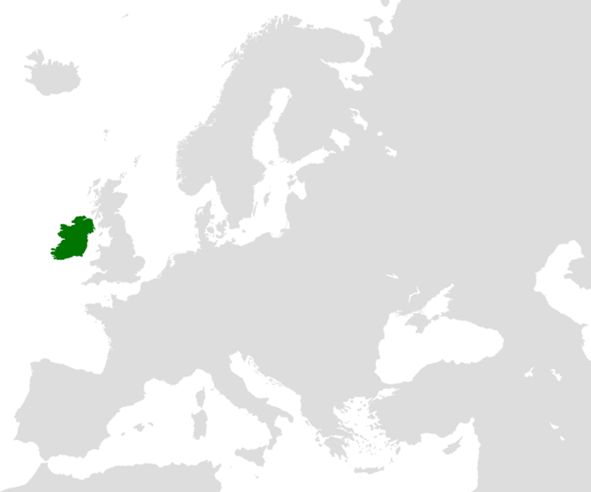
Circular Economy in Ireland
On the measure of circularity, Ireland currently lags behind its EU peers.
In 2019, Ireland’s circular material use rate (material recovered and fed back into the economy -saving extraction of primary raw materials) was the second worst in the EU according to Eurostat figures.
Ireland’s rate was 1.6%, compared to an EU average of 11.9%. The best performing EU Member State, the Netherlands, achieved a rate of 28.5%.
Countries which have been most successful in moving towards circularity appear to benefit from having overarching national circular economy policies

Slide 39
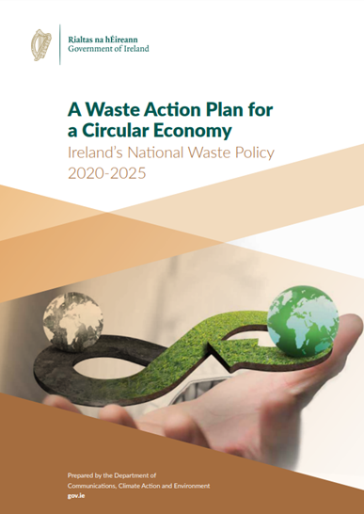
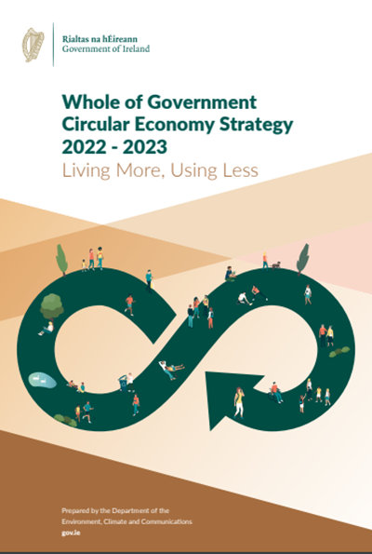
Ireland: Circular Economy and Miscellaneous Provisions Act 2022
Shifts Ireland away from a "take-make-waste" economy
Incentivises the use of recycled and reusable alternatives to wasteful, single-use disposable packaging
Moves Ireland closer to being among the first in the world to eliminate disposable drinks cups
Tackles illegal fly-tipping and littering
Signed into Law in July 2022

Slide 40
Multi-functional Green Roofs Facades and Exterior Elements

Slide 41
Multi-functional Green Roofs Facades and Exterior Elements
Green & Blue Roof Guide 2021
https://www.dublincity.ie/sites/default/files/2021-12/dcc-green-blue-roof-guide-2021.pdf
Green Roofs Guidance Document
https://www.dlrcoco.ie/sites/default/files/atoms/files/appendix16.pdf
A guide to GREEN roofs, walls and facades
https://202020vision.com.au/media/41918/growing_green_guide_ebook_130214.pdf

Slide 42
QUIZ/ASSIGNMENT/ACTIVITY

Slide 43
EXTRA READING/STUDY

Slide 44
EXTRA READING/STUDY
For Further Case Studies and Training Material Please Follow the Link Below
https://docs.google.com/spreadsheets/d/1DTte4Ph8pQ4lKzYGFt2_S-d1Z_Rmd9-i/edit?usp=sharing&ouid=112148808974461842163&rtpof=true&sd=true

Slide 45
EXTRA READING/STUDY
Green Transition Ireland
https://www.enterprise-ireland.com/en/productivity/build-a-green-sustainable-business/

