Slide 1
Circular Economy and its Implementation in the Design and Construction Sector
Module 1
Circular Economy in the Construction Industry

Slide 2
Circular Economy in the Construction Industry Summary
Through this module the learner will gain an understanding of what the Circular Economy is in a general sense and what the benefits and barriers are in order to implement this today. They will explore the current situation within Europe and internationally in relation to the Circular Economy and further explore how this relates to the construction industry. Finally the trainer will define Multi-functional Green Roofs Facades and Interiors Elements and explore what the opportunities are when pairing this with Circular Economy.

Slide 3
Objectives/Learning Outcomes
The learning outcomes for BUS-goCircular can be found here on the https://busgocircular.eu/ website. These Units of Learning Outcomes (ULO’s) relate to the circular economy and the implementation of circular skills in the construction industry.
In this module, trainees will gain an understanding of the Circular Economy and Multi-functional Green Roofs Facades and Interior Elements which will then be built upon in future modules.

Slide 4
Module Content
The Circular Economy and its Application in the Construction Sector
Introduction to the Circular Economy
Circular Economy in the Construction Sector
The Key Elements Framework
Multi-functional Green Roofs Facades and Exterior Elements and the Circular Economy
Introduction to Multi-functional Green Roofs Facades and Exterior Elements
Types of Green Roofs
Benefits of Multi-functional Green Roofs Facades and Exterior Elements

Slide 5
The Circular Economy and its Application in the Construction Sector

Slide 6
What is A Circular Economy? Overview
In our current economy, we take materials from the Earth, make products from them, and then they become waste. In a Circular Economy, we try to stop waste being produced.
The circular economy is based on three principles, driven by design:
Eliminate waste and pollution
Circulate products and materials (at their highest value)
Regenerate nature
It is underpinned by a transition to renewable energy and materials. A circular economy decouples or brakes the link between economic activity and the consumption of finite resources. It is a resilient system that is good for business, people and the environment.
Source: https://ellenmacarthurfoundation.org/topics/circular-economy-introduction/overview

Slide 7
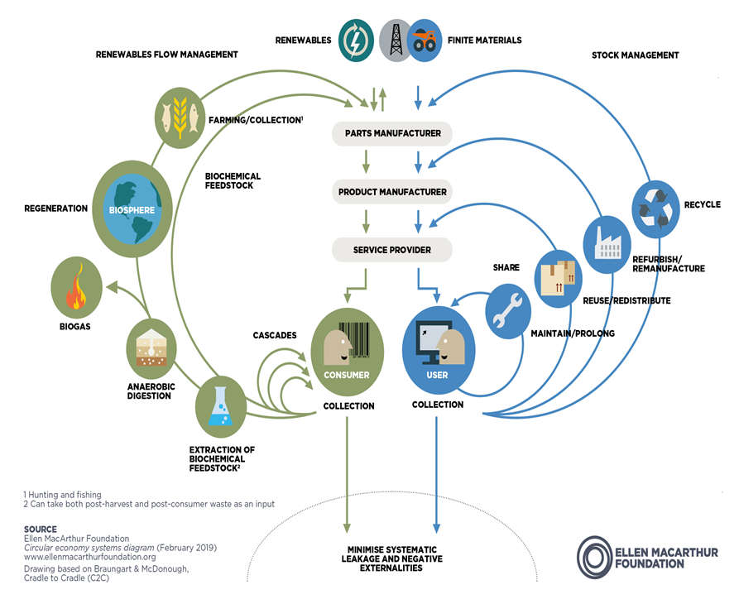
Source: https://ellenmacarthurfoundation.org/topics/circular-economy-introduction/overview

Slide 8
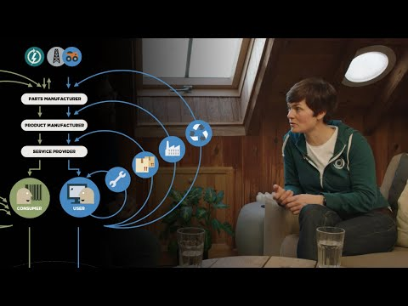
What is A Circular Economy?
Press play on video or go to - https://ellenmacarthurfoundation.org/topics/circular-economy-introduction/overview

Slide 9
Why do we need a Circular Economy?
Climate change, the loss of biodiversity and the depletion of natural resources have provoked an unprecedented global crisis, leading to what some scientists consider to be a new geological era: the Anthropocene (The most recent period I human history).
Currently, the Earth’s annual demand for resources due to anthropogenic (Human activity in the anthropocene era) activities exceeds its regenerative capacity. In 2019, humanity consumed an amount of natural resources equivalent to 1.6 Planets.
Earth Overshoot Day marks the date when humanity has used all the biological resources that Earth regenerates during the entire year.
In 2022, Earth Overshoot Day fell on July 28. You can explore proposed solutions on their website.
Source: https://www.overshootday.org/

Slide 10
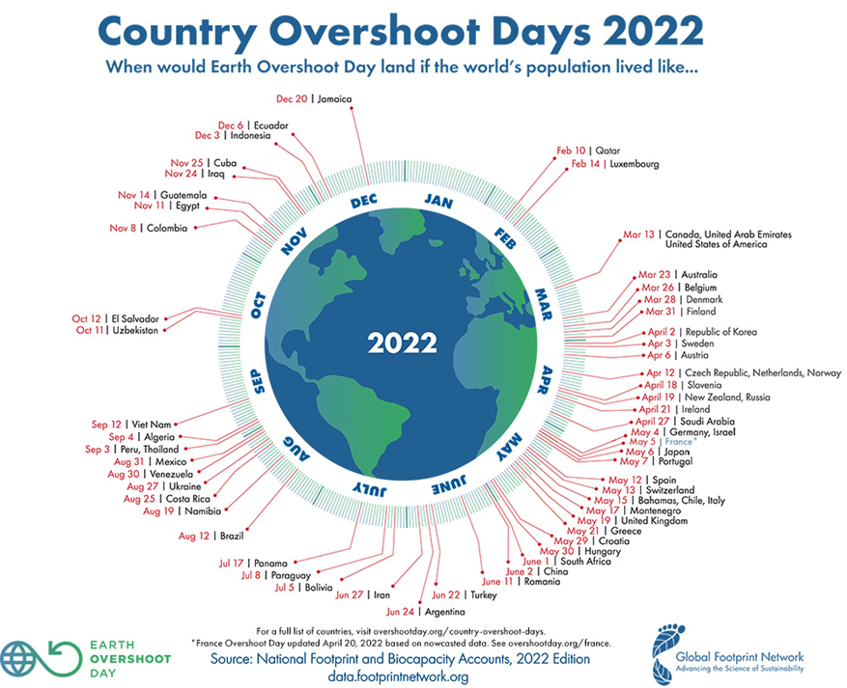
Source: https://www.overshootday.org/

Slide 11
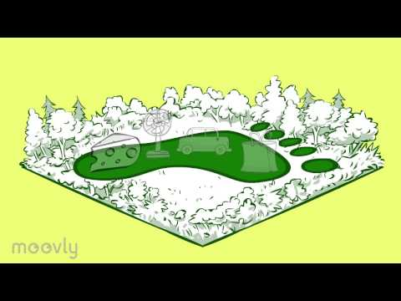
Our Ecological Footprint
Press play on video or go to - https://www.youtube.com/watch?v=fACkb2u1ULY

Slide 12
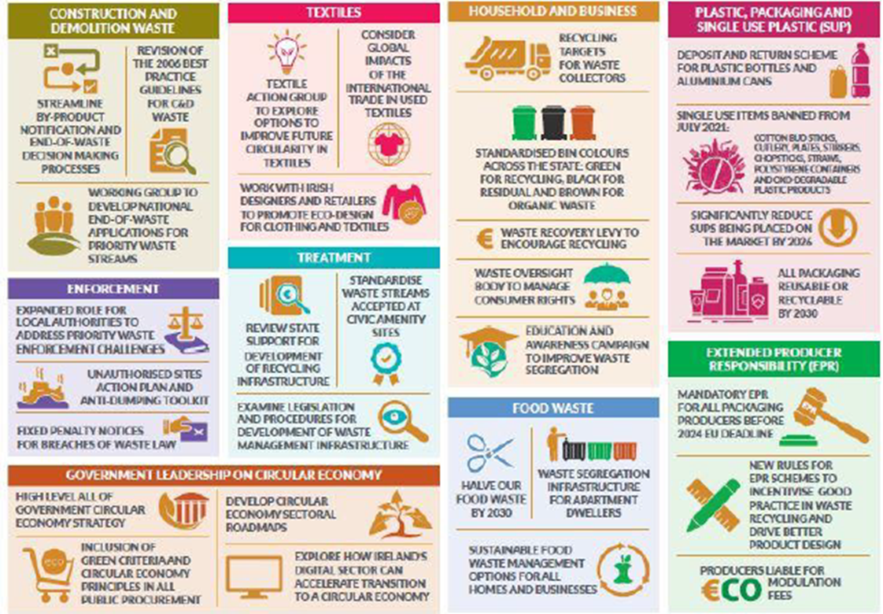
Waste and Recycling
Today, (2022) the global economy is only 8.6% circular
Source: https://gupp-class.eu/

Slide 13
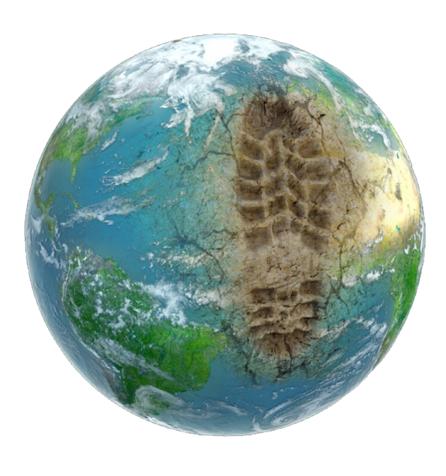
Linear Economy
Circular Economy application is still low which is caused, in part, by the current model of production and consumption, called “linear economy”.
This economic system, implemented since the first industrial revolution, is based on the pattern of “produce, use and throw away”, under the assumption that natural resources are inexhaustible.
This is the modern day consumer society!
So, what is Linear Economy?
Source: https://gupp-class.eu/

Slide 14
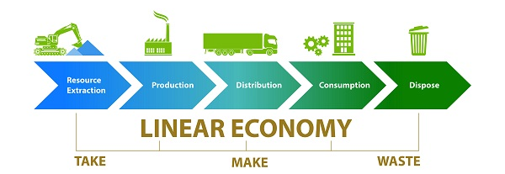
Linear Economy
The linear model follows a source to grave approach where material is sourced, used to create products, distributed, consumed and then disposed of. This model means that the finite amount of materials we have on the planet are depleting, this poses a severe risk to our environment and leaves a huge amount of waste, leading to pollution across the world.
Source: https://uk.glasdon.com/images/news/linear-economy-graph.jpeg

Slide 15
Linear Economy
The key learnings were that our current linear economy..
The ecological disadvantage of the linear economy is that the production of goods is at the expense of the productivity of our ecosystems. Excessive pressure on these ecosystems jeopardises the provision of essential ecosystem services, such as water, air and soil cleaning
Consumes 100 billion tonnes of material annually - a number which has tripled in the last 50 years
Emits almost 60 gigatonnes of greenhouse gas emissions - 70% of greenhouse gasses are directly linked to the extraction, handling, and consumption of materials. In other words, our out-of-control consumption patterns and systems are directly linked to the current climate crisis.
And of this 100 billion tonnes, only 7.2% is kept in the loop, 92.8% is wasted every year.
Source: Circle Economy and Michelini, Moraes et al., 2017

Slide 16
The Current ‘Linear’ Economy . . .
Consumes
KG
100 billion tonnes of materials annually
Tripled in the last 50 years
Emits over
59.1 Gt
of GHGs
Is only
Expected to hit 80 Gt by 2032
7.2%
circular
Wasting 92.8% of everything we use
Source: Circle Economy
Notes:
The key learnings were that our current linear economy..
Consumes 100billion tonnes of material annually - a number which has tripled in the last 50years
Emits almost 60 gigatonnes of greenhouse gas emissions - 70% of greenhouse gasses are directly linked to the extraction, handling, and consumption of materials. In other words, our out-of-control consumption patterns and systems are directly linked to the current climate crisis.
And of this 100billion tonnes, only 7.2% is kept in the loop, 92.8% is wasted every year.

Slide 17
Circular Economy
The circular economy, as a model of production and consumption, is a more sustainable alternative to the linear economy.
The objective of the circular economy is to achieve more efficient and resilient production and consumption systems, that minimize the use of natural resources and preserve the ones they use within continuous cycles, maintaining or improving their value.
The Circular Economy requires a new approach in the following areas:
the design of products and services
management and market models
how to convert and reuse waste into resources
national regulations
the commitment of citizens to change their consumption habits
Source: https://gupp-\class.eu/

Slide 18
A Circular Economy Changes the Way we Produce and Consume Materials
prevent climate breakdown
future-proof businesses
create decent and more sustainable jobs
COULD CHANGE ARGUMENTS PER AUDIENCE
Enabling us to...
1
2
3
Source: Circle Economy
Notes:
And while, at its core, the circular economy is about changing the way we produce and consume materials…it's impact is much greater then just more efficient resource use.
And enables us to:
Prevent CLIMATE BREAKDOWN = 70% OF Green House Gas Emmissions ARE DIRECTLY LINKED TO MATERIAL EXTRACTION AND HANDLING
It enables us to create future proof businesses, that can decouple value creation from resource extraction avoid what we call linear risks - that is the market, operational, business legal and reputational risks that come with continuing with conventional take make waste models of working
And finally, can create decent jobs. We know that incinerating 10,000 tonnes of waste creates 1 job, landfilling creates 2 jobs, recycling creates 36 jobs, and refurbishing and reusing creates up to 300.

Slide 19
Decarbonizing Europe
The decarbonization of European Economy by 2050 is at the core of the European Green Deal adopted at the end of 2019. The implementation of the circular economy will be key to achieving a decarbonised Europe.
Source: GBCE. Circular economy in building.2021

Slide 20
Type of resources
Materials
including metals, minerals, concrete and wood (timber) used in construction;
Energy (embodied) and related GHG emissions
this is energy used linked to the extraction of materials, manufacturing of construction products, the construction phase itself, construction and demolition, but not energy used directly during the use-phase (see below);
Water
this relates to the full cycle but primarily to water use in buildings. However, quantifications of embodied water have been excluded after thorough investigation of existing literature due to a high level of uncertainty with the figures;
Land
with land we understand direct use of land (land take);
Biodiversity impacts.
Source: https://ec.europa.eu/environment/eussd/pdf/Resource%20efficiency%20in%20the%20building%20sector.pdf

Slide 21
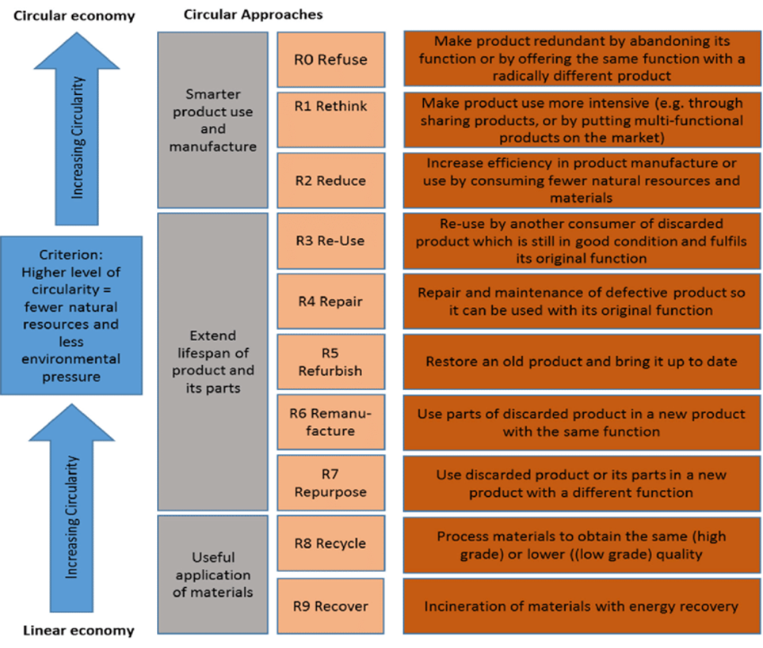
9 Rs of Circular Economy
Refuse, Rethink and Reduce (R0 – R2)
Eliminating waste at the design stage. E.g. designing for disassembly.
Reuse, Repair, Refurbish, Remanufacture, and Repurpose (R3 – R7)
Extending the lifespan of materials in a building. E.g. reuse of windows
Recycle and Recovery (R8 – R9)
Applied to building products labelled ‘waste’ by the industry, requiring technical equipment and energy inputs to create a new value. E.g. recycling concrete by crushing it into rubble for road base
Source:https://www.google.com/url?sa=i&url=https%3A%2F%2Fwww.researchgate.net%2Ffigure%2FThe-9R-Framework-of-Circular-Approaches-with-the-production-chain-in-order-of-priority_fig5_328662037&psig=AOvVaw1IQiCR9uJDlwfx1lWLyUUG&ust=1670320537396000&source=images&cd=vfe&ved=0CBAQjRxqFwoTCPCF9Iab4vsCFQAAAAAdAAAAABAE

Slide 22
For a circular economy there are 3 principles of action which apply to the building sector
Avoiding the generation of waste and pollution by design
Keep products and materials in use for as long as possible
Regenerate natural capital
Source:https://southernwasteregion.ie/sites/default/files/Circular%20Economy%20Checklist%20Construction%20Designers.pdf

Slide 23
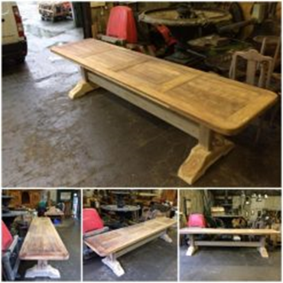
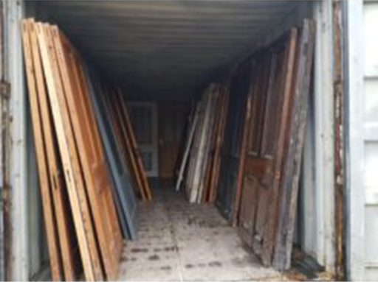
For a circular economy there are 3 principles of action which apply to the building sector
Avoiding the generation of waste and pollution by design
To achieve this, it is necessary to reduce the amount of raw materials, water and energy needed to meet the needs required at any given time, and prioritize the use of renewable energy and secondary raw materials
Source:https://southernwasteregion.ie/sites/default/files/Circular%20Economy%20Checklist%20Construction%20Designers.pdf

Slide 24
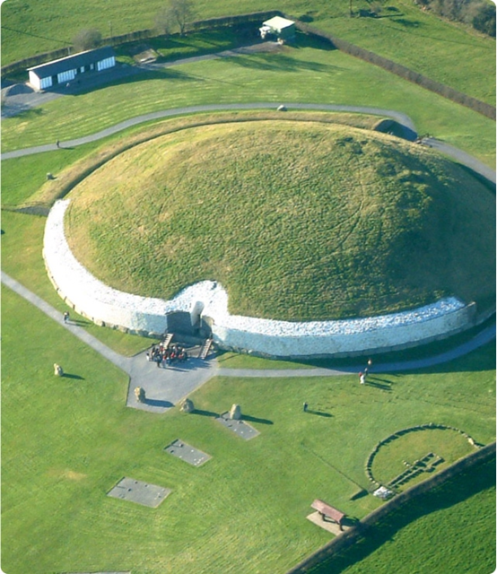
For a circular economy there are 3 principles of action which apply to the building sector
Keep products and materials in use for as long as possible
To achieve this, efficient management of the resources that are used is essential. The aim is to keep material resources in use for as long as possible and to recirculate them in the value chain as many times as possible through reuse and recycling... Energy recovery should always be the last option and landfill is not envisaged in the framework of Circular Economy.
Source:https://southernwasteregion.ie/sites/default/files/Circular%20Economy%20Checklist%20Construction%20Designers.pdf

Slide 25
For a circular economy there are 3 principles of action which apply to the building sector
Regenerate natural capital
This principle is essential to guarantee the supply of natural goods and services on which human survival and well-being depends.
The circular economy is regenerative, and is inspired by natural cycles, where everything that is born and grows returns to its point of origin, the earth, and is born again, forming a constant dynamic balance. In nature there is no "waste", all elements have a function, and are reused and transformed to be used in different stages.
Source:https://southernwasteregion.ie/sites/default/files/Circular%20Economy%20Checklist%20Construction%20Designers.pdf

Slide 26
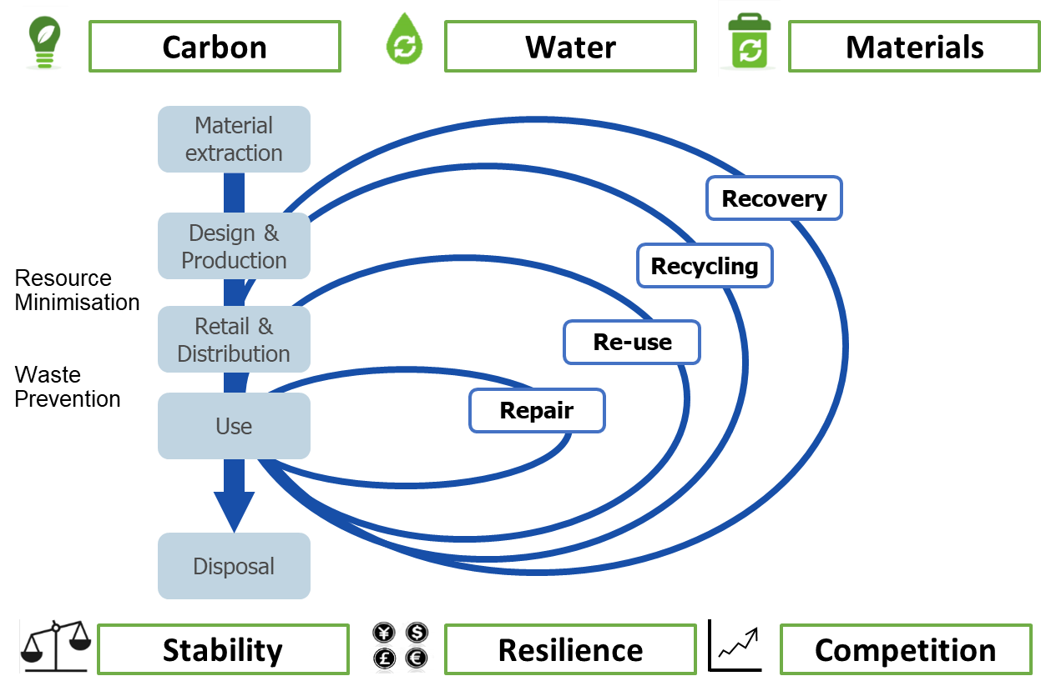
More Information: The more detailed Ellen MacArthur Foundation butterfly diagram with nutrient and technical material flows can be found by clicking this link
Source: https://gupp-\class.eu/

Slide 27
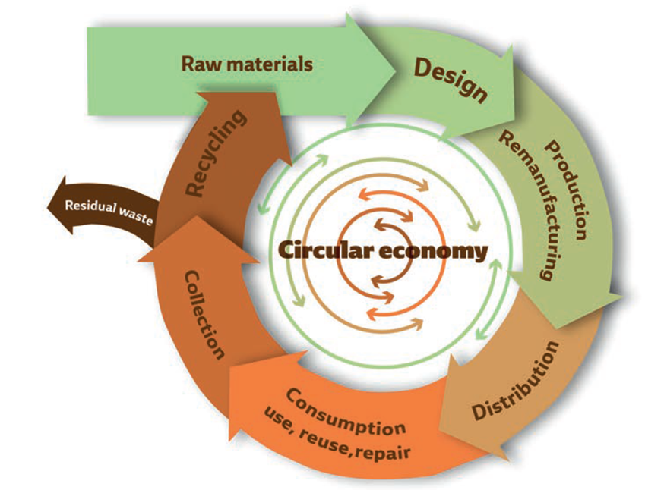
Circular Economy in the building industry
Not only does Circular Economy provide environmental benefits, it also boosts competitiveness and employment generation, with the creation of new business opportunities and innovation in products and services.
Key to achieving circularity is implementing digitalization and new technologies.

Slide 28
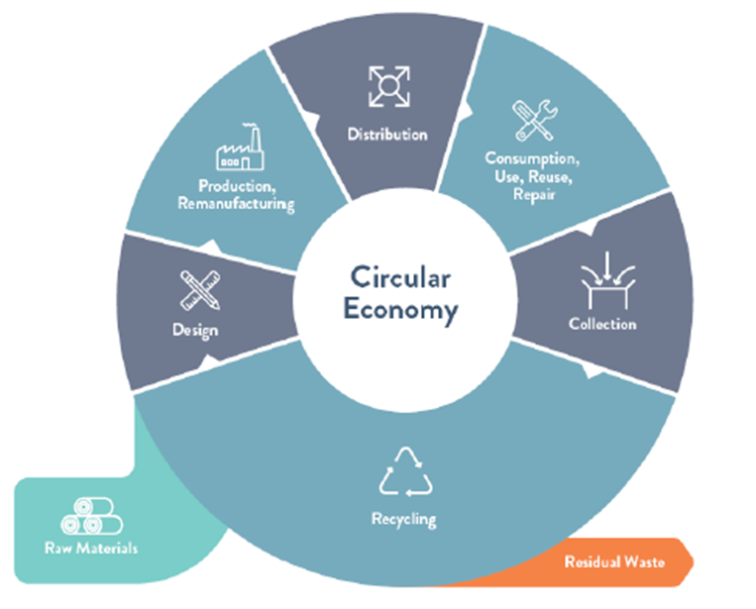
Impacts
Raw material extraction and material processing is responsible for 90% of biodiversity loss and water stress.
We need to make sustainable products, services and business models the norm and transform consumption patterns so that no waste is produced in the first place.
Source:https://www.un.org/en/actnow/facts-and-figures#:~:text=The%20extraction%20and%20processing%20of,keep%20up%20with%20our%20demands.

Slide 29
Learn more!
You can find more information about the theories on which the circular economy is based on the following website:
In this website you will find 8 videos that explain the circular economy.
In this link you will find the film “closing the loop”, with comments from world experts, as well as innovative cases of circular economy.

Slide 30
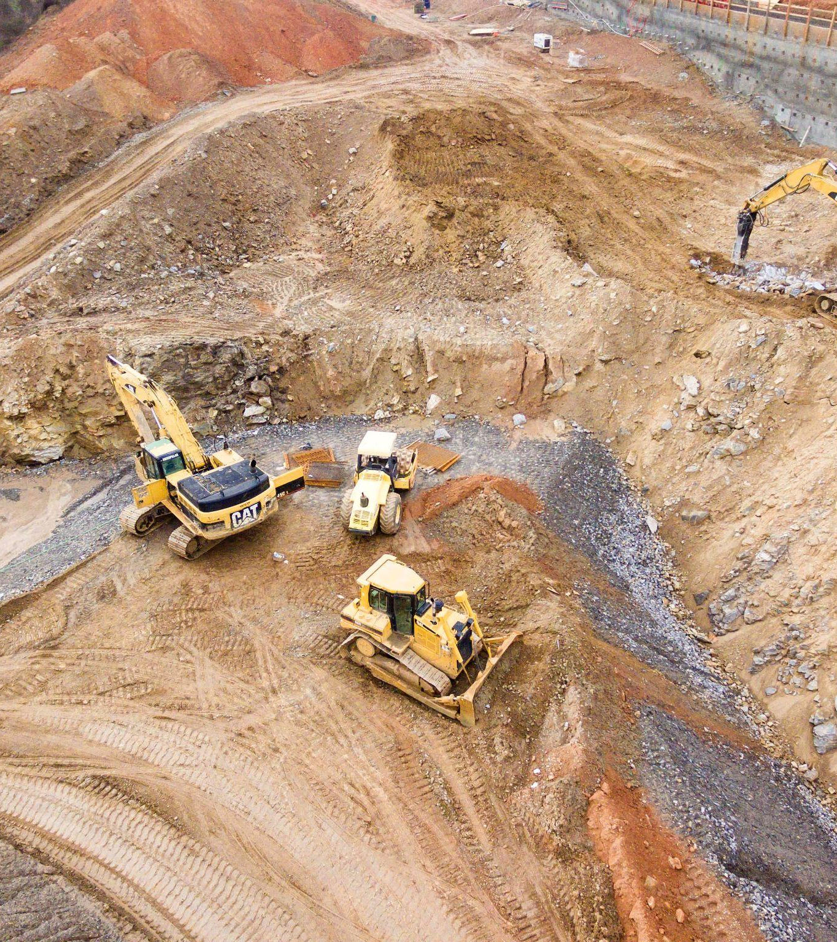
The Challenge
The need for a Circular Built Environment
Construction materials are the biggest portion of the volume of materials consumed in most cities.
Despite high demands for concrete, steel, bricks and wood only 13% of these input materials originate from secondary and renewable sources.
Moreover, buildings generate nearly 40% of annual global CO2 emissions.
Source: Circle Economy
Notes:
Construction materials are the biggest portion of the volume of materials consumed in most cities.
Despite high demands for concrete, steel, bricks and wood only 13% of these input materials originate from secondary and renewable sources.
Moreover, buildings generate nearly 40% of annual global CO2 emissions.
Against a backdrop of bold ambitions and an increasing number of policies focussed on the sector, real on-the-ground action is limited and scattered. The real challenge remains upscaling these efforts.

Slide 31
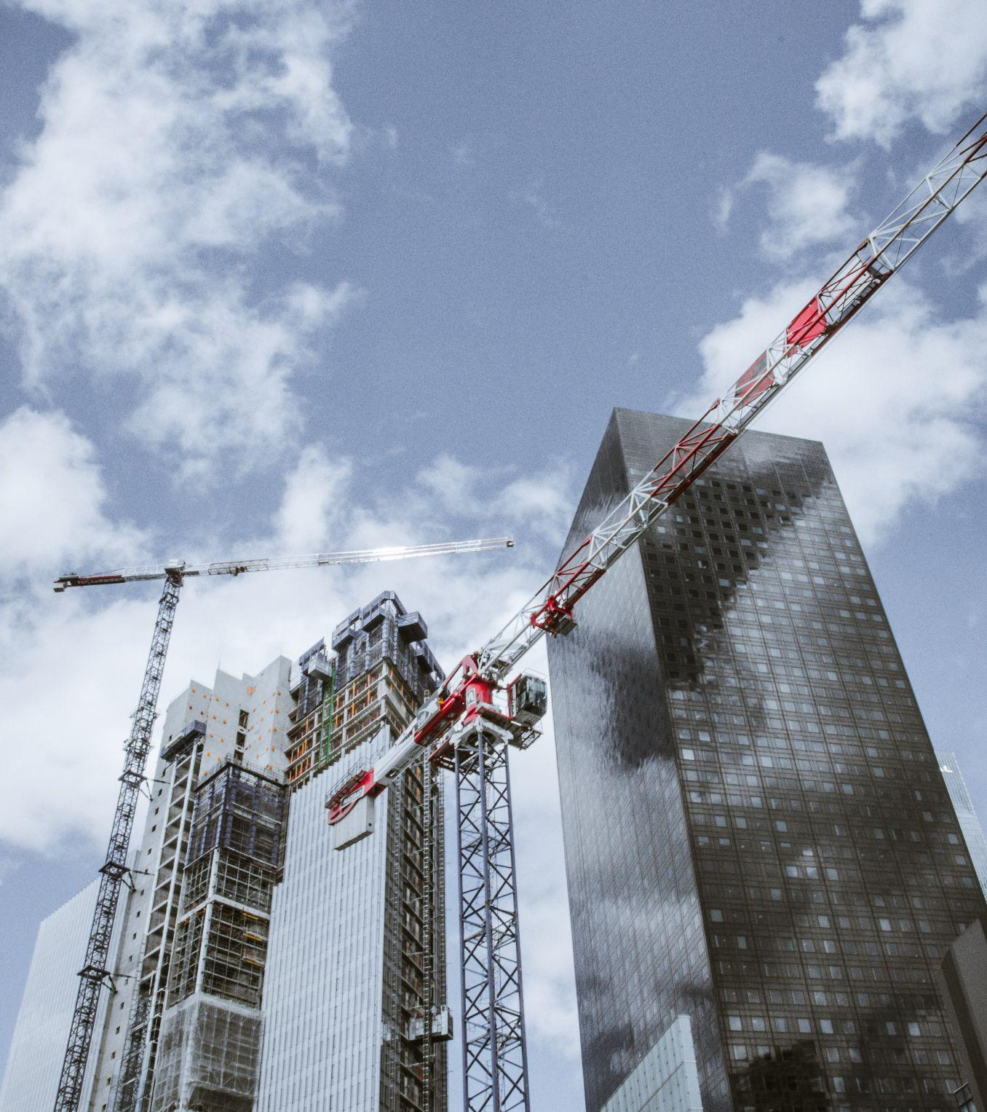
Why Care?
Why do we currently continue to mine, produce, and transport all materials from mines around the world, when there are abundant sources throughout the city to cover part of this demand?
However the most important barrier to tackle is the lack of information on what recoverable materials are present and what their value in reuse could be.
Source: Circle Economy

Slide 32
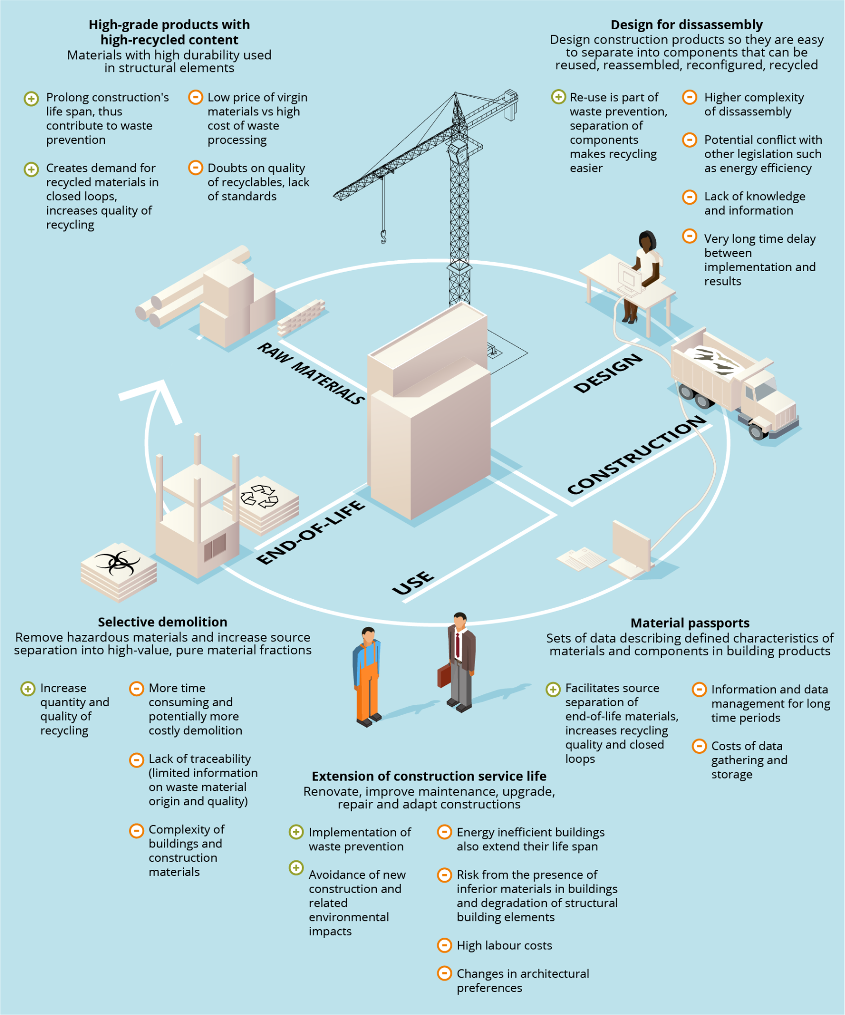
What Needs to Happen?
From current state to ideal state
Against a backdrop of bold ambitions and an increasing number of policies focused on the sector
Real on-the-ground action is limited and scattered
Collaboration is not happening at scale
Investments are lacking and demand needs to increase
In short, we need a holistic strategy that aims at:
Increasing awareness and scaling of the available opportunities
Increasing knowledge exchange and collaboration
Strengthening demand and investment in available solutions
Source: Circle Economy

Slide 33
Circular Economy in the Construction Sector
The construction sector provides infrastructures, urban spaces and buildings on which all other sectors rely on, and is therefore a key sector for European economic and social development, generating 18 million direct jobs.
In the construction sector, as in the rest of the sectors, moving from a linear model of open cycles to a circular model, of closed cycles, requires a complete systemic change.
The circular model is a sustainable model which can provide important benefits for the environment, as well as new employment and business opportunities in the sector. In the long term, all this has an impact on improving the environment, the health and well-being of users, increasing productivity, and saving costs.
Source: https://gupp-\class.eu/

Slide 34
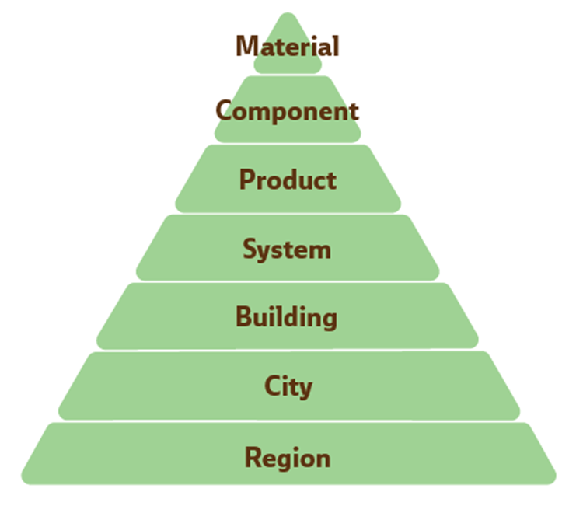
Integrating the principles of the Circular Economy in the construction sector involves addressing different levels: material, component, product, system, building, city and territory.
Source: https://gupp-\class.eu/

Slide 35
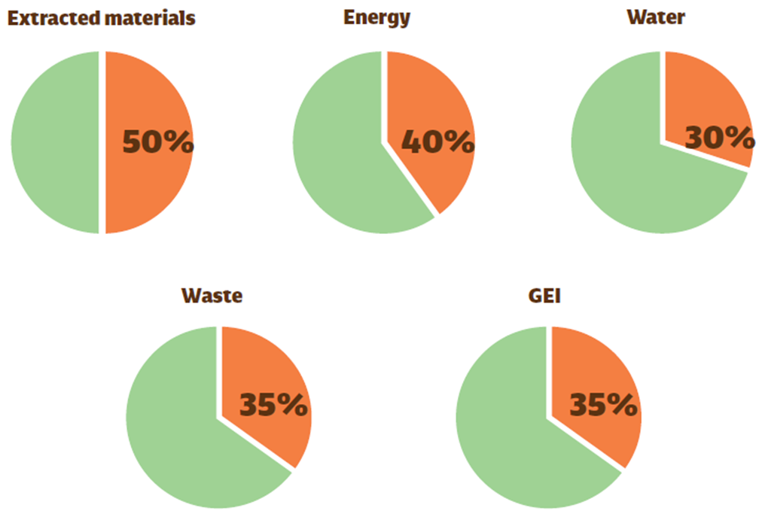
Impact
In Europe, in recent years, the data on the impact of the construction sector are as follows:
Impacts of the construction sector in Europe. Data source: Eurostat 2016 data. Green Building Council Spain. 2021. Report on circular economy in building in Spain[TS2]
GHG
Source: https://gupp-\class.eu/

Slide 36
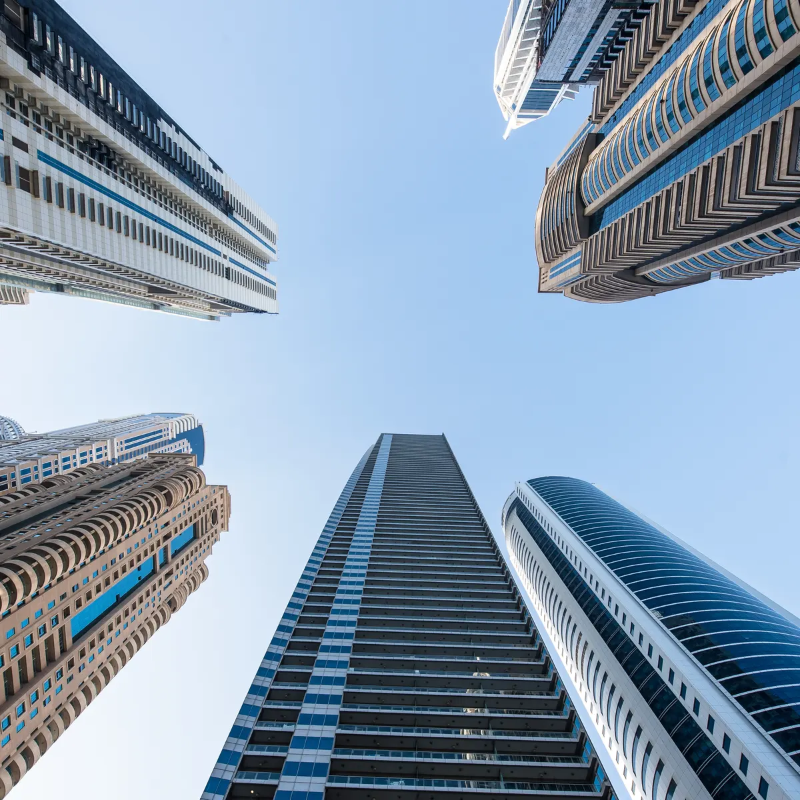
Climate Change and Building Stock
In 2010, the world’s buildings accounted for 32% of global final energy use amd 19% of all greenhouse gas (GHG) emissions.
If we continue as usual the projections for use of energy in buildings globally could double or even triple by 2050.
Even if emissions are immediately stopped, temperatures will remain elevated for centuries to come, due to the effect of greenhouse gases in the atmosphere from previous human impact.
Source: Google image search
Source: Fit-to-NZEB: Ecology & Sustainability

Slide 37
Climate Change and Building Stock
Limiting the rise in temperature will require substantial and sustained reductions of greenhouse gas emissions.
Buildings face major risk of damage from the projected impacts of climate change, having already experienced a big increase in extreme weather damage in recent decades. There is likely to be significant regional variation in the intensity and nature of such impact.
Source: Fit-to-NZEB: Ecology & Sustainability

Slide 38
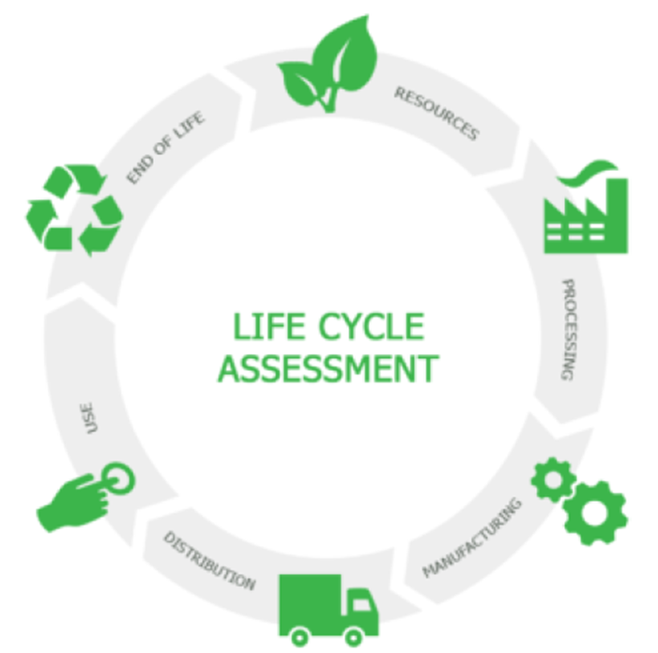
Life Cycle
The standard EN 15798:2011 (sustainability of construction works) establishes, in a generic way, the stages of the life cycle of construction.
The four stages are:
Product Stage
Construction Stage
Use Stage
End-of-Life Stage
Each stage has different effects on the environment, which depend on factors such as: the characteristics of the surroundings, the materials and construction techniques used, the energy and water consumed, the waste generated, etc.
Source: https://gupp-\class.eu/

Slide 39
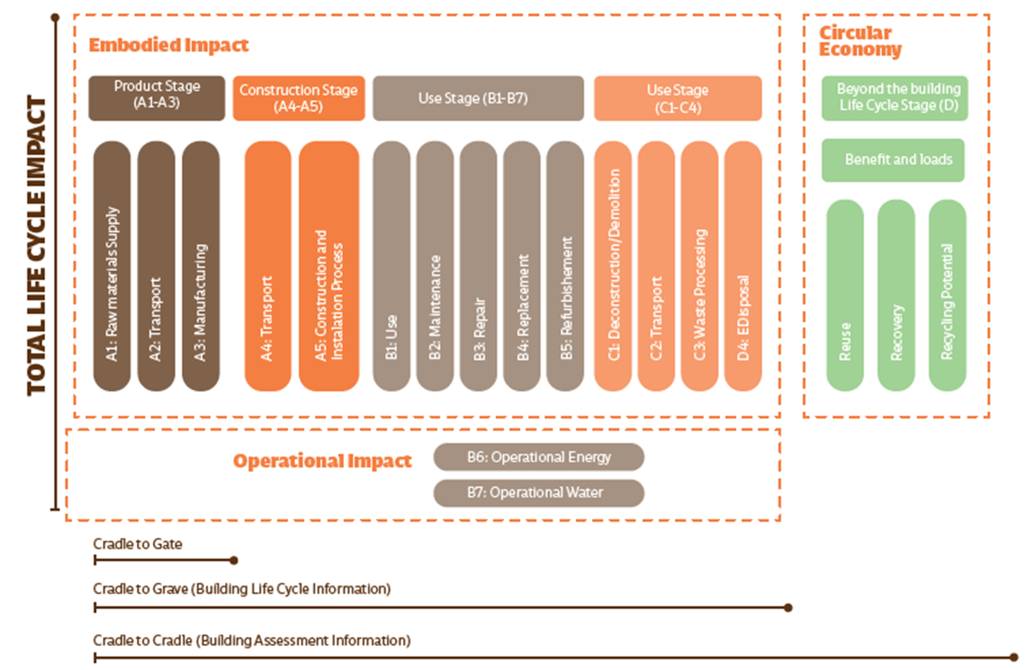
Source: https://gupp-\class.eu/

Slide 40
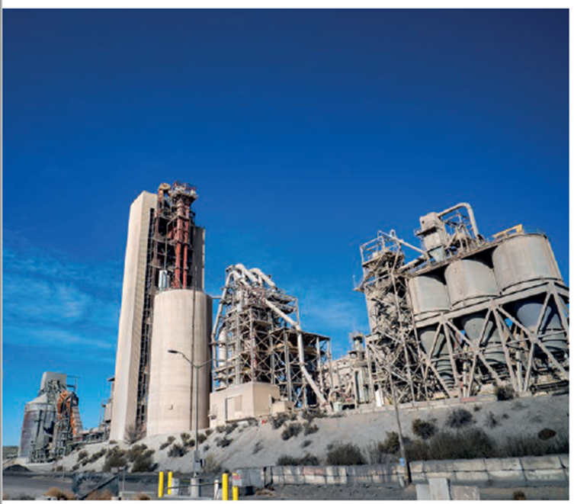
Production Stage
In the production stage, raw materials are extracted, transported and processed into building materials. This stage generates significant negative environmental impacts.
Many minerals and rocks are extracted in open-pit quarries and gravel pits, which implies, in the area of action, the elimination of vegetation, the loss of the organic matter layer of the soil and its exposure to erosion.
For example, cement manufacturing generates approximately 8% of the world’s CO2 emissions. Sixty % of these emissions are due to chemical reactions during the process.
Cement factory
Source: Green Growth Project
Source: https://gupp-\class.eu/

Slide 41
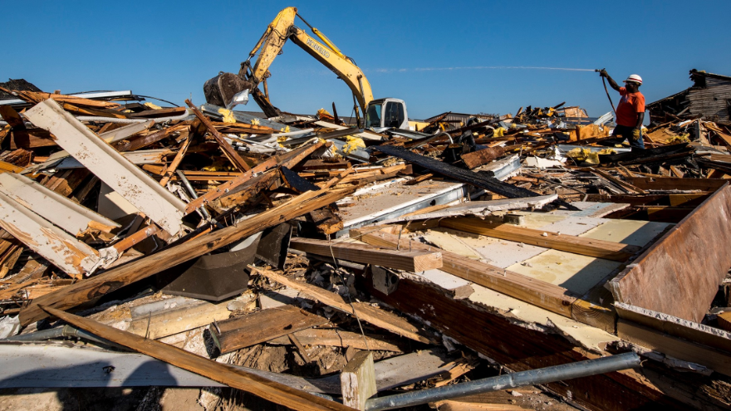
Construction Stage
In the construction stage the building takes shape and many agents are involved (city council, architects, builders, etc,.).
This stage includes the transport of materials to the site and the construction and installation process, and involves the environmental impact caused by the implantation of the building in the territory, the consumption of a large amount of materials, water and energy, as well as the production of waste from discarded materials, packaging, etc,.
Image source: Google images
Source: https://gupp-\class.eu/

Slide 42
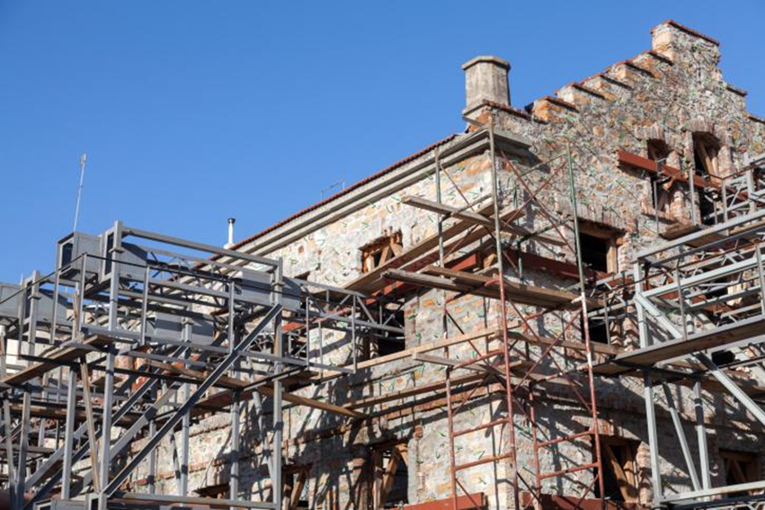
Use Stage
The use and maintenance stage of the building is the longest-lived stage. It includes maintenance, repair and renovation.
It is associated with the consumption of water, operational energy, and the emission of pollutant gases as a consequence of the consumption of energy from fossil fuels. The construction of energy efficient buildings and the integration of local renewable energy systems, at building or neighbourhood level, significantly reduces the consumption of non-renewable energy. This is the case for near-zero energy buildings (NZEB).
At this stage, circular strategies such as repair and refurbishment extend the life of the building.
Image source: Google images
Source: https://gupp-\class.eu/

Slide 43
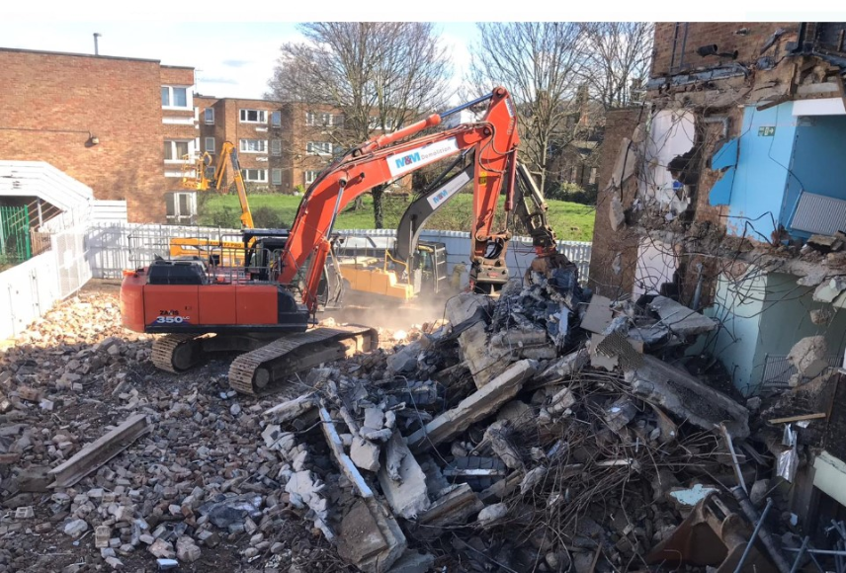
End-of-life (Deconstruction) Stage
The end-of-life stage in a linear economy is the demolition process, where materials become waste. The possibility of reinsertion into the value chain of materials at the end of their useful life depends on:
the type of materials and construction systems chosen in the design phase, and
the way in which demolition and waste management are carried out.
In this phase, the environmental impact is related to the burning of fossil fuels from machinery and transport, as well as emissions related to landfill disposal.
Image source: Google images
Source: https://gupp-\class.eu/

Slide 44
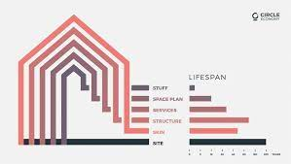
Building in layers
One technique to help envisage how to do this is to think of your project in layers and within each layer there are different opportunities:
The site should be reused continuously.
The structure should last as long as possible.
The skin and services should be accessible and replaceable.
The space plan should be flexible and adaptable.
The stuff should be durable and reusable.
Source-https://www.circle-economy.com/resources/new-financing-needed-to-accelerate-circular-built-environment
Source: https://drive.google.com/file/d/1kO6DhVUIsmICevjrKGoDLfrQTWUIjuXd/view

Slide 45
Tools to measure circularity in construction
“What cannot be measured cannot be improved”. Therefore, a series of tools have been designed to measure and compare in a quantitative and verifiable way the environmental performance buildings and materials, and others to monitor the circular economy in the construction sector, these are:
Life Cycle Assessment (LCA)
Environmental Product Declarations (EPDs)
Level(s)
Material Passports
Cradle to Cradle Certification
Source: Green Growth Project

Slide 46
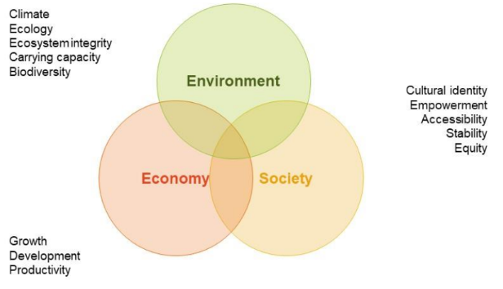
National & International Building Codes
“[A]green economy [is] one that results in improved human well-being and social equality, while significantly reducing environmental risks and ecological scarcities”, Green Jobs Report (UNEP,2008) and the Green Economics Report (UNEP, 2011a).
No country is the pan-European region has yet produced an assessment specifically focused on the green economy. Nonetheless, many countries are developing broad strategies for greening the economy, or have undertaken sectoral or topic-based assessments.
UN Environment Green Economy Initiates (GEI), a programme of global research and country-level assistance designed to motivate policymakers to support environmental investments.
Source: https://gupp-\class.eu/

Slide 47
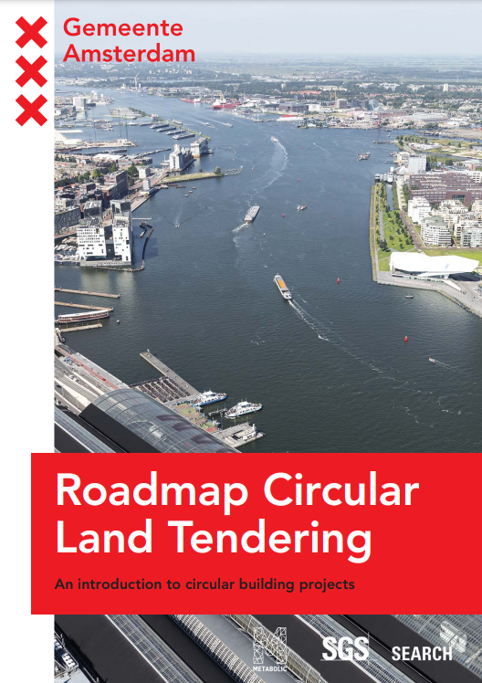
Targets and Reporting
Establishing targets and reporting structures to help achieve the client vision needs to be mandated through the procurement process in a relevant and proportionate manner. To do this, clients should embed the requirements into project-specific briefs/statements, and in the design team and contractor tendering process i.e. Pre-Qualification Questionnaire (PQQ) and Invitation to Tender (ITT) and the main construction contract (general conditions).
Source-https://www.metabolic.nl/wp-content/uploads/2019/02/roadmap_circular_land_tendering.pdf
Source: https://southernwasteregion.ie/content/circular-economy-checklists-construction

Slide 48
Targets and Reporting
Planned actions, metrics and targeted outcomes should be communicated between the client and contractor and passed down through the supply chain (including design and consultancy teams, sub-contractors, waste management contractors and material suppliers) and across all project phases – from option identification and preliminary/outline design through to project completion and whole-life management.
Taking this approach gives a legal standing to the targets and will create binding key performance indicators that gives the client recourse should these targets not be met. A robust monitoring and reporting process will be needed to follow progress and achievements against the targets and reported at key stages within the project.
Source: https://southernwasteregion.ie/content/circular-economy-checklists-construction

Slide 49
Further reading
Irish Green Building Council (IGBC) - Towards a circular economy in construction: Assessing low carbon, healthy, responsible products for the construction sector
https://www.igbc.ie/wp-content/uploads/2018/06/IGBC-Report-Web-Final-21.06.18.pdf
UK Green Building Council (UKGBC) - Circular economy guidance for construction clients: How to practically apply circular economy principles at the project brief stage
https://www.ukgbc.org/ukgbc-work/circular-economy-guidance-for-construction-clients-how-to-practically-apply-circular-economy-principles-at-the-project-brief-stage/
Circular Economy Implementation Packs for Products as a Service and Reuse
https://www.ukgbc.org/ukgbc-work/circular-economy-implementation-packs/

Slide 50
Further reading
Zero Waste Scotland - Construction Resources For a Circular Economy Procuring resource efficient construction projects
https://zerowastescotland.org.uk/content/procuring-resource-efficient-construction-projects
ARUP - Circular Economy in the Built Environment
https://www.arup.com/perspectives/publications/research/section/circular-economy-in-the-built-environment

Slide 51
Key Elements
The Key Elements framework is a conceptual framework of eight elements of circularity that can be applied at different intervention levels (for example, national, regional, sector, business, product, process, or material) towards a circular economy.
The KE framework consists of three core elements and five enabling elements. Core elements deal with physical flows directly, whilst enabling elements deal with creating the conditions or removing barriers, for a circular transition.
Source:https://www.circle-economy.com/resources/the-key-elements-of-the-circular-economy-framework#:~:text=WHAT%20IS%20IT%3F,material)%20towards%20a%20circular%20economy

Slide 52
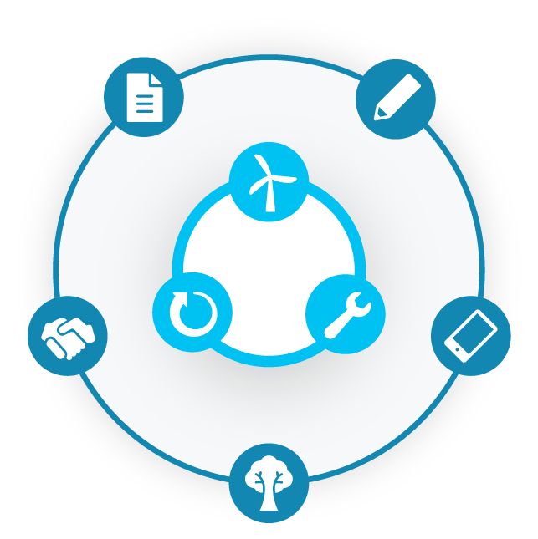
Core Elements
Prioritise
Regenerative
Resources
Stretch the
Lifetime
Use Waste as a
Resource
Source:https://www.circle-economy.com/resources/the-key-elements-of-the-circular-economy-framework#:~:text=WHAT%20IS%20IT%3F,material)%20towards%20a%20circular%20economy.
Notes:
The inner circle of the framework is the core elements
The core elements of the circular economy relate to direct circular handling of material and energy
There are 3 core elements
Prioritise Regenerative Resources: Ensure renewable, reusable, non-toxic resources are utilised as materials and energy in an efficient way.
Stretch the lifetime: While resources are in-use, maintain, repair and upgrade them to maximise their lifetime and give them a second life through take back strategies when applicable.
Use waste as a resource: Utilise waste streams as a source of secondary resources and recover waste for reuse and recycling.

Slide 53
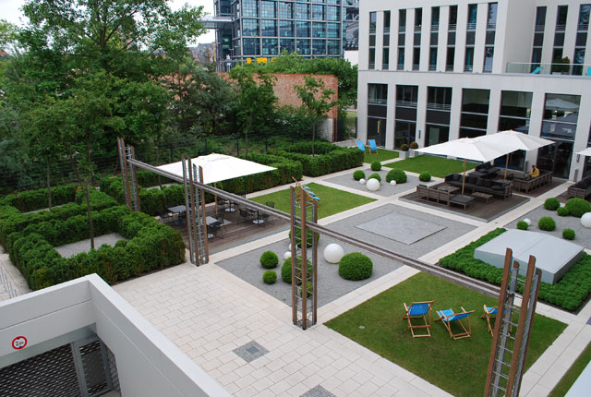
PRIORITISE REGENERATIVE RESOURCES
RAINWATER USE
PRIORITISE REGENERATIVE RESOURCES
Ensure renewable, reusable, non-toxic resources are utilised as materials and energy in an efficient way.
Keywords:
alternative bio-based materials ◦ reusable materials ◦ non-toxic materials ◦ non-critical materials ◦ material efficiency ◦ alternative water use ◦ water efficiency ◦ renewable energy ◦ energy efficiency electrification ◦ recyclable materials
Example on water efficiency:
Berlin (Germany) is becoming a sponge city, simply put, it promotes natural measures that allow the water system of the city to operate more naturally through green infrastructure projects. .
Find out more!

Slide 54
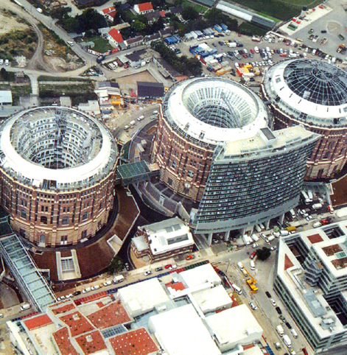
STRETCH THE LIFETIME
REPAIR AND REFURBISHMENT
STRETCH THE LIFETIME
Maintain, repair and upgrade resources in use to maximise their lifetime and
give them a second life through take-back strategies, where applicable.
Keywords:
upgradeability ◦ maintenance & (self) repair ◦ take-back systems ◦ secondary materials ◦ adaptive reuse ◦ refurbishment ◦ remanufacturing ◦ part or component recovery ◦ preservation & conservation
Example on adaptive reuse:
Four immense disused gasometers in Vienna were successfully revamped into apartment blocks and commercial space as the structures were too beautiful to be demolished.
Find out more!
Notes:
The second element is Stretch the lifetime
While resources are in-use, the aim is to maintain them for as long as possible through repair and upgrade and give them a second life through take back strategies when applicable.
A great example here is The North Face Renewed project. They collaborate with the Renewal Workshop - an external partner - to refurbish and repair North Face clothing through an eight step process. The refurbished garments are resold online at a slightly discounted price, with an additional 1 year long warranty.

Slide 55
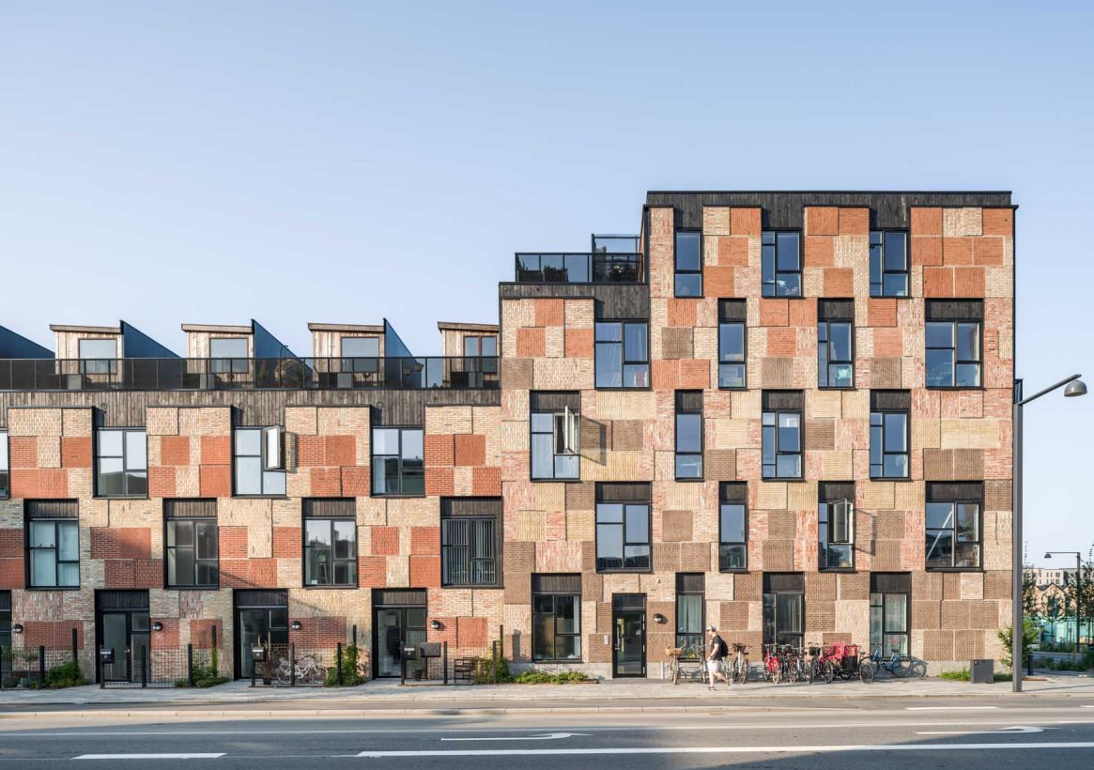
USE WASTE AS A RESOURCE
RECYCLED MATERIAL
USE WASTE AS A RESOURCE
Utilise waste streams as a source of secondary resources and recover waste for
reuse and recycling.
Keywords:
reuse ◦ repurposing into new products ◦ using already recycled materials ◦ recovery and reuse of waste energy ◦ mechanical recycling ◦ chemical recycling ◦ open loop ◦ closed loop
Example on reuse:
The Resource Rows is using upcycled bricks and waste wood, a recycled concrete beam used as a bridge and old windows and waste wood as rooftop community gardens huts with an atmosphere of allotment gardens.
Find out more!
Ørestad, Copenhagen
Notes:
The third and last core element is Use waste as a resource.
This is about utilising waste streams as a source of secondary resources and recovering waste through reuse, redesign and recycling.
Here an example of partnership between Stussy and the Artisan Project

Slide 56
Enabling Elements
Design for the
Future
Rethink the
Business Model
Incorporate Digital
Technology
Team Up to Create
Joint Value
Strengthen and
Advance Knowledge
Source:https://www.circle-economy.com/resources/the-key-elements-of-the-circular-economy-framework#:~:text=WHAT%20IS%20IT%3F,material)%20towards%20a%20circular%20economy.
Notes:
Then, apart from the core 3 CORE elements, there are 5 ENABLING ELEMENTS.
These are elements that support the implementation and uptake of circularity by removing some of the obstacles for core elements—for example, using waste as a resource is difficult to implement unless the products have been designed with eventual recycling in mind - hence design for the future is an enabling element. Stretching the lifetime of a product can be enabled through new business models such as rental and resale.
There are 5 enabling elements
Design for the future: Account for the systems perspective during the design process, to use the right materials, to design for appropriate lifetime and to design for extended future use.
Rethink the business model: Consider opportunities to create greater value and align incentives through business models that build on the interaction between products and services.
Incorporate digital technology: Track and optimise resource use and strengthen connections between supply chain actors through digital, online platforms and technologies that provide insights.
Team up to create joint value: Work together throughout the supply chain, internally within organisations and with the public sector to increase transparency and create joint value.
Strengthen and advance knowledge: Develop research, structure knowledge, encourage innovation networks and disseminate findings with integrity.
All around the world, countries, regions, cities and businesses are adopting these strategies. As part of the follow-up package today, we will share more information on the 8KE framework, with live case studies of each strategy.
But, today's focus is on the first enabling element on this sheet - Designing for the Future.

Slide 57
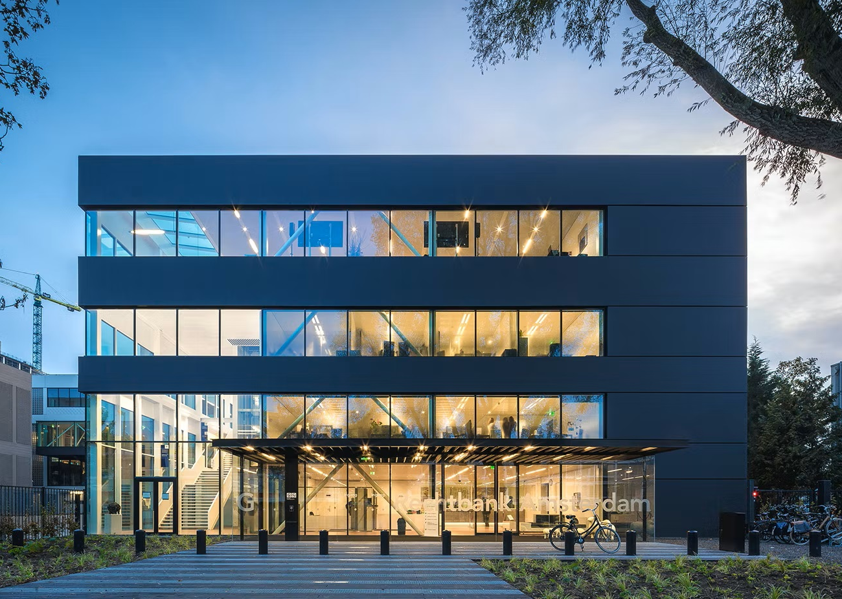
DESIGN FOR THE FUTURE
MODULARITY
DESIGN FOR THE FUTURE
Adopt a systemic perspective during the design process, to employ the right
materials for appropriate lifetime and extended future use and optimal recovery..
Keywords:
modularity ◦ dis- & reassembly ◦ reuse ◦ physical durability ◦ standardization & compatibility ◦ maintenance & repair ◦ adaptability & upgradability ◦ material recycling ◦ biodegradability ◦ mono-materials ◦ emotional durability ◦ design for reverse systems
Example on design for disassembly:
The temporary courthouse building has been designed with a well adaptable configuration of parts that can be easily assembled and disassembled , to render the structure as customizable and circular as possible.
Find out more!
Temporary courthouse
Notes:
The first ENABLING element is Design for the future.
Design out the future is concerned with the way we create, and aims to take into account a circular perspective from the beginning of the design process to use the right materials, to design for appropriate lifetime and to design for extended future use.
This element will be discussed extensively later on regarding apparel, so a non textile example is fairphone, the smartphone brand based in the Netherlands.
A Fairphone is a modular smartphone, built for dissassembly, Because of its modularity, the lifespan of the phone doesn't depend on breakdown of one part of the product. In this way you don't have to buy a complete new phone when for example the battery stops working, or when the camera doesn't work anymore. The parts can be replaced independently.
--------------------------
Fairphone's strategy is to make a product with 'minimal damage to people and planet'. They do this by looking for honest elements, for example tantalum in warfree zones, or to look at improved employment conditions. Another example is the reuse of used phone covers. Fairphone partnered with a company named vanPlestik, who melts the used phone covers to 3d print material.
In April 2019 the sales of the fairphone 2 stopped, by then they have sold around 100.000 of the product. They are currently on the market with the fairphone 3.

Slide 58
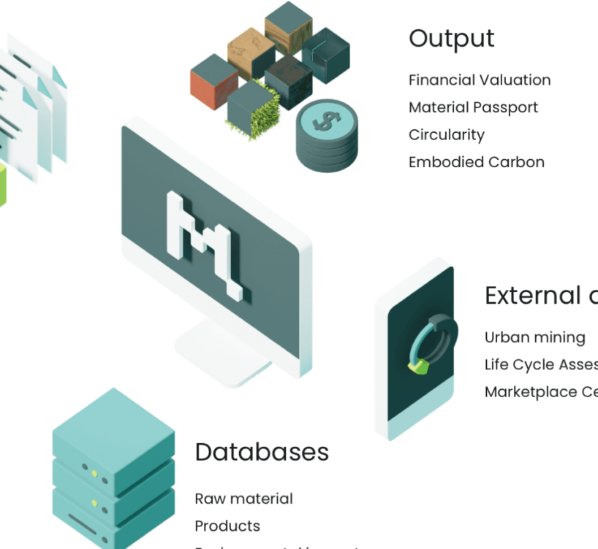
RETHINK THE BUSINESS MODEL
RENTAL SUBSCRIPTION
INCORPORATE DIGITAL TECHNOLOGIES
Track and optimise resource use and strengthen connections between supply-chain
actors through digital, online platforms and technologies.
Keywords:
data analytics ◦ data modelling ◦ internet enabled, connected operations ◦ sensors, monitoring systems ◦ additive manufacturing ◦ artificial intelligence ◦ online platforms ◦ peer-to-peer online marketplaces ◦ Material passports
Example on material passport:
Madaster is the online library of information on materials and products that provides insight into the materials and products used and their location, as well as their impact on circularity and the environment.
Find out more!
Notes:
Rethink the business model - Talks about creating greater value and align incentives to build on. Think of the interaction between products and services, and specifically optimizing usage.
In fashion we are seeing a huge flux in rental and re-commerce business models. One of the pioneers in the space of rethinking their business model is a company previously known as Vigga- now Circos. They run a clothing rental subscription for babies. So as the baby grows, you have access to a changing wardrobe of size appropriate clothes.

Slide 59
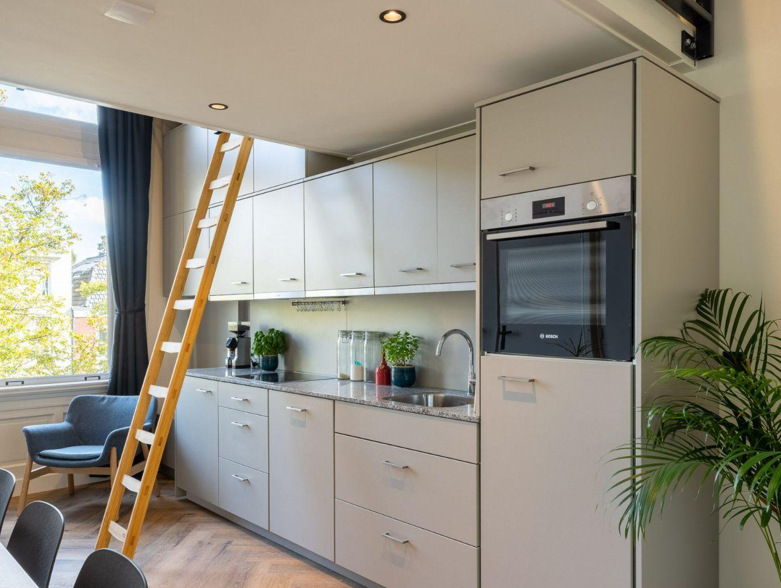
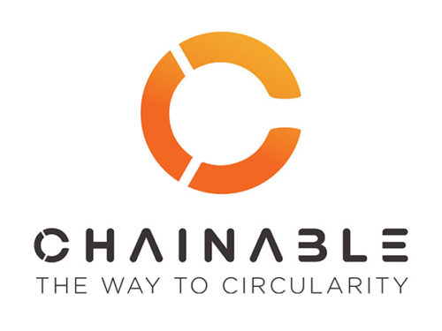
RETHINK THE BUSINESS MODEL
RENTAL SUBSCRIPTION
RETHINK THE BUSINESS MODEL
Consider opportunities to create greater value and align incentives through
business models that build on the interaction between products and services.
Keywords:
sale of durable, long-lasting goods ◦ sale of exchangeable parts ◦ peer to peer sharing or resale ◦ leasing ◦ rental ◦ pay per use ◦ crowd-based services ◦ subscription based products and services
Example on product-as-a-service:
Chainable supplies modular and circular kitchen for residential projects through a circular business model: Kitchen-as-a-service to ensure a circular supply chain.
Find out more!
Notes:
Rethink the business model - Talks about creating greater value and align incentives to build on. Think of the interaction between products and services, and specifically optimizing usage.
In fashion we are seeing a huge flux in rental and re-commerce business models. One of the pioneers in the space of rethinking their business model is a company previously known as Vigga- now Circos. They run a clothing rental subscription for babies. So as the baby grows, you have access to a changing wardrobe of size appropriate clothes.

Slide 60
TEAM UP TO CREATE JOINT VALUE
SHARING RESOURCES
TEAM UP TO CREATE JOINT VALUE
Work together throughout the supply chain, internally within organisations and
with the public sector to increase transparency and create shared value.
Keywords:
Internal collaboration ◦ industry collaboration ◦ government collaboration ◦ community collaboration ◦ industrial symbiosis
Example on industrial symbiosis:
The 30 meters of plastic bike path contain recycled plastic equivalent to more than 218.000 plastic cups or 500.000 plastic bottle caps. An example of collaboration between bottle and construction supply chain.
Find out more!
Plastic Road

Slide 61
STRENGTHEN AND ADVANCE KNOWLEDGE
Develop research, encourage innovation networks, structure and disseminate
information with integrity.
Keywords:
education ◦ curriculum ◦ knowledge management ◦ research and development ◦ communication and awareness ◦ co-creation ◦ living labs
Example on co-creation:
Digital solutions for smart urban mobility, energy efficiency, sustainable housing, digital public services, and civic-led governance. Through co-creation with citizens, the aim is to bring the economic and social benefits of this transformation to all local communities.
Find out more!

Slide 62
MGRFIE - Multifunctional Green Roofs Facades and Interior Elements

Slide 63
What are MGRFIE
MGRFIE - Multifunctional Green Roofs Facades and Interior Elements
A green roof or living roof is a roof of a building that is partially or completely covered with vegetation and a growing medium, planted over a waterproofing membrane. MGRFIE encompases green roofs, facades and interior elements that can involve several other uses such as, energy and water collection and storage and accessibility for public and private use.

Slide 64
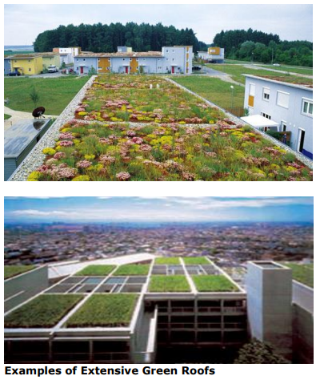
What are Green Roofs?
Green Roofs are made up of layers that create an environment suitable for vegetation to grow. They are becoming increasingly important as a mechanism in attenuating stormwater run-off from sites.
Source: https://www.dlrcoco.ie/sites/default/files/atoms/files/appendix16.pdf

Slide 65
Types of Green Roofs
There are two main types of Green Roof – Intensive and Extensive.
Intensive Green Roofs or Roof gardens provide similar benefits as a small urban park. They have a deep layer of soil, which can support a range of plants, trees and shrubs. Native species (plants which would grow naturally in the local area) can provide a rich habitat for wildlife. Intensive Green Roofs are designed to include access for people. These Roofs may require regular maintenance.
Source: https://www.dlrcoco.ie/sites/default/files/atoms/files/appendix16.pdf

Slide 66
Types of Green Roofs
Extensive Green Roofs are more lightweight with a shallow soil layer and are not normally designed to provide access for people. They need little maintenance. There are three main types of Extensive Green Roof.
Extensive Green Roofs, which are made up of sedum or vegetated mats – fabric mats that are prepared before the Green Roof is built. The mats are sprinkled with sedum cuttings. These are then left in appropriate conditions to grow into the fabric mat. Once the mats are ready, they are rolled up and delivered to the construction site and laid down on to the roof.
Extensive Green Roofs where a soil layer is laid down and then planted directly with small plants. These plants (often sedum) will have been grown in small pots. They are often known as plug plants.
Extensive Green Roofs where the soil layer is laid down and then planted with seeds (which are suitable for the local environment), this type of roof is often known as a biodiverse or Brown Roof.
Source: https://www.dlrcoco.ie/sites/default/files/atoms/files/appendix16.pdf

Slide 67
Green Roofs
Notes:
Extensive – natural low maintenance green roofs
Adapted plant communities- sedum plants, bulbs, wild flowers and succulents lower contribution to urban climate and biodiversity
Lower social co-benefits (often inaccessible)
Minimal maintenance required (supply of water and nutrients mostly through natural processes)
Shallow build-up height (30-150 mm)
Weight 50-250 kg / m²
Low capital cost
Less technical expertise needed
Easy to implement as a retrofitting method for existing structures
Intensive – parks and gardens including urban agriculture
Ornamental lawn, summer flowers, demanding shrubs, bushes and trees
Higher contribution to urban climate and biodiversity
High social co-benefits i.e. recreation, agriculture
Regular maintenance required
Build-up height depending on plant selection vary between 300-1000 mm
Weight >150 kg/m² up to 2000 kg/m²
Higher capital cost
More complex systems and greater expertise needed
More suitable for particularly sturdy

Slide 68
Green walls

Slide 69
Green roof/facades benefits
Reduction of Urban Heat Island and improvement of urban microclimate
Water retention
Thermal Performance
Air Quality
Sound Insulation
Biodiversity
Amenity Space
Urban Agriculture
Protection of Waterproofing
Protection of Building Stock
METAL FACADE
GREEN FACADE
Source: Bez názvu-1 (zivestavby.cz)
EFB | European Federation of Green Roof Associations (efb-greenroof.eu)
Notes:
Reduction of Urban Heat Island and improvement of urban microclimate
Research in Tyndale Centre for climate change suggests we need a 10% increase in green space in our cities to combat climate change. This is particularly relevant to the reduction in the Urban Heat Island Effect [UHIE]. Green roofs are recognized to have a positive effect on reducing the UHIE
Water retention
Green roofs can significantly reduce the surface run off volumes and rates of rainfall leaving roofs. As a source control mechanism in the Sustainable Urban Drainage System green roofs can help reduce flash floods as a consequence of intense rainfall events. This will become increasingly important as a consequence of climate change.
Green roofs also improve the quality of water and although the amount of water is reduced it is possible to rainfall harvest from roofs that have been greened.
Thermal Performance
Green roofs cannot be given a U-value at present. However they have been shown to significantly reduce the need for air conditioning in summer and can provide a degree of insulation in winter.
Air Quality
Airborne particles and pollutants are filtered from the atmosphere by the substrates and vegetation on a green roof.
Sound Insulation
The combination of soil, plants and trapped layers of air within green roof systems can act as a sound insulation barrier. Sound waves are absorbed, reflected or deflected. The growing medium tends to block lower sound frequencies whilst the plants block higher frequencies.
Biodiversity
Green roofs can provide important refuges for wildlife in urban areas. Research in Switzerland and the UK has demonstrated that green roofs can provide important refuges for rare invertebrate populations.
Protection of Waterproofing
The original green roofs in Germany stem from covering wet bitumen with 6cm of sand, which became vegetated. This covering was to protect the wet bitumen from fire. Green roofs have now been shown to double if not triple the life of waterproofing membranes beneath the green roof.
Amenity Space
In dense urban environments there is often a lack of green space for residents. Roof Gardens and roof top parks provide important green spaces to improve the quality of life for urban residents.
Urban Agriculture
Urban Rooftop Food Growing – roofs strong enough to provide a space for urban food growing. Although many large flat roofs may not have the loading capabilities to hold food growing, some roofs will and the many balconies in urban areas are ideal.
Protection of Building Stock
A well-designed green wall is a natural protective shield against negative impacts and contributes to the prolongation of life of building stock. Climbing plants act like a green curtain, the leaves form a shed structure and protect the surface. The drainage effect of the roots helps to retain the foundations dry. Green walls have a temperature-balancing effect. They function as a thermal insulation. In addition, they provide protection against UV radiation, pollutants, dirt, and thereby inhibit the fatigue of materials. Green walls can be an effective, low-cost and low-maintenance facade protection against graffiti as well.

Slide 70
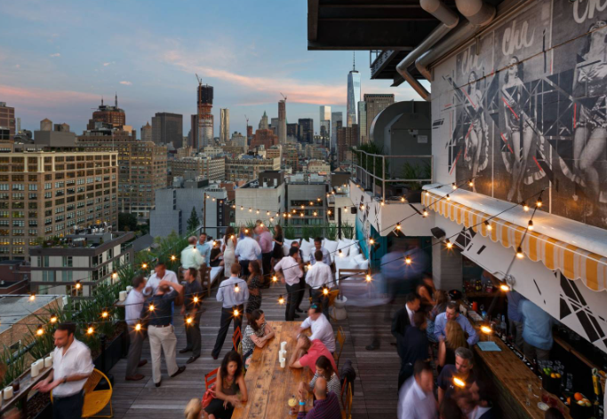
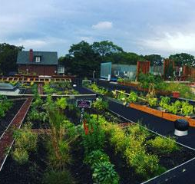
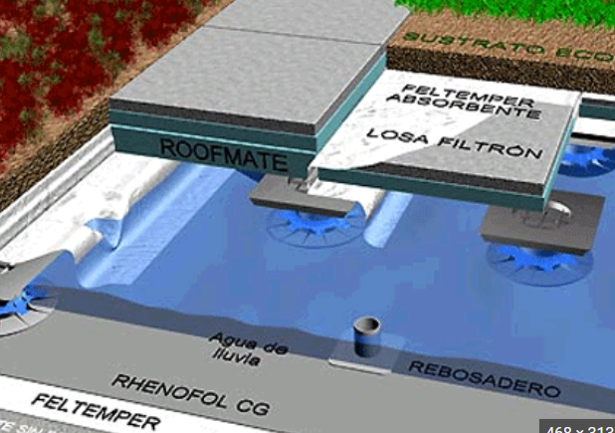
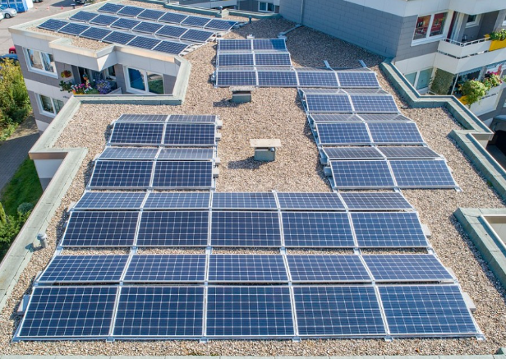
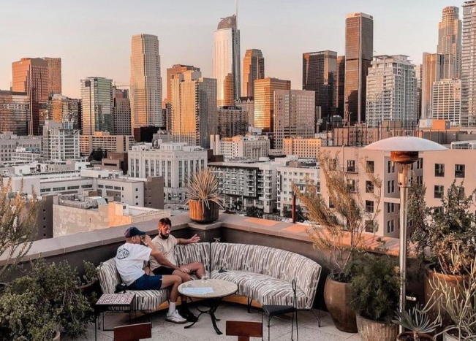
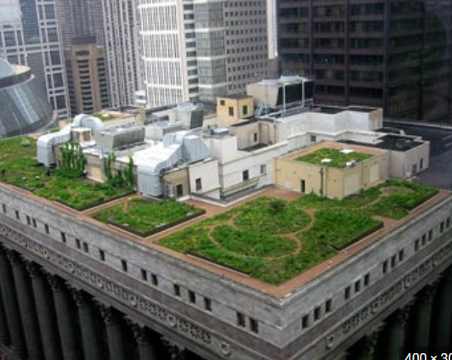
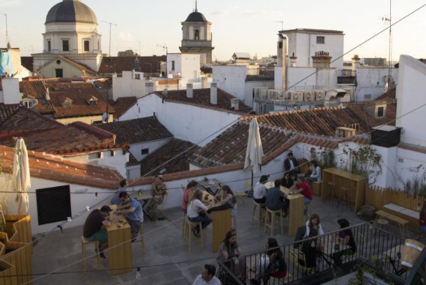
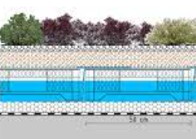
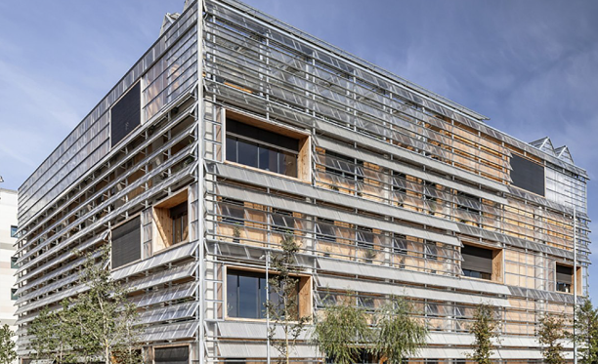
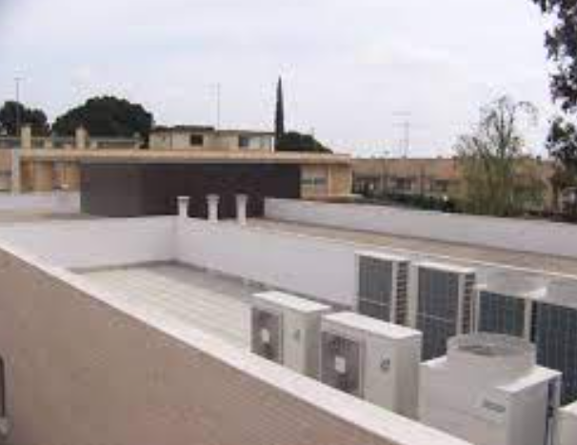
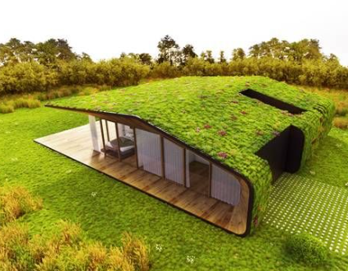
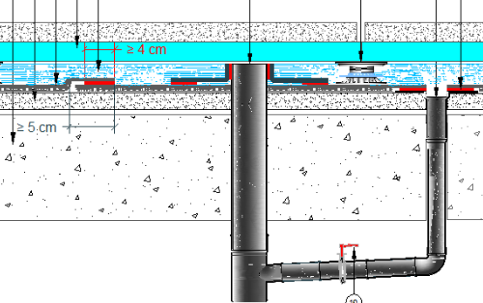
Types of Multifunctional green roofs, façades, and interior elements
FUNCTION
BY COLOUR - CODE
GREEN
BLUE
YELLOW
RED
GREY
Vegetation (from moss, grass to trees) and horticulture
Water retention and harvesting
Generate sustainable energy (power or heat)
Used for social functions
Host technical functions
Notes:
Combine multiple functions in order to maximize the return of a roof or façade or even interior elements.

Slide 71
Green + Red
Green + Grey
Blue + Green
Rooftop garden - Green Conceptors
Green + Red
The blue green roof - helping cities cope with stormwater (livingroofs.org)
Green + Grey + Red
Green roof gardens
The best FREE water play spots in Singapore! | HoneyKids Asia
10 KEY BENEFITS OF ROOF GARDENS — Todd Haiman Landscape Design
Rooftop Farming Is Getting Off The Ground : The Salt : NPR
Notes:
Combine multiple functions in order to maximize the return of a roof or façade or even interior elements.

Slide 72
Solar green facades
Solar green roofs
Rooftop and/or Facade root wastewater treatment plant
Zelená střecha, zelená fasáda, kořenová čistírna (zivestavby.cz)
EFB | European Federation of Green Roof Associations (efb-greenroof.eu)
Green + Yellow + Red
Copenhagen’s Four-Fold Path to Carbon Neutrality (renewableenergyworld.com)
The solar cells of tomorrow come in all colours and patterns (stateofgreen.com)

Slide 73
Interior green walls (living walls)
Source:Living Walls Planters Canada | Vertical Oxygen
https://livewall.com/

Slide 74
12 Spectacular Garden Walls and Atriums Worth Contemplating (forbes.com)
Benefits of interior green walls
Better Air
Better Acoustics
Health & Wellbeing
Productivity & Creativity
Workplace Satisfaction
Learn about 9 Benefits of an Indoor Living Green Wall – Biotecture
Notes:
1. Better Air
Measurable Indoor Air Quality (IAQ) is a key indicator of the health and wellbeing of our indoor spaces. There is considerable scientific evidence as to the ability of plants to improve the air.
Plants remove significant quantities of VOCs from the air
Plants reduce CO2 levels by 10 to 25%
2. Better Acoustics
Plants absorb, diffract and reflect sound. The balance varies with the frequency at which the sound is generated and the room’s physical properties. The number of plants, the size of the plants and their surface area will all affect its ability to absorb sound. Plants alter room acoustics by reducing the reverberation time. They tend to work better in acoustically live spaces, such as those that have hard surfaces like marble walls, exposed concrete and stone floors.
3. Building Integration
The introduction of large numbers of plants into our workspaces and other interior spaces has the potential to be included within the design strategy of spaces. The plants will improve oxygen balance (for the better), remove toxins and balance humidity etc. The potential for plants to be included within building strategies as part of EcoSystem Services becomes a reality at scale.
Our Biotecture Living Walls offer the potential to introduce lots of plants into spaces in a dynamic system. The environmental benefits of the plants can be evaluated and incorporated into M&E calculations so that, for instance, the number of air changes per hour needed can be reduced because the building is producing some of its own fresh air needs. A well designed internal living wall can potential reduce HVAC energy loads. Form and Function.
1. Health & Wellbeing
The environmental benefits of plants in our spaces are good for our physical wellbeing. Cleaner air means fewer headaches. Being surrounded by plants is also good for our mental health. Our intrinsic connection with nature is often lost or forgotten particularly during the working week. Viewing plants, even peripherally, restores this connection.
Internal living walls set large numbers of plants within the vision of people who are otherwise often captive in unnatural environments. Questionnaire studies show that this is enough to redress the balance we need in our lives.
There is overwhelming evidence which demonstrates that the design of an office impacts the health, wellbeing and productivity of its occupants. Furthermore it is increasingly clear that there is a difference between office environments that are simply not harmful – i.e. the absence of ‘bad’ – and environments that positively encourage health and wellbeing, and stimulate productivity.
2. Productivity & Creativity
A number of studies including one commissioned by Biotecture have shown significant benefits in terms of productivity and creativity when we can see plants whilst carry out tasks. This leads to potential returns on investment.
Data from the findings of the study The Relative Benefit of Green Versus Lean Office Space: Three Field Experiments Nieuwenhuis, Knight, Postmes, Haslam as published in the Journal of Experimental Psychology 2014 indicate that a green working environment is consistently more enjoyable for employees, more conducive to concentration, and more productive for the business than its lean equivalent. Indeed, simply enriching a previously spartan space with plants served to increase productivity by 15%. Accordingly, the results point to the value of introducing plants into a workspace for the benefit of employees as well as for the financial health of the organisation. This conclusion is at odds with the present economic and political zeitgeist as well as with modern management techniques, yet it nevertheless identifies a pathway to a more enjoyable, more comfortable, and a more profitable form of office-based working.
3. Botanic Art
Nature restores mental functioning in the same way that food and water restore bodies. The business of everyday life — dodging traffic, making decisions and judgment calls, interacting with strangers, answering emails — is depleting, and what man-made environments take away from us, nature gives back. There’s something mystical and, you might say, unscientific about this claim, but its heart actually rests in what psychologists call attention restoration theory (ART). According to ART, urban environments are draining because they force us to direct our attention to specific tasks (e.g., avoiding the onslaught of traffic) and grab our attention dynamically, compelling us to “look here!” before telling us to instead “look over there!” These demands are draining — and they’re also absent in natural environments. Forests, streams, rivers, lakes, and oceans demand very little from us, though they’re still engaging, ever changing, and attention-grabbing. The difference between natural and urban landscapes is how they command our attention. While man-made landscapes bombard us with stimulation, their natural counterparts give us the chance to think as much or as little as we’d like, and the opportunity to replenish exhausted mental resources.
1. Workplace Satisfaction
Research has shown that 94% of staff view their working environment as a reflection of how they are valued as employees but only 39% feel that their working environment has been designed with them in mind. Echo Research reported that employees said that they would feel 62% more motivated if their employers made more of an effort to improve their surroundings and that they would be 30% more productive as a result. Factors such as natural light, good ventilation and greenery were found to be the most important factors for workplace satisfaction in office design.
Studies prove that provision of an enriched environment will lead to greater workplace satisfaction. This, in turn, will lead to increased levels of staff retention and a significant reduction in staff turnover, recruitment and training budgets. IN 2004 the British Council for Offices found that 45% of workers said that they would change their job for another one if the working environment was better; even if their role, salary and benefits were to stay the same.
2. Staff Retention
Research has shown that 94% of staff view their working environment as a reflection of how they are valued as employees but only 39% feel that their working environment has been designed with them in mind. Echo Research reported that employees said that they would feel 62% more motivated if their employers made more of an effort to improve their surroundings and that they would be 30% more productive as a result. Factors such as natural light, good ventilation and greenery were found to be the most important factors for workplace satisfaction in office design.
Studies prove that provision of an enriched environment will lead to greater workplace satisfaction. This, in turn, will lead to increased levels of staff retention and a significant reduction in staff turnover, recruitment and training budgets. IN 2014 the British Council for Offices found that 45% of workers said that they would change their job for another one if the working environment was better; even if their role, salary and benefits were to stay the same.

Slide 75
Design Considerations
Planning Consent/Permission
Access
Manufacturers
Biodiversity
Fire Risk
Maintenance
Roof Pitch
Capacity & Space
Source: https://architizer.com/blog/product-guides/product-guide/green-roofs/

Slide 76
Design Considerations
Planning Consent/Permission:
Designing green roofs in a development may gain support which can help to secure planning consent.
Access:
As with all roofs, maintenance is required and therefore access must be considered. It is important to design for ease of access to all types of green roofs, as all green roofs require some degree of maintenance. While extensive green roofs require less maintenance than intensive roofs, there are still routine cleaning and clearing that needs to be done.
Source: https://architizer.com/blog/product-guides/product-guide/green-roofs/

Slide 77
Design Considerations
Manufacturers:
It’s best practice to include them in the design process as industry experts can advise you on the specifics of thermal performance, drainage, loading and other factors.
Biodiversity:
Understanding the desired biodiversity and habitat is a major factor in selecting a green roof system. A general understanding of the bioregion, species requirements and planting can help inform clients which system makes the most sense. Biodiversity is also closely tied to everything from water management to insulation. When designing for this, consider a range of elements like deeper soils, un-vegetated areas, hard surfaces, as well as varying depths and composition of substrate.
Source: https://architizer.com/blog/product-guides/product-guide/green-roofs/

Slide 78
Design Considerations
Fire Risk:
Dry vegetation on green roofs has the potential to catch fire. Consider a variety of factors when selecting your system: pebble or concrete paving, vegetation barriers around roof penetrations, routine maintenance to reduce the fire hazard, and try to make sure that green roof substrate does not contain a high volume of organic content.
Maintenance:
The maintenance schedule should be considered during the design process.
Caixa Forum Museum
Source: https://architizer.com/blog/product-guides/product-guide/green-roofs/

Slide 79
Structure of a Green Roof - in general
Roof Pitch:
Any pitch can be greened, over 45 degrees is considered a living walls. A pitched roof reduces the risk of water penetrating the roof structure.
Capacity & Space:
The roof can often be the space where major building systems are specified. As a rule of thumb, extensive green roofs usually support 10-25 pounds of vegetation per square foot, while intensive roofs support 80-150 pounds of vegetation per square foot.
Source: https://architizer.com/blog/product-guides/product-guide/green-roofs/

Slide 80
Structure of a Green Roof - in general
Usually, a Green Roof has a waterproof membrane at the bottom to protect the building from leaks. There is then an insulation layer and another protective layer, which will prevent damage from any penetrating roots, or other structural movement.
A drainage layer is then put down over the insulation layer and the protective layer. The drainage layer can be made of lightweight gravel or light granulated clay. It helps to keep air in the Green Roof and soaks up any extra water. The drainage layer can also help store water for the plants to use at a later time. For maintenance purposes, it is important that the drainage points can be accessed from above.
On top of the drainage layer, a filter mat may be installed to allow water to soak through. This will also prevent the fine soil from eroding. The top layers of a Green Roof system include the soil layer (or substrate), plants and a wind blanket. The soil layer is made up of a lightweight material (for example, crushed clay bricks, clay granules etc) and will help with drainage as well as providing nutrients to the plants. The wind blanket protects the soil layer until the roots of the plants take hold.
Source: https://www.dlrcoco.ie/sites/default/files/atoms/files/appendix16.pdf

Slide 81
Structure of a Green Roof - in general
Source:https://architizer.com/blog/product-guides/product-guide/green-roofs/

Slide 82
The Benefits of Installing Green Roofs, facades and interior elements
Green Roofs can be designed to give a wide range of benefits. These include:
Reducing the amount of surface water running off the Roof and so reducing the risk of flooding. Completed projects show a reduced annual run-off of at least 40% and up to 60-70%. In some cases, for Intensive Green Roofs, the water retention can be up to 90%.
Providing habitat, shelter and feeding opportunities for wildlife(especially in built up areas).
Contribute to sustainable drainage systems and water quality improvement.
Helping to meet the targets of our biodiversity action plan.
Improving the character and appearance of the building and the wider area.
Offering an opportunity to boost the environmental credentials of a business.
Source: https://www.dlrcoco.ie/sites/default/files/atoms/files/appendix16.pdf

Slide 83
The Benefits of Installing Green Roofs, facades and interior elements
Providing extra heat and noise insulation.
Keeping the building cool in the summer.
Increasing the lifespan of the Roof membrane.
Helping to reduce the amount of dust and pollutants in the air.
Creating new open space for relaxation, providing potential for the creation of usable green spaces.
Source: https://www.dlrcoco.ie/sites/default/files/atoms/files/appendix16.pdf

Slide 84
Further Reading
Green & Blue Roof Guide 2021, DCC - Irish Green and Blue roof guidelines for Dublin city
https://www.dublincity.ie/sites/default/files/2021-12/dcc-green-blue-roof-guide-2021.pdf
A guide to GREEN roofs, walls and facades, Victoria, Australia - Growing Green Guide, guide to green roofs, walls and facades.
https://202020vision.com.au/media/41918/growing_green_guide_ebook_130214.pdf
Regularly updated Green Roofs Database
https://www.greenroofs.com/
European Federation of Green Roof & Wall Associations
https://efb-greenroof.eu/

Slide 85
QUIZ/ASSIGNMENT/ACTIVITY

Slide 86
EXTRA READING/STUDY

Slide 87
EXTRA READING/STUDY
For Further Case Studies and Training Material Please Follow the Link Below
https://docs.google.com/spreadsheets/d/1DTte4Ph8pQ4lKzYGFt2_S-d1Z_Rmd9-i/edit?usp=sharing&ouid=112148808974461842163&rtpof=true&sd=true

Slide 88
EXTRA READING/STUDY
Discover and contribute practical examples of the circular economy
https://knowledge-hub.circle-lab.com/
Drive 0 - Circular Homes
https://www.circularhomes.eu/
King County Green Roof Case Study Report
https://kingcounty.gov/~/media/depts/dnrp/solid-waste/green-building/documents/KC_Green_Roof_case-study.ashx?la=en
An Architect’s Guide To: Green Roofs
https://architizer.com/blog/product-guides/product-guide/green-roofs/

